Slide 1
Physical assessment with an adult living with obesity
Developed by the team at University College Dublin
Notes:
Hello. Welcome to this PROMINENCE project presentation regarding physical assessment in relation to an adult with obesity. I’m Caitriona Cunningham and this presentation was developed by myself and Dr Mary Davis from the Physiotherapy division at the University College Dublin, Ireland.
In this session, I’ll be talking about how we can effectively and sensitively conduct a physical assessment for adults living with obesity. The aim
of this presentation is to continue to support you to effectively gather relevant clinical information whilst using a compassionate and person-centred approach.
So, let’s get started.

Slide 2
Overview
Considerations for physical assessment
Anthropometric assessment
Musculoskeletal and physical function assessment
Cardiorespiratory fitness and pre-exercise assessment
Objective outcome measures
Notes:
Here’s a quick overview. The focus of this presentation is on the core components of a physiotherapy physical assessment for adults living
with obesity. We’ll begin with some key considerations for performing
a physical assessment safely and respectfully.
Then we’ll look at how to approach anthropometric measurements, assessment of musculoskeletal and physical function and how to conduct a cardiorespiratory fitness, and pre-exercise assessment.
We’ll also highlight some commonly used objective outcome measures that can help track progress over time.

Slide 3
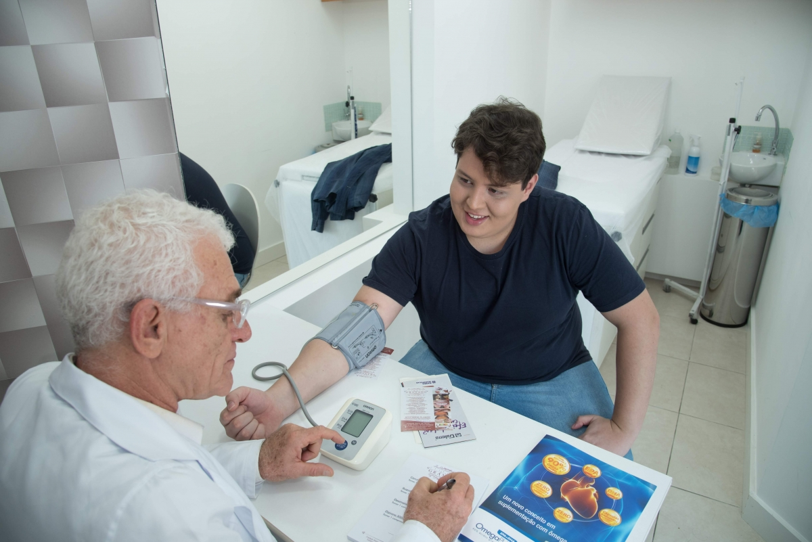
Introduction
The components of the assessment will depend upon a number of factors (i.e. age, findings from subjective assessment, role of physiotherapist in person’s care, patient preference, cultural/ethnic considerations, etc.)
Clinical judgement is a core pillar of evidence-based assessment
Source: World Obesity Image Bank
Notes:
The approach to physical assessment needs to be tailored to the individual.
Factors like the person’s age, your initial observations, the clinical history,
and your specific role in their care as a physiotherapist will guide which components you focus on.
Remember, effective assessment relies heavily on your clinical judgement, combining your knowledge, skills, and taking the person’s unique circumstances into account help you to decide what is most appropriate and meaningful.

Slide 4
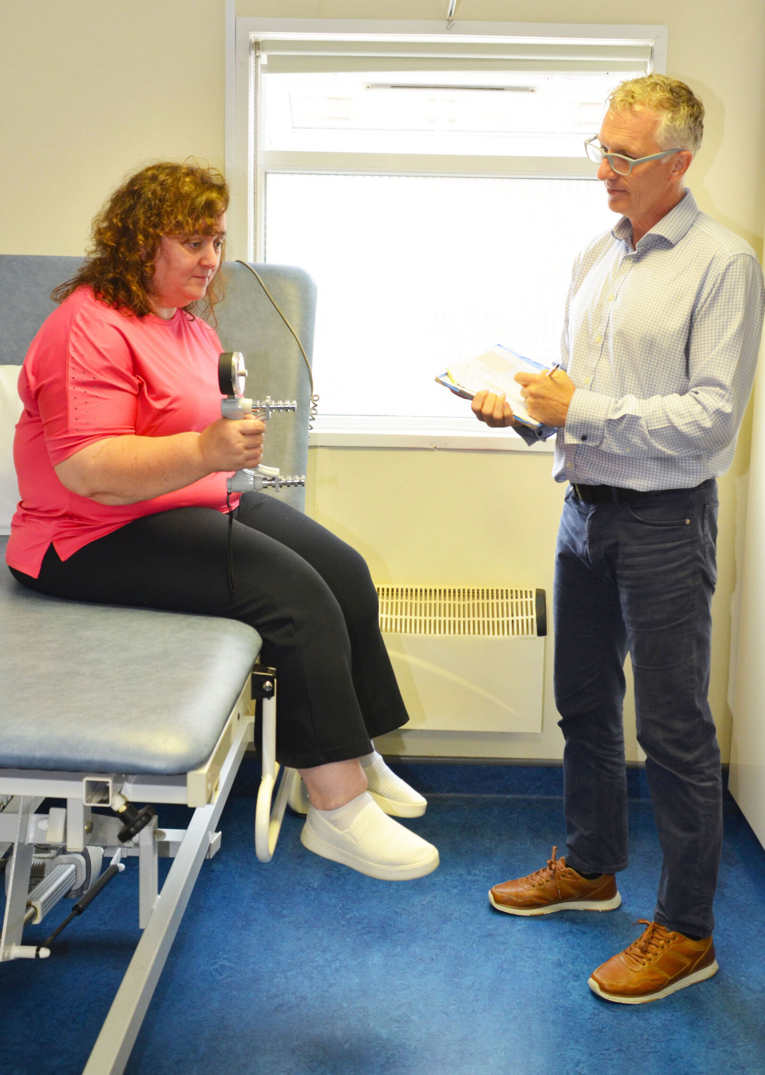
Considerations for physical assessment
Prior to commencing the physical assessments, please consider the following factors:
  Appropriately sized equipment
  Privacy for the assessment
  Appropriate environment
  Safety for sub-maximal or maximal* exercise testing
*Note: maximal testing likely not appropriate or feasible in most clinical settings
Source: ECPO Image Bank
Notes:
First some considerations to ensure an effective and respectful physical assessment.
Make sure you have appropriately sized equipment — for example, blood pressure cuff or hospital gown. This helps ensure measurement accuracy, and the person’s comfort.
When conducting assessments like body composition, privacy is essential to maintain dignity and build trust.
The assessment space should be sufficiently large and accessible, allowing for any necessary bariatric equipment, and ensuring the individual feels comfortable throughout.
If testing the use of a mobility aid, consider what’s known as its safe working load, and size to support the person safely and comfortably.
Adults living with obesity often have reduced heat tolerance due to factors like increased insulation and altered sweating. So, remember to account for thermoregulation by keeping the assessment room cooler.
Finally, when conducting sub-maximal or maximal exercise tests,
pay close attention to safety. This may include using obesity-specific protocols for tests like VO2 max, and adjusting step heights or other test parameters accordingly.

Slide 5

Anthropometric assessment
Body weight
Height
Body Mass Index (BMI)
Waist circumference
Waist to height ratio
Body composition analysis (DXA, Bioelectrical impedance)
* Physiotherapists may also measure ankle circumference or neck circumference if relevant to their client.
For measures such as waist circumference, consider if appropriate for patient (i.e., if they are comfortable with physical touch).
Source: World Obesity Image Bank
Notes:
In physiotherapy, physical assessments of adults with obesity, several anthropometric measurements can help us understand body composition, and related health risks.
Among these, BMI and waist-to-height ratio are particularly important -they are central to the current diagnosis of obesity. So, obesity is diagnosed when the person has a BMI >30 or their BMI is >25 with
a WtHR greater than 0.5, and the person is having health-related complications.
Like all HCPs, physiotherapists play a vital role in screening for obesity using these key measures.
Also commonly used is waist circumference to estimate abdominal fat, which is strongly linked to cardiometabolic risk. Please review other OER sections for the cut-off scores for waist circumference for adults
with obesity.
Physiotherapists may also measure ankle circumference to assess
for lymphoedema and/or neck circumference, which is an important indicator of risk for sleep apnoea.
Anthropometric measurements provide valuable information to identify obesity. However, changes in these measurements should not be
the primary focus of a physiotherapy intervention. Instead, physiotherapy interventions should focus on improving functional capacity such
as mobility, cardiorespiratory fitness, and strength.

Slide 6
Physical function and musculoskeletal assessment
Visual inspection* of posture, gait, muscle bulk, limb appearance, movement patterns, etc.
Joint specific testing as appropriate (i.e., range of motion, manual muscle strength, etc.)
Mobility and ergonomics (including assessment for mobility aids, equipment)
Strength/ endurance testing (i.e., grip-strength, 5 times sit to stand)
Balance and/or coordination (i.e., tandem stance)
Falls-risk assessment (including timed-up and go)
Flexibility
Ability to perform tasks related to ADLs, work and exercise
*Assessment of skin condition including screening for presence of cellulitis may also be relevant for onward referral for nursing/medical ax
Notes:
When assessing physical function and musculoskeletal health in adults with obesity, physiotherapists should tailor their approach, based
on clinical judgement, the person’s presentation and the goals of care.
Assessment may include visual inspection of muscle bulk, limb appearance, skin condition, and movement patterns. It can be helpful
to observe for signs of muscle loss, asymmetry, or compensatory movement strategies.
Measurement of active and passive ROM may be indicated, particularly
if the person reports stiffness or difficulty with movement. Strength
and power may be tested – using manual muscle testing, grip strength testing, or functional tests like a squat or the 5 Times Sit to Stand.
Mobility and ergonomics need assessment - how the person moves through space - are mobility aids needed, and does the person appear safe and efficient during movement? Gait assessment is important.
Where relevant, you may wish to test balance or coordination, especially if there's a history of instability or falls. Tests like the Timed Up and Go,
or single leg stand test may be used as part of a falls risk screen.
Flexibility may require testing, especially if affecting daily function
or exercise participation.
It’s also important to consider the person’s ability to perform daily tasks, including self-care, work, and physical activity.
Screening for a skin condition may be appropriate. For example, examining for signs of cellulitis or irritation in skin folds. If concerns arise, this should prompt onward referral to a medical or nursing colleague.
Overall, your assessment should be guided by what’s clinically relevant, safe and meaningful for the person in front of you.

Slide 7
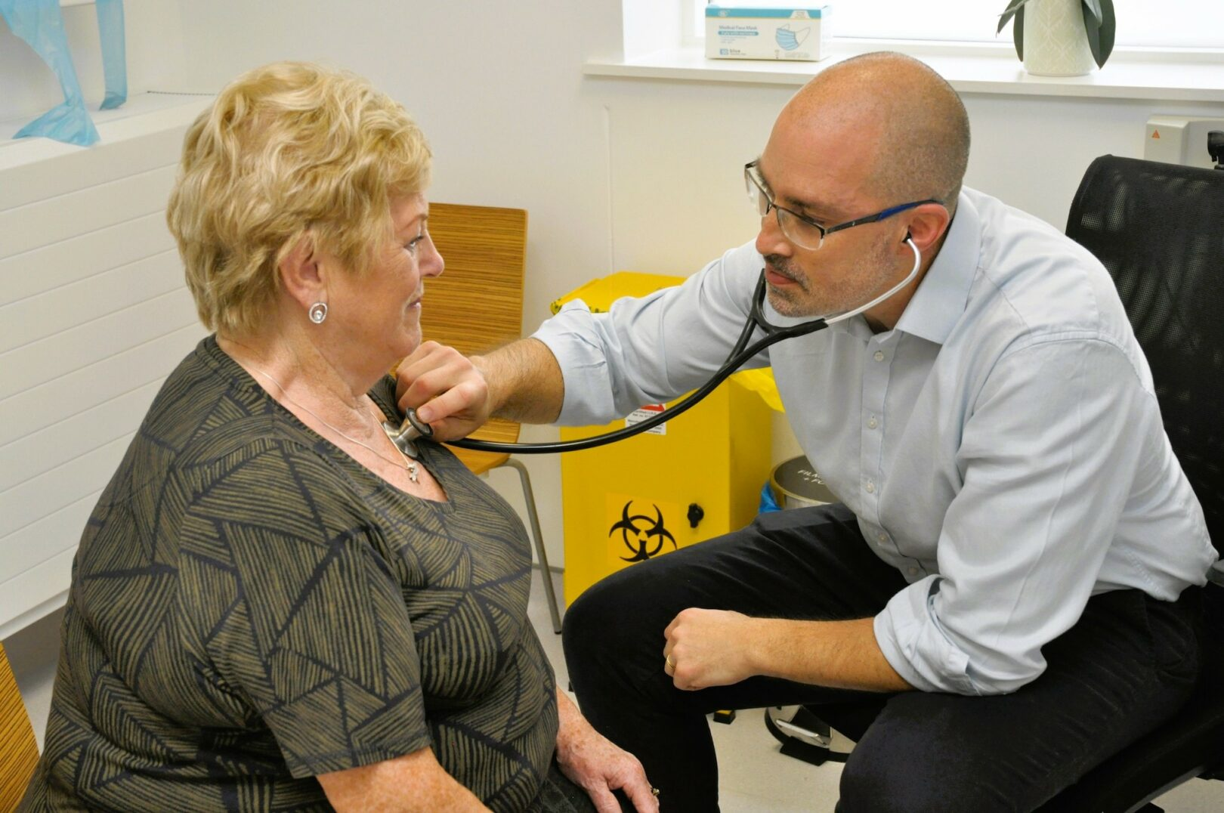
Cardiorespiratory fitness and pre-exercise screening
Blood pressure
Heart rate
Oxygen saturation
Safety to exercise and patient consent
Consider contraindications and precautions (i.e., accelerated hypertension/hypotension on the day, patient feels safe to exercise, etc.)
Submaximal fitness testing (6-minute walk test; Chester Step test)
Source: ECPO Image Bank
Notes:
Before engaging an adult living with obesity in any kind of structured exercise, pre-exercise screening and risk stratification is required
to ensure safety.
Are there any known contraindications or precautions? In other words, ask: Is it safe for this person to begin exercise or increase physical activity level?
A widely used tool to support this process is the Physical Activity Readiness Questionnaire for Everyone (PAR-Q+). This tool helps screen for medical conditions that may require further medical clearance before starting exercise and is suitable for use across a range of clinical settings.
As for all clinical populations, you should be aware of the absolute
and relative contraindications and precautions to exercise. These include uncontrolled hypertension, unstable angina, or recent myocardial infarction, acute infections.
Liaise with the broader healthcare team before progressing with exercise as required. It’s essential to assess cardiorespiratory fitness.
This may begin with basic observations, such as resting blood pressure and resting heart rate, which provide a baseline for cardiovascular status and may help flag any immediate concerns. Depending on the clinical setting and person’s needs, additional cardiorespiratory assessments - like chest auscultation, oxygen saturation levels, or pulmonary function testing may be required.
Physiotherapists may also conduct submaximal or maximal fitness testing to assess aerobic capacity and functional endurance.
Common submaximal tests include:
- The 6-Minute Walk Test, which gives a good indication of walking endurance and tolerance.
- The Chester Step Test, a graded step test that provides an estimate
of cardiorespiratory fitness.
These assessments can help guide exercise prescription and track changes over time.
Although less commonly available in routine clinical practice, if maximal fitness testing (such as VO₂ max) is considered, ensure the use
of obesity-specific protocols that are safe and validated for this population.
Ultimately, the goal is to introduce physical activity and exercise safely, with gradual progression in a way that aligns with the person’s capacity and clinical status, and incorporating behaviour change principles.

Slide 8
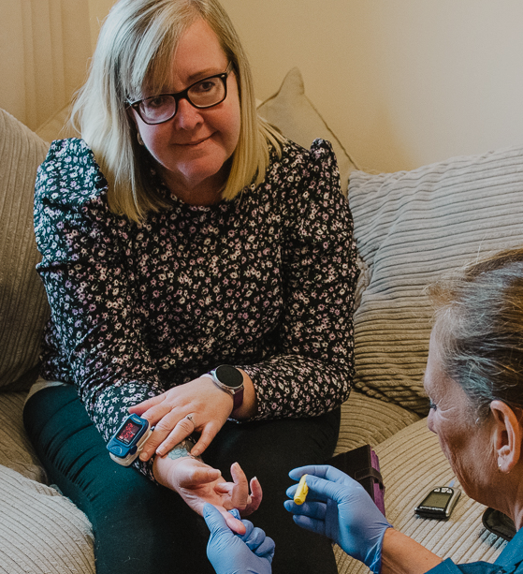
Objective outcome measures
Anthropometric: weight, BMI, waist to height ratio, etc.
Blood pressure
Heart rate
Measure of comorbidity (Edmonton Obesity Staging System)* - both subjective and objective
Fat mass and fat free mass (DEXA or BIA)
Energy expenditure (Basal metabolic rate)
Cardiorespiratory fitness (six-minute walk test, Chester step test)*
Strength (grip strength)*
Functional outcomes (5 times sit to stand, Timed Up and Go)
Source: ECPO Image Bank
*Denotes specific outcome measures recommended by core outcome sets (Mackenzie et al 2020, Alligier et al. 2020 and Valli et al. 2022).
Notes:
Both subjective and objective measures are used to measure outcome.
This last slide provides a list of objective outcome measures that may be used as part of a physical assessment for adults living with obesity.
These measures are drawn from current Core Outcome Sets (reference below), and can be used to support assessment, monitor progress,
and guide clinical reasoning.
Depending on your role and the care setting, you may not use all of these routinely – and you may choose others - but this slide serves
as a reference point for the kinds of measures you might consider.
These tools can help build a clearer picture of the person’s health, functional status, and response to intervention over time.
Remember, selecting the right outcome measures is about more than data. It’s about choosing tools that are meaningful, safe, and aligned
with the physiotherapy intervention goals which reflect the person’s goals and clinical needs.

Slide 9
Resources
Guidelines
EASO Clinical Practice Guideline Resources - includes links to EU specific guidelines
Obesity Canada Guidelines – Assessment
Relevant Research
OBEDIS Core Variables for obesity interventions
STAR-LITE Core outcome set for behavioural weight management interventions
COMPARE-EU core outcome set for self-management interventions
Notes:
Here are a few resources you may mind helpful. These include links
for relevant clinical practice guidelines and the three core outcome sets mentioned on the last slide.
Please also check out other practical tools and resources included
in the Assessment section of the PROMINENCE OER, including a sample assessment proforma, an overview of some relevant diagnostic blood tests you may see performed by your medical colleagues, evidence-based frameworks to support structured clinical reasoning, and links to calculators for anthropometric measurements.

Slide 10
References
Alligier M, Barrès R, Blaak EE, Boirie Y, Bouwman J, Brunault P, Campbell K, Clément K, Farooqi IS, Farpour-Lambert NJ, Frühbeck G. OBEDIS core variables project: European expert guidelines on a minimal core set of variables to include in randomized, controlled clinical trials of obesity interventions. Obesity facts. 2020 Jan 16;13(1):1-28.
Duggan D and Kearney C, Hynes M, Manning S, O’Malley E. ASOI Adult Obesity Clinical Practice Guideline adaptation (ASOI version 1, 2022). Chapter adapted from: Rueda-Clausen C, Poddar M, Lear S, Poirier P, Sharma A. Available from: https://asoi.info/guidelines/assessment/ [Accessed 01 Mar 2025].
Mackenzie RM, Ells LJ, Simpson SA, Logue J. Core outcome set for behavioural weight management interventions for adults with overweight and obesity: standardised reporting of lifestyle weight management interventions to aid evaluation (STAR-LITE). Obesity reviews. 2020 Feb;21(2):e12961.
Rueda-Clausen CF, Poddar M, Lear SA, Poirier P, Sharma AM. Canadian Adult Obesity Clinical Practice Guidelines: Assessment of People Living with Obesity. Available from: https://obesitycanada.ca/guidelines/assessment [Accessed 03 Mar 2025].
Valli C, Suñol R, Orrego C, Niño de Guzmán E, Strammiello V, Adrion N, Immonen K, Ninov L, Van der Gaag M, Ballester M, Alonso-Coello P. The development of a core outcomes set for self-management interventions for patients living with obesity. Clinical obesity. 2022 Feb;12(1):e12489.
Acknowledgement: Special thanks to Emer O’ Malley at the Center for Obesity Management at St Columcille's Hospital, Loughlinstown, Dublin, Ireland for sharing her expertise which supported the development of this slide deck.

