Slide 1
Obesity diagnosis, classification and staging
Developed by Dr Mary E. Davis and Dr Caitriona Cunningham, University College Dublin, Ireland.
Notes:
Hello and welcome to this PROMINENCE project presentation on obesity diagnosis classification and staging. I’m Caitriona Cunningham and this presentation was compiled by Dr Mary E. Davis and myself from University College Dublin, Ireland.

Slide 2
Overview
Obesity diagnosis and classification
Obesity staging
Notes:
This is the first short presentation for the clinical assessment section of our PROMINENCE Open Education Resource (OER) for physiotherapists. In this presentation, I’ll be talking about obesity diagnosis, classification, and staging in adults.

Slide 3
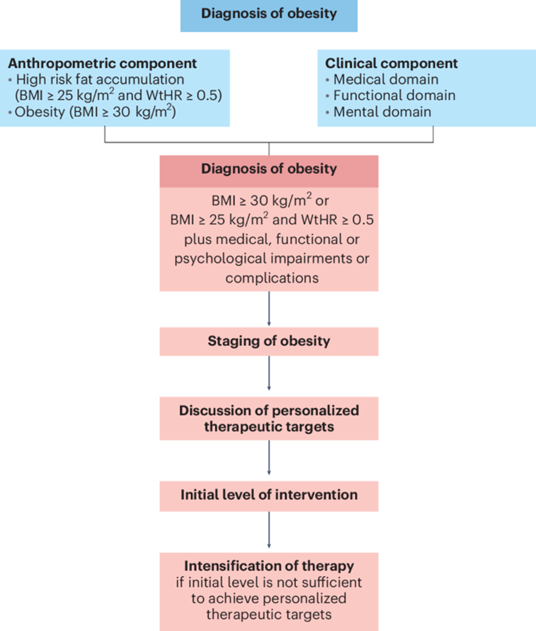
Obesity diagnosis and classification
Obesity is defined as an abnormal or excessive fat accumulation that can impair health.
Obesity is a chronic, relapsing disease with multifactorial causes.
(Bowman-Busato et al. 2024; Busetto et al. 2024)
Notes:
As you have probably seen in the first section of our OER, obesity is more than just a matter of weight. Obesity is defined as an abnormal or excessive fat accumulation that can impair health.
Obesity is a multifactorial chronic disease resulting from complex genetic, molecular, environmental, and behavioural interactions.
From the graphic you can see that the diagnosis of obesity is not just based on anthropometric measures but combined also with other clinical factors.
So, when it comes to diagnosing obesity, we need a framework that reflects this complexity — and that’s where Busetto’s new diagnostic framework presented here, comes in.
Previously adults were diagnosed with obesity based only on having a BMI greater than 30. However, traditional BMI-based approaches are limited. They don’t fully capture the individual’s health risks. For example, two people can have the same BMI but very different metabolic profiles.
This new framework highlights the importance of fat distribution, not just body mass. In particular, the waist-to-height ratio is a stronger indicator of cardiometabolic disease risk than BMI alone.
The new framework also emphasises the need to assess the function and health effects of excess or dysfunctional adipose tissue, such as but not limited to inflammation, insulin resistance, or mechanical loading on joints.
Crucially, this model recognises that people with a BMI of 25–30, who may not meet the classic definition of obesity, can still be at increased health risk if they carry excess abdominal fat.
This shift in perspective helps us as clinicians to better understand risk, to tailor interventions, and to avoid underestimating the health impacts in people who don’t fit the typical BMI categories.

Slide 4
Obesity diagnosis and classification
The diagnosis of obesity should be based on the recognition of abnormal and/or excessive fat accumulation and the analysis of its presence and potential effects on health.
  Adults of European descent with BMI ≥ 25 kg/m², a waist-to-height ratio > 0.5 and the presence of any medical, functional or psychological impairments or complications in the diagnosis of obesity.
  Adults of European descent on the presence of BMI ≥ 30 kg/m² and the absence or presence of any medical, functional or psychological impairments or complications.
  Apply ethnicity-specific cut-offs for BMI.
(Busetto et al. 2024)

Slide 5
Obesity diagnosis and classification
BMI cut-offs as per the WHO (Caucasian, Europid and North American ethnicity)
  Class I: 30.0-34.9kg/m²
  Class II: 35.0-39.9kg/m²
  Class III: 40- 49.9kg/m²
  Class IV: 50–59.9kg/m²
  Class V: ≥ 60kg/m²
Other body composition measures
  Waist circumference cut-offs: >102 cm (40 inches) in men and > 88 cm (35 inches) in women
  Waist to height ratio cut off: ≥0.5 in adults
Notes:
This slide presents the BMI cut-off scores as defined by the World Health Organization.
While we’ve just discussed more comprehensive diagnostic frameworks and we’ll soon move on to staging, which may be more clinically relevant, it’s important to know that you may still see these BMI classes used in practice and documentation.
What’s key to understand is that these classes are really just a starting point. They help describe the severity of excess weight, but they don’t tell us how obesity is impacting someone’s health.
It’s also important to note the shift in language to describe more severe levels of obesity. We now use more neutral, respectful, non-stigmatising language like Obesity Class III or above.
Below the BMI categories, you can also see waist circumference and waist-to-height ratio measures. These are additional tools we can use to estimate fat distribution, particularly abdominal or visceral fat, which is more strongly linked to cardiometabolic disease risk.
In particular, waist circumference is helpful in identifying increased risk of type 2 diabetes, high blood pressure, and cardiovascular disease, even in people who don’t meet the obesity threshold as defined by BMI alone. Cut-offs above are for defining “central obesity”.
But like BMI, waist measurements have their limitations. They don’t always reflect visceral fat accurately on an individual level, and can vary with body type and ethnicity.
So, the takeaway message here is that while BMI, waist circumference, and waist-to-height ratio are useful screening tools, they should always be interpreted using overall clinical judgement, and never used in isolation to inform clinical decisions.

Slide 6
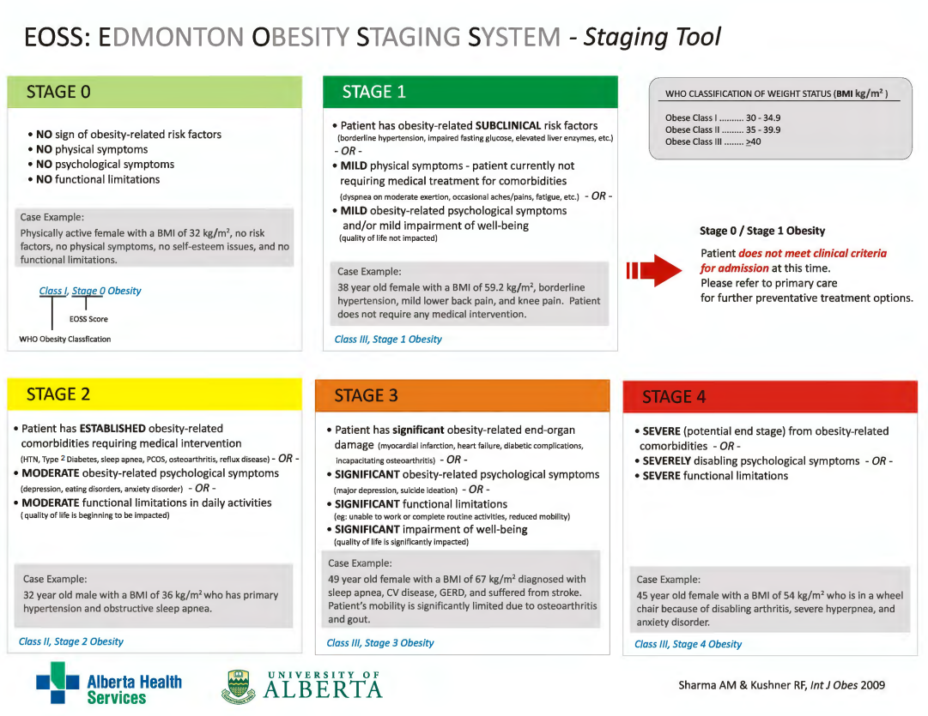
Obesity staging
Notes:
So, in response to the limitations of measures that we’ve just highlighted, Sharma and Kushner developed the Edmonton Obesity Staging System, or EOSS.
This is a five-stage clinical framework that classifies obesity based on its actual impact on a person’s physical health, mental well-being, and functional status, rather than just on weight or body size. The stages range from:
Stage 0 – where there are no obesity-related risk factors, symptoms, or functional limitations,
to Stage 4 – where severe or end-stage complications are present, such as organ failure or significant loss of function.
What’s important here is that EOSS acknowledges a clinical reality: not everyone with a high BMI has the same health risks. Two people with the same BMI could be at very different stages of health and this has major implications for how we approach treatment.
For us as physiotherapists, this means we can use EOSS to help prioritise care, to better tailor interventions, and to focus on what’s actually clinically meaningful for each person.
It also supports a more person-centred approach, moving away from weight-focused language and towards functional goals, quality of life, and long-term health outcomes.
In short, EOSS helps shift the focus from how much a person weighs to how they’re doing, which is far more useful in guiding treatment.
It is important to note that the EOSS is just one example of the frameworks that can be used to classify the severity of obesity.

Slide 7
Resources
EASO 5-Minute CPD: A New Approach to Obesity Diagnosis, Staging, and Management Link
EASO 5-Minute CPD: Obesity conversations: Why weight stigma matters in clinical practice? Link
EASO Infographic: Talking about weight - guidance for GPs & healthcare professionals Link
Obesity Canada Infographic: 5As Framework for Obesity Management in Adults Link
Edmonton Obesity Staging System Link
EASO Infographic: Framework for obesity diagnosis, staging and management Link
Notes:
Here are a few resources you may mind helpful. Please also check out the assessment section of our OER for its practical assessment tools and resources, including a sample assessment proforma, an overview of some relevant diagnostic blood tests you may see performed by your medical colleagues, some other evidence-based frameworks to support structured clinical reasoning and links to calculators for anthropometric measurements.

Slide 8
References
Bowman-Busato J, Schreurs L, Halford JC, Yumuk V, O’Malley G, Woodward E, De Cock D, Baker JL. Providing a common language for obesity: the European Association for the Study of Obesity obesity taxonomy. International Journal of Obesity. 2025 Feb;49(2):182-91.
Busetto L, Dicker D, Frühbeck G, Halford JC, Sbraccia P, Yumuk V, Goossens GH. A new framework for the diagnosis, staging and management of obesity in adults. Nature Medicine. 2024 Sep;30(9):2395-9.
Sharma A. M., Kushner R. F. A proposed clinical staging system for obesity. International Journal of Obesity. 2009;33(3):289–295. doi: 10.1038/ijo.2009.2
Acknowledgement: Special thanks to Emer O’ Malley at the Center for Obesity Management at St Columcille's Hospital, Loughlinstown, Dublin, Ireland for sharing her expertise which supported the development of this slide deck.

