Slide 1
History taking with adults living with obesity
Developed by Dr Mary E. Davis and Dr Caitriona Cunningham, University College Dublin, Ireland.
Notes:
Hello, welcome to this PROMINENCE project presentation regarding clinical history taking with adults with obesity. This presentation was developed by Dr Mary Davis and myself, Dr Caitriona Cunnigham, from the physiotherapy discipline at University College Dublin in Ireland.

Slide 2
Overview
Introduction
Weight history
Medical and surgical history
Social and family history
Review of lifestyle behaviours
Self-reported outcome measures
Notes:
So, let’s get started. This presentation aims to support you to become competent gathering relevant clinical information while also developing a compassionate and person-centred approach. This presentation focuses on the core components of history taking starting, with the patient’s weight history, and then considering the person’s broader medical, surgical, social, and family history, alongside their lifestyle behaviours.
Finally, this presentation will include a discussion of outcome measures.

Slide 3
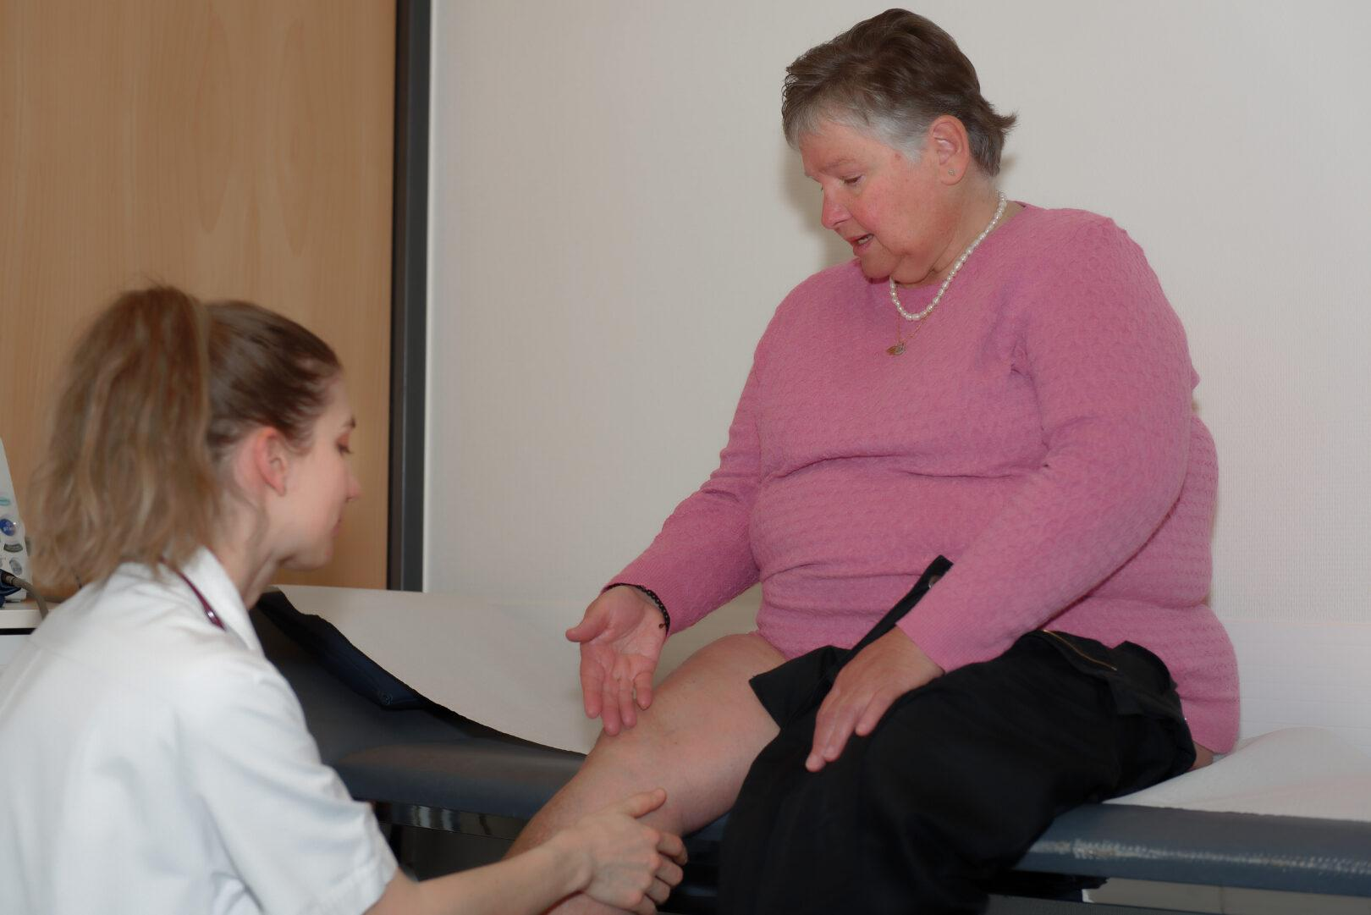
Introduction
The components of a clinical assessment of a person living with obesity (PwO) will depend on
Age (adult vs paediatric)
Physiotherapist’s role in their management
Stage of obesity
Purpose of assessment
Primary presenting condition
Patient’s goals and priorities for management
Cultural/ethnic and environmental considerations
Source: ECPO Image Bank
Notes:
It’s important to note that the content and focus of a physiotherapy clinical assessment can vary significantly depending on a number of key factors.
These include the person’s age, for example, whether you’re working with an adult or child. Also, your specific role as a physiotherapist within the broader care team. Other factors influencing the assessment are the stage or severity of obesity, the primary reason for the physiotherapy referral or assessment, and importantly, the patients own goals and priorities for their management. There are also cultural and ethnic considerations.
Understanding these contextual factors helps ensure that your assessment is both person-centred and clinically appropriate.

Slide 4

History taking
History taking/ subjective assessment of adults with obesity should include the following components:
Obesity/ weight history
Medical and surgical history
Social and family history
Review of lifestyle behaviours
* Specific components of the subjective assessment should be determined by the physiotherapist
Source: World Obesity Image Bank
Notes:
Let’s look at the key components of a physiotherapy subjective assessment as part of a consultation where the focus is on addressing obesity and its related complications. Assessment’s components typically include an obesity or weight history, medical and surgical history, social and family history, and a review of lifestyle behaviours. The specific areas you focus on will depend on your clinical judgement, and the individual needs of the patient.
We’ll explore each of these components in more detail over the next few slides.

Slide 5
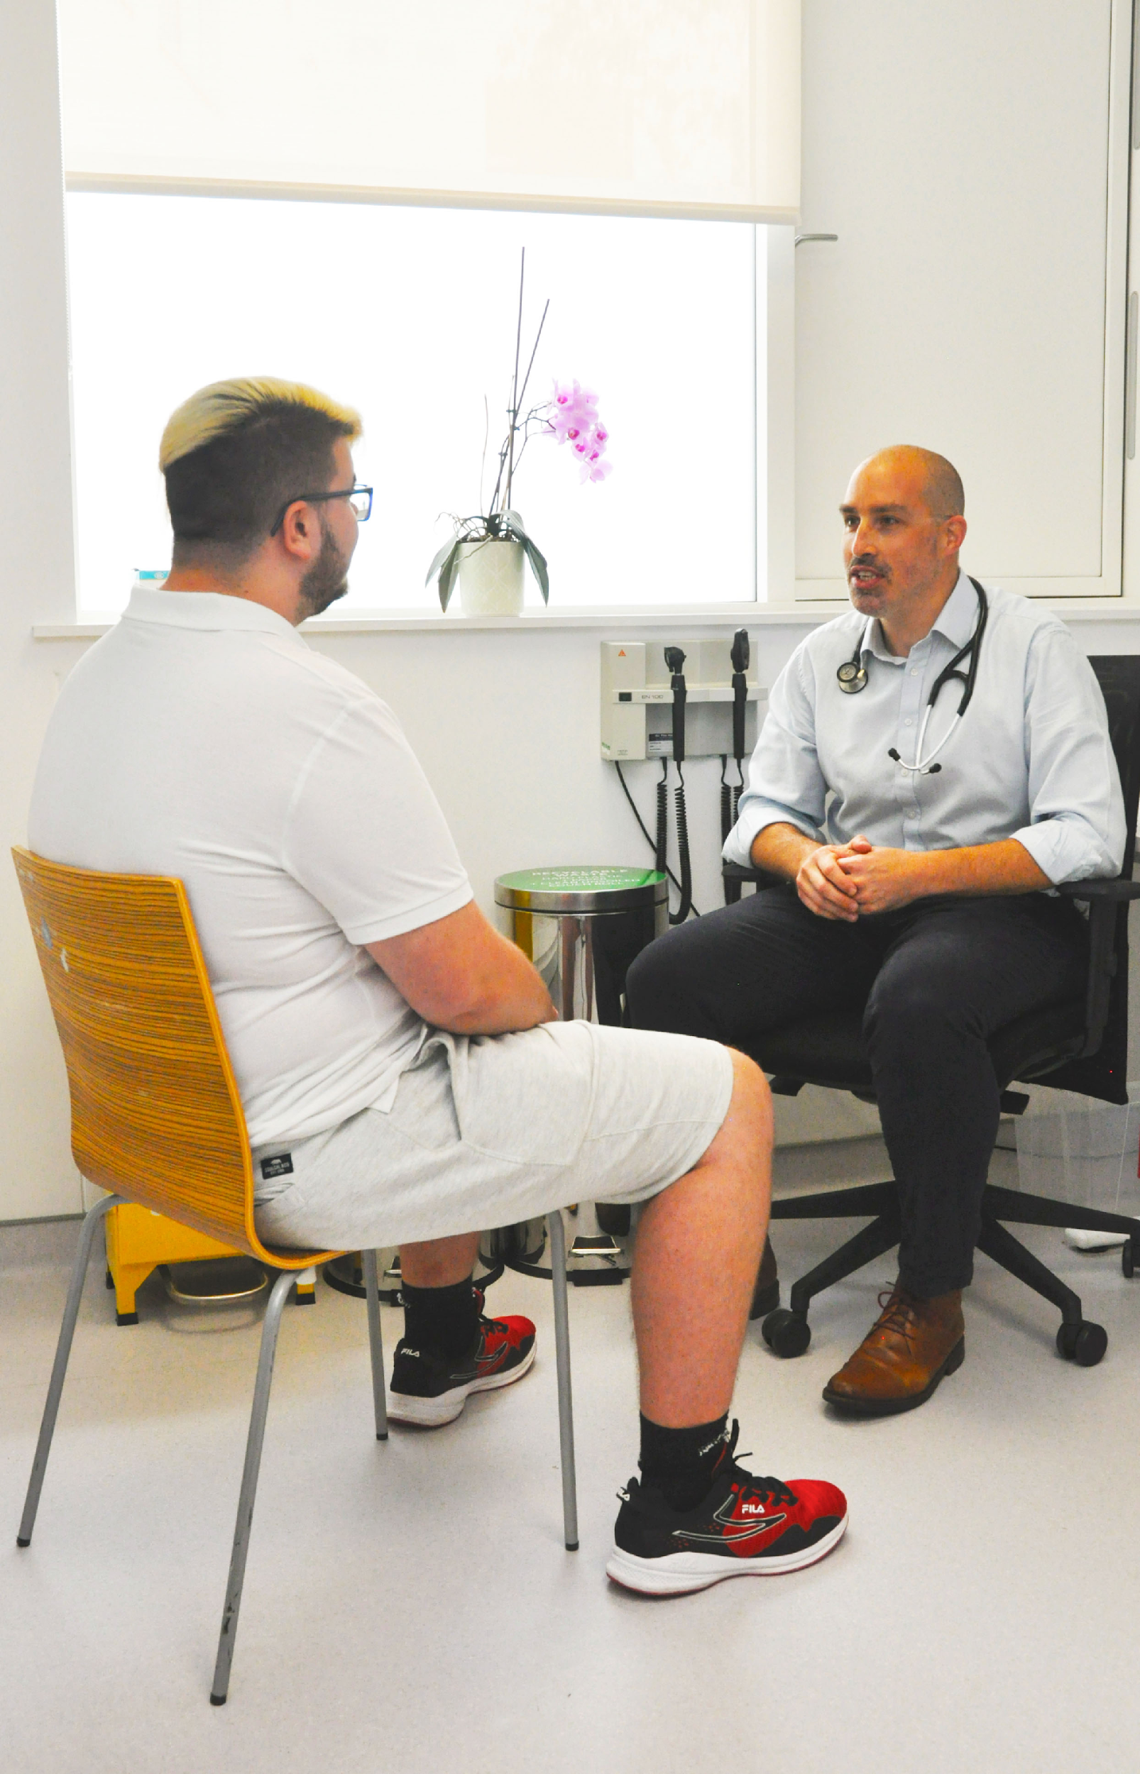
Weight history
Age onset of obesity (childhood, gradual or recent weight gain)
Highest and lowest weight
Variation in body weight in past three months (associated with any life events)
Current phase of weight (gaining, losing or stable)
Source: ECPO Image Bank
Notes:
An important first area to explore is the person’s weight or obesity history. This helps us understand how the person’s weight has changed over time and can give insight into both contributing factors and the person’s experiences with weight management. Key aspects to cover include the age of obesity onset. For instance, whether weight gain began in childhood, developed gradually, or occurred more recently.
It’s also helpful to ask about their highest and lowest adult weight, any recent weight fluctuations, particularly over the past three months, and their current phase of weight, whether they are gaining, losing, or maintaining. This can help guide treatment planning and goal setting.

Slide 6



Weight history
Weight gain history: potential causes include pregnancy, medications, psychological disorders, change in physical activity or health status, comorbidities, etc.
Weight loss/ obesity care history: previous attempts to lose weight; past and/or current treatments (diet, exercise programmes, bariatric surgery, etc.); weight maintained after weight loss?; Is the client under the care of/has been referred to a weight management service?
Relevant family history: history of obesity, bariatric surgery and cardiometabolic diseases (i.e. diabetes)
Notes:
As we continue building this weight history, it’s useful to explore possible causes of weight gain such as pregnancy, medication use, mental health conditions, changes in physical activity or health status, and the presence of comorbidities.
Understanding these contributing factors helps us identify potential barriers to progress and to tailor appropriate support.
We should also take note of the person’s previous experiences with weight loss or obesity care. What types of interventions have they tried? Dietary changes, physical activity programmes, medications, surgery. Were they successful? – and if so, were they able to maintain the weight loss over time? This information can reveal both effective and ineffective strategies for the individual.
Understanding whether the person is currently engaged with or has been referred to a weight management service is also important and may help inform where you, the physiotherapist, fit in as part of the broader care team.
Lastly, relevant family history can offer important context, particularly if there’s a history of obesity, bariatric surgery, or cardiometabolic conditions, such as type 2 diabetes.

Slide 7
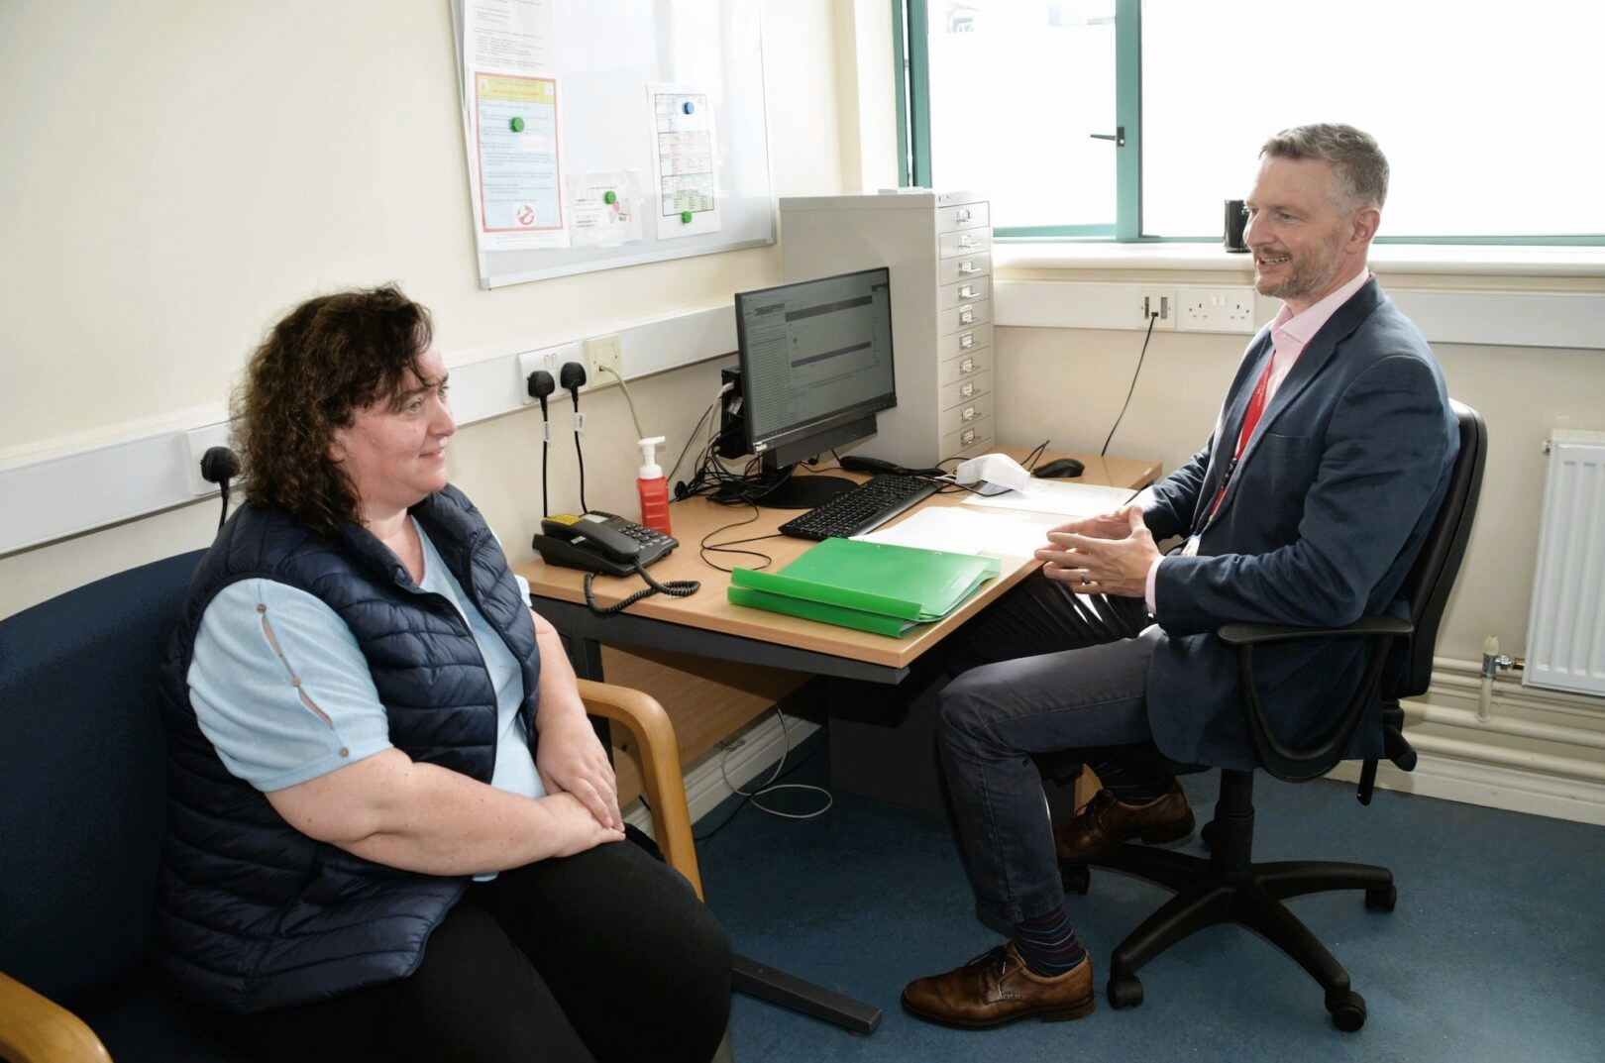
Medical and surgical history
As with any physiotherapy subjective assessment, assessment of PwO should include a general review of the person’s medical and surgical history
Determine if there are any obesity-related complications
Source: ECPO Image Bank
Notes:
As with any physiotherapy history taking, it’s important to take a thorough medical and surgical history. Our specific focus here is on identifying any obesity-related complications that may impact the person’s function, goals, or care plan.
However, depending on your role in your patient’s care or their presenting complaint, you may place a greater emphasis on specific aspects of the medical or surgical history.

Slide 8
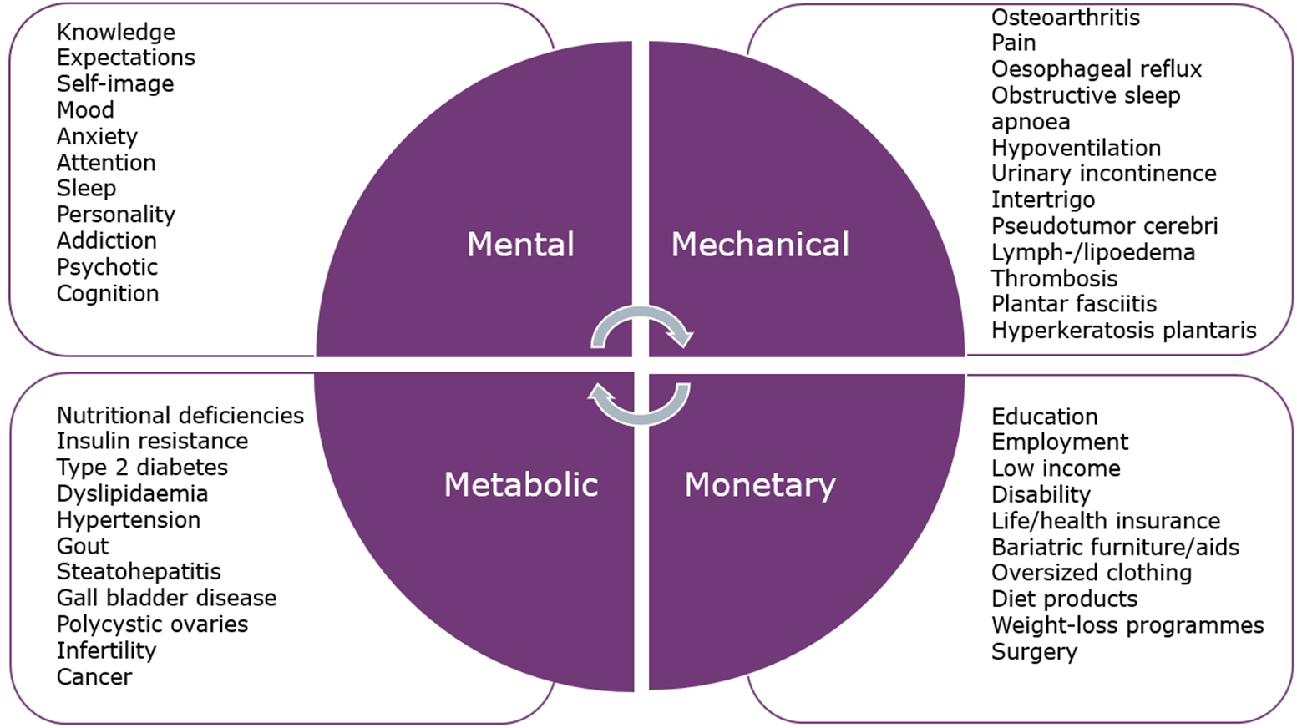
4M’s Framework
Adapted from Sharma 2010
Notes:
To support a more comprehensive and person-centred assessment,
we can use clinical tools like the 4Ms framework, which helps to structure an exploration of the major drivers, barriers, and complications of obesity. The 4Ms is an example of just one tool that we can use almost like
a checklist to help structure a thorough and efficient obesity assessment.
The 4Ms stand for:
- first, mental health such as depression, anxiety, body image concerns, or cognitive difficulties.
- Mechanical health including pain, osteoarthritis, sleep apnoea,
or reduced mobility.
- The third M, metabolic health like type 2 diabetes, hypertension,
or dyslipidaemia.
- And finally, monetary, which refers to the person’s social, economic,
and environmental context, including housing, finances, and access
to resources.
As physiotherapists, the 4Ms can guide both history taking and clinical reasoning, helping us develop a more complete understanding
of the person in front of us. Used alongside tools, such as the Edmonton Obesity Staging System, the 4Ms support a more holistic person-centred approach, shifting the focus away from weight alone and towards
the individual’s real world health needs and goals.

Slide 9
Medical and surgical history
Physical concerns/issues:
Pain (consider impact on mobility)
osteoarthritis
mobility and/or balance issues/falls history
etc.
Cardiovascular status:
cardiac risk factors (including hypertension, dyslipidemia, etc.)
ongoing cardiovascular disease
history of stroke or other events
other conditions (i.e. gout, lymphedema)
etc.
Diabetes Status:
diagnosis of diabetes
diabetes controlled? (hypoglycemia/hyperglycemia)
etc.
Metabolic/ endocrine status:
presence of metabolic syndrome
hormonal status (thyroid; polycystic ovary syndrome; menopausal status)
Notes:
Expanding on the 4Ms framework, we now move on to specific areas of the medical history relevant for adults living with obesity, and consider why these matter for physiotherapy.
First, screening for physical comorbidities is essential. Conditions like osteoarthritis, chronic pain and mobility or balance impairments can limit movement, reduce exercise tolerance, and increase falls risk. Understanding these helps us to tailor interventions to the person’s physical capacity and to ensure safety.
Next, review cardiovascular health. Cardiac risk factors, such
as hypertension, dyslipidaemia, or smoking, along with existing cardiovascular disease or stroke history, all affect exercise tolerance
and safety. Knowing this guides appropriate exercise prescription
and monitoring of exercise intensity during sessions.
Assessing diabetes status is also critical. Poorly controlled diabetes can cause blood sugar fluctuations, hypo- or hyperglycaemia that may impact safety during physical activity. Awareness enables us to plan safe, targeted, and effective exercise and to monitor for warning signs.
Finally, it may be relevant to discuss metabolic and hormonal health
with your patient. Conditions like metabolic syndrome, thyroid disorders, polycystic ovarian syndrome, or menopausal status, can all influence energy balance and metabolism, affecting how the person responds
to physical activity and weight management.
Understanding these health areas informs your clinical reasoning, helps classify the severity and impact of obesity, and ensures physiotherapy, including exercise plans, are safe, effective, and tailored to individual needs.

Slide 10
Medical and surgical history
Respiratory Health:
asthma
obstructive sleep apnea
abnormal function (i.e., breathlessness)
obesity hypoventilation syndrome
etc.
Urinary or fecal incontinence/impairment
particularly relevant when there has been weight loss (and potential muscle loss)
type: stress incontinence, urgency, etc.
Mental health issues/drivers:
depression
Anxiety
Psychiatric diagnosis
Eating disorder (i.e. bulimia, etc.)
etc.
Other health issues:
gallbladder disease
pancreatitis
metabolic dysfunction associated steatotic liver disease
reproductive
kidney disease
dermatological (i.e. cellulitis, etc.)
oncological
etc.
Medications:
general medication history
any weight reducing/ controlling medication?
Any medications that are likely to be contributing to weight gain?
Notes:
To complete the medical history, we explore additional areas with important implications for physiotherapy. Remember, you may be providing care to an adult with obesity in any setting and for any presenting condition.
You may be providing respiratory physiotherapy or low energy levels
or respiratory issues may arise as a barrier to engagement in treatment.
Awareness of conditions such as obstructive sleep apnoea, obesity, hypoventilation syndrome or breathlessness will require you to adjust activity levels and consider safety.
Ask about urinary or faecal incontinence and pelvic floor issues. Remember, muscle loss associated with weight loss itself or obesity management medications will impact the pelvic floor muscles, as well
as other muscles, and thus may result in incontinence issues. Such issues can affect movement confidence, exercise participation, and require specific physiotherapy and other management approaches.
Mental health must be considered. Disorders like depression and anxiety can affect motivation, adherence to therapy and overall well-being. Recognising these helps tailor communication, goal setting, and support.
Be aware of other obesity-related conditions including gallbladder disease, pancreatitis, fatty liver disease, gynaecologic issues, and skin conditions like fungal infections. These can impact comfort, function, and treatment tolerance.
Finally, review the medication history. Some medications promote weight gain or loss and can influence energy, mood, or physical capacity.
This knowledge helps optimise the care plan and manage expectations.
It is important to flag any drugs that may be contributing to weight gain such as corticosteroids, certain anti-depressants or antipsychotic medications. This may be useful not only for understanding the weight trajectory of your patient, but also in supporting the broader management as part of the multi-disciplinary team.
Together, this comprehensive history enables safe, person-centred physiotherapy that addresses the real-world impact of obesity on health and function.
Footnote – Not exhaustive

Slide 11
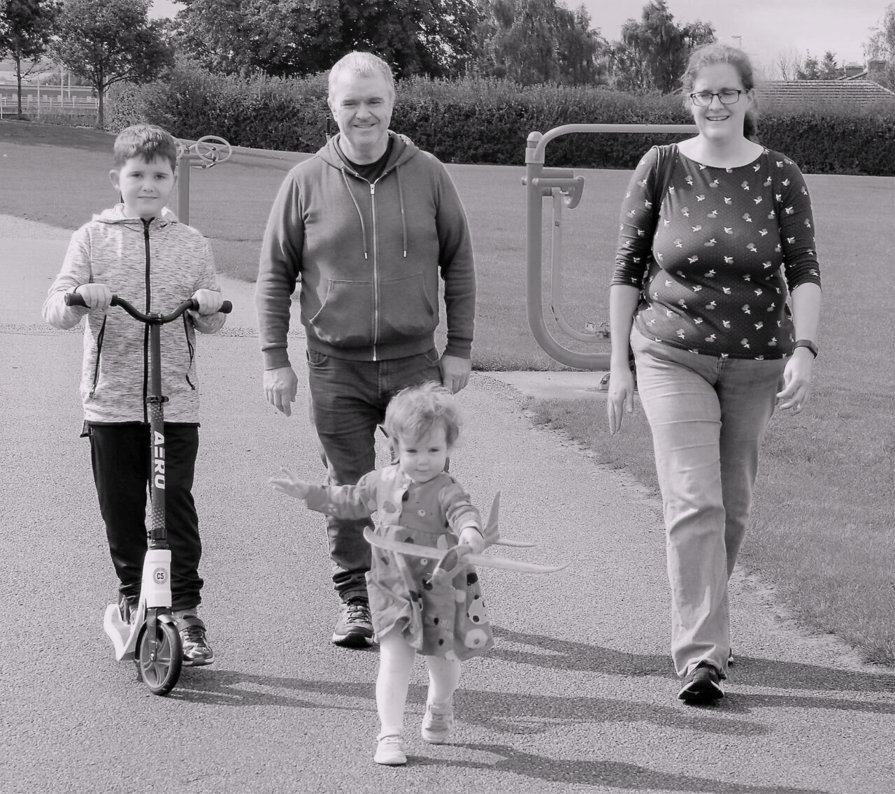
Social and family history
Includes history that might be taken in any holistic physiotherapy subjective assessment (working status, screen time, family and support network, home environment, ability to perform activities of daily living [ADLs], etc.)
Other relevant social and family history for PwO might include:
Access to exercise facilities or opportunities
Income support (if needed)
Medical insurance for health expenses
Consideration of screening for previous and current forms of physical, psychological and sexual abuse. This may be appropriate only if options for onwards referral are available.
Source: ECPO Image Bank
Notes:
In any holistic biopsychosocial physiotherapy assessment, understanding a person’s social and family history is essential. And this is particularly true when working with individuals living with obesity. Start by gathering standard information: the person’s working status, family and support network, home environment, and ability to manage activities of daily living. These details help you understand the context in which the person lives and how their environment may support or limit their capacity
to engage in physiotherapy and self-management. There are also specific social determinants that can significantly affect a person’s ability
to engage in or sustain physiotherapy strategies. Ask about access
to exercise facilities or opportunities. These might include access to safe walking environments, appropriate exercise equipment, or community programmes.
It may be relevant to explore whether the person has adequate income
or medical insurance to cover necessary care including physiotherapy, specialist referrals, or specialised equipment. These factors can either support or present barriers to treatment and recognising them allows you to make more realistic and sustainable recommendations.
Finally, it may be important to screen sensitively and appropriately for any history of physical, psychological, or sexual abuse, whether current
or historical. This may be of particular relevance if the person expresses distress and may wish to avoid certain types of assessment. Trauma history can influence body image, trust in healthcare providers, and readiness to engage in care. These experiences can have a profound impact on mental health, coping mechanisms, and may contribute
to behaviours associated with obesity. They can also influence how comfortable a person feels during physical assessments or interventions.
If a trauma history is disclosed, it’s essential to acknowledge this
with care, and consider appropriate referral pathways for trauma informed support.
By considering the person’s broader social history, physiotherapists can provide more personalised, realistic, and compassionate care, helping reduce barriers and supporting long-term behaviour change.

Slide 12

Review of PA and mobility
Physical activity (PA)
Consider PA vital sign
Current PA, including time spent in sedentary activities
Time spent and method of commuting/ travel
Limitations/barriers to activity (e.g., pain, time, obesity-related impairments, etc.)
Identify social limiting factor restricting access to increasing PA
Consider fear avoidance of PA/ exercise
Mobility
Current mobility status and mobility history
Falls history and falls risk
Mobility aid requirement and any falls risk for PA
Source: ECPO Image Bank
Notes:
As physiotherapists, assessing physical activity and mobility is a critical part of understanding how obesity is impacting function and where we can support safe and sustainable changes. Start by exploring the person’s current physical activity levels. Consider using a tool like the physical activity vital sign to record the frequency and duration of activity, including time spent in sedentary behaviours such as sitting or screen time.
It’s also useful to ask about commuting or travel. How much time is spent moving throughout the day and by what method? This gives you a better picture of the person’s baseline activity. Be sure to identify any barriers
or limitations to physical activity. These might include pain, fatigue, time constraints, or obesity-related impairments like breathlessness, reduced joint range, or low general or exercise specific confidence.
As highlighted previously, also consider social or environmental factors such as access to safe spaces for exercise or affordable activity options that may be limiting participation. Alongside this, assess the person’s mobility status. What is their current functional capacity? Has it changed over time?
You should also ask about any falls history or known falls risk and whether or not the person requires any mobility aids, and these may need to be specialised. All of this information is essential for safe exercise planning and goal setting. Together, these details help you design interventions that are realistic, tailored, and safe, and that support
the person’s autonomy and progress over time.

Slide 13

Review of lifestyle behaviours
Sleep
Number of hours of sleep per night,
Sleeping pattern (bedtime/rise time, sleep quality)
Sleep position (i.e. side-lying)
Barriers to initiation/maintenance.
Use of pharmacologic sleeping aids.
Sleep apnea screening (STOPBANG)
Nutrition (see dedicated OER section for diet/food approaches)
Substance abuse (including smoking, alcohol, etc.)
Screen time
* Other areas that may be covered in the assessment but may not be wholly relevant to the physiotherapist's immediate priorities or their role in the patient’s care.
* May be relevant for onward referral to other members of MDT e.g. addiction/dependency
Source: ECPO Image Bank
Notes:
As part of a holistic assessment, reviewing key lifestyle behaviours, such as sleep, nutrition, and smoking can help you better understand the broader factors influencing a person’s health, function, and engagement with physiotherapy.
That said, it’s important to recognise that it may not always be relevant
or feasible to assess all of these areas in a single or even repeated consultations, particularly in time limited settings. Use your clinical judgement to decide what’s a priority and most appropriate for the individual in front of you.
When relevant, ask about sleep, including average hours of sleep, sleep quality, bedtime routines, and any barriers to falling or staying asleep. Also ask about sleep position, especially in the presence of pain
or mobility limitations. Screening for obstructive sleep apnoea may also be indicated and tools like STOP-BANG can help guide decisions about onward referral.
While physiotherapists are not expected to provide nutrition counselling, you may briefly explore eating patterns, if they are clearly linked
to physical function, energy levels, or recovery.
A more in-depth discussion of diet is covered in a separate dedicated section of this OER.
Smoking status is another lifestyle factor that may come up. While it may not always be central to your physiotherapy intervention, it’s important
to consider its impact on cardiorespiratory health and physical capacity.
Lastly, be mindful that some lifestyle behaviours, such as substance abuse or addiction, may not fall within the physiotherapist’s scope, but can significantly affect health and engagement with care. In these cases, consider referral to appropriate members of the multidisciplinary team.
Overall, use this part of the assessment to inform your clinical reasoning and identify opportunities for collaboration and referral, always keeping
the patient’s goas and context in mind.

Slide 14

Self-reported outcome measures
Quality of Life (EUROQOL 5Q-5D version)*
Depression (Patient Health Questionnaire‐9)*
Self-confidence and self-esteem ( eg. Warwick‐Edinburgh Mental Well‐being Scale)*
Physical Activity and sedentary behaviour (accelerometer, Paffenbarger Physical Activity Questionnaire, Lasa Sedentary Behaviour Questionnaire)*
Sleep (sleep duration, sleep quality e.g. Pittsburgh Sleep Quality Index)
Stress ( eg.Perceived Stress Scale)
Pain (eg. Brief Pain Inventory, Pain Catastrophizing Scale)
Self-efficacy ( eg. Weight Efficacy Lifestyle Questionnaire)
Mental wellbeing (e.g. World Health Organization-Five Well-Being Index)
Lymphoedema specific measure (e.g. Lymphoedema Life Impact Scale)
Source: ECPO Image Bank
*Denotes specific outcome measures recommended in core outcome sets (Mackenzie et al 2020; Alligier et al. 2020; Valli et al. 2022).
Notes:
To close, this slide provides a summary and list of outcome measures that are evidence-based and/or recommended by the core outcome sets referenced at the base of this slide and for use in adults living with obesity. While you may not use these routinely in every clinical interaction, they can be valuable tools for capturing meaningful information about a person’s health, function, and quality of life, especially when monitoring progress or contributing to a multidisciplinary care plan. Of these measures, physical outcomes, such as Timed Up and Go may be the most relevant to your assessment as a physiotherapist. These measures support your clinical reasoning and may highlight intervention priorities or the need for onward referral.
They may allow change to be tracked over time in a structured evidence-based way. We’ve included this slide as s resource, something to draw
on when you’re selecting outcome measures that align with your patient goals, your clinical focus, or the broader service context in which you work.

Slide 15
Resources
ACSM Exercise is Medicine PA Vital sign
Guidelines
EASO Clinical Practice Guideline Resources - includes links to EU specific guidelines
Obesity Canada Guidelines – Assessment
Relevant Research
OBEDIS Core Variables for obesity interventions
STAR-LITE Core outcome set for behavioural weight management interventions
COMPARE-EU core outcome set for self-management interventions
Notes:
Here are a few resources you may find helpful. These include links to relevant clinical practice guidelines and three core outcome sets previously mentioned. Please also check out other elements of the assessment section of this PROMINENCE OER for practical tools and resources, including a sample assessment proforma, an overview of some relevant diagnostic blood tests you might see performed by your medical colleagues, evidence-based frameworks to support structured clinical reasoning, and links to calculators for anthropometric measurements. Thank you.

Slide 16
References
Alligier M, Barrès R, Blaak EE, Boirie Y, Bouwman J, Brunault P, Campbell K, Clément K, Farooqi IS, Farpour-Lambert NJ, Frühbeck G. OBEDIS core variables project: European expert guidelines on a minimal core set of variables to include in randomized, controlled clinical trials of obesity interventions. Obesity facts. 2020 Jan 16;13(1):1-28.
Duggan D and Kearney C, Hynes M, Manning S, O’Malley E. ASOI Adult Obesity Clinical Practice Guideline adaptation (ASOI version 1, 2022). Chapter adapted from: Rueda-Clausen C, Poddar M, Lear S, Poirier P, Sharma A. Available from: https://asoi.info/guidelines/assessment/ [Accessed 01 Mar 2025].
Mackenzie RM, Ells LJ, Simpson SA, Logue J. Core outcome set for behavioural weight management interventions for adults with overweight and obesity: standardised reporting of lifestyle weight management interventions to aid evaluation (STAR-LITE). Obesity reviews. 2020 Feb;21(2):e12961.
Rueda-Clausen CF, Poddar M, Lear SA, Poirier P, Sharma AM. Canadian Adult Obesity Clinical Practice Guidelines: Assessment of People Living with Obesity. Available from: https://obesitycanada.ca/guidelines/assessment [Accessed 03 Mar 2025].
Sharma AM. M, M, M & M: a mnemonic for assessing obesity. Obesity reviews. 2010 Nov;11(11):808-9.
Valli C, Suñol R, Orrego C, Niño de Guzmán E, Strammiello V, Adrion N, Immonen K, Ninov L, Van der Gaag M, Ballester M, Alonso-Coello P. The development of a core outcomes set for self-management interventions for patients living with obesity. Clinical obesity. 2022 Feb;12(1):e12489.
Acknowledgement: Special thanks to Emer O’ Malley at the Center for Obesity Management at St Columcille's Hospital, Loughlinstown, Dublin, Ireland for sharing her expertise which supported the development of this slide deck.

