Slide 1

Movement, Mobilisation & Ergonomic Considerations for People Living with Obesity (PwO)-Physiotherapy Perspective
Developed by: Theresa Flynn, Specialist Physiotherapist in Ergonomics , Physiotherapy Department, St Vincent’s University Hospital Dublin and Dr Caitríona Cunningham, School of Public Health, Physiotherapy and Sports Science, University College Dublin, Ireland
Notes:
Welcome to this presentation.
I’m Caitriona Cunningham from UCD Ireland…… and this presentation has been developed by myself and Theresa Flynn, who is a specialist physiotherapist in ergonomics at St Vincent’s University Hospital,Dublin

Slide 2
Overview
Movement, Mobilisation & key Ergonomic issues to consider for PwO in healthcare setting
Physiotherapy Implications
Case Studies
Notes:
The content of this presentation is not exhaustive. Physiotherapy learners will need to engage with relevant content elsewhere in their Physio programme. Additionally Physiotherapists may decide to embark on further education and training to specialise in ergonomics/ bariatric physiotherapy
This presentation will give an overview of key moving, handling , mobilisation and ergonomic issues as they relate to people with obesity with the goal of highlighting key implications for Physiotherapy practice .
Some Case Studies will be shared as the basis for a learning activity

Slide 3
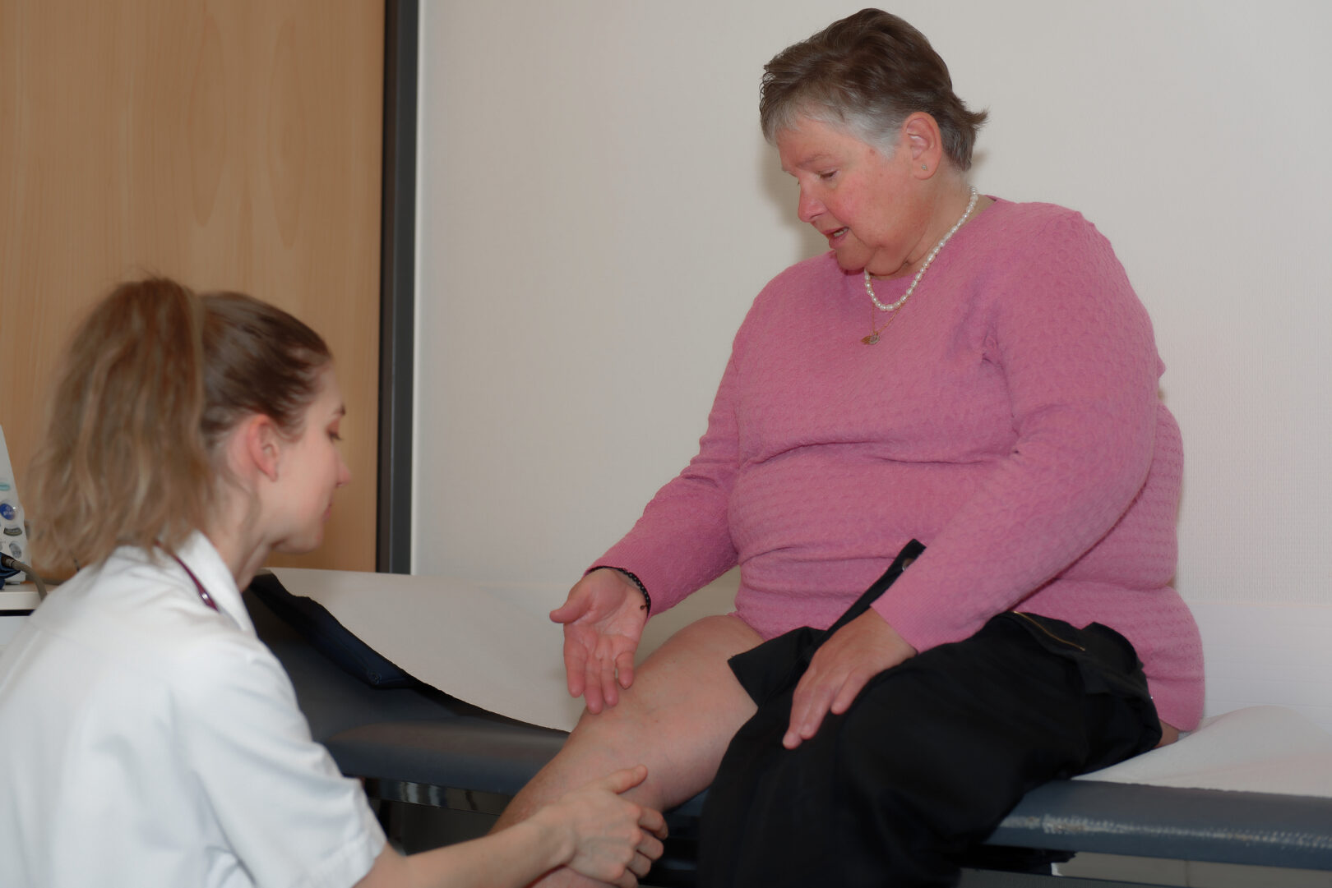
Obesity – Movement & Ergonomic Challenges
Obesity as a disease may lead to movement impairments and presents unique mobility & ergonomic challenges, which will vary dependent on obesity stage.
  Primary reason for referral of PwO to Physiotherapy will vary and
  the goal of physiotherapy will differ.
  e.g.:
  Musculoskeletal injury affecting ability to walk-
  PwO presents as an outpatient
  Cardiorespiratory disease leading to hospital admission,
  of PwO with a significant period of bedrest and reduced mobility
Notes:
Obesity as a disease may lead to movement impairments and obesity presents unique mobility & ergonomic challenges
The primary reason for referral of a PwO to Physiotherapy will vary and the goal of physiotherapy will differ
eg.
A person with obesity may be referred with a
Musculoskeletal injury affecting ability to walk-
and presents as an outpatient
Or a PwO and
Cardiorespiratory disease may be admitted to hospital, resulting in a significant period of bedrest and poor mobility
Obviously the mobility challenge presented by obesity will also depend on the obesity stage

Slide 4
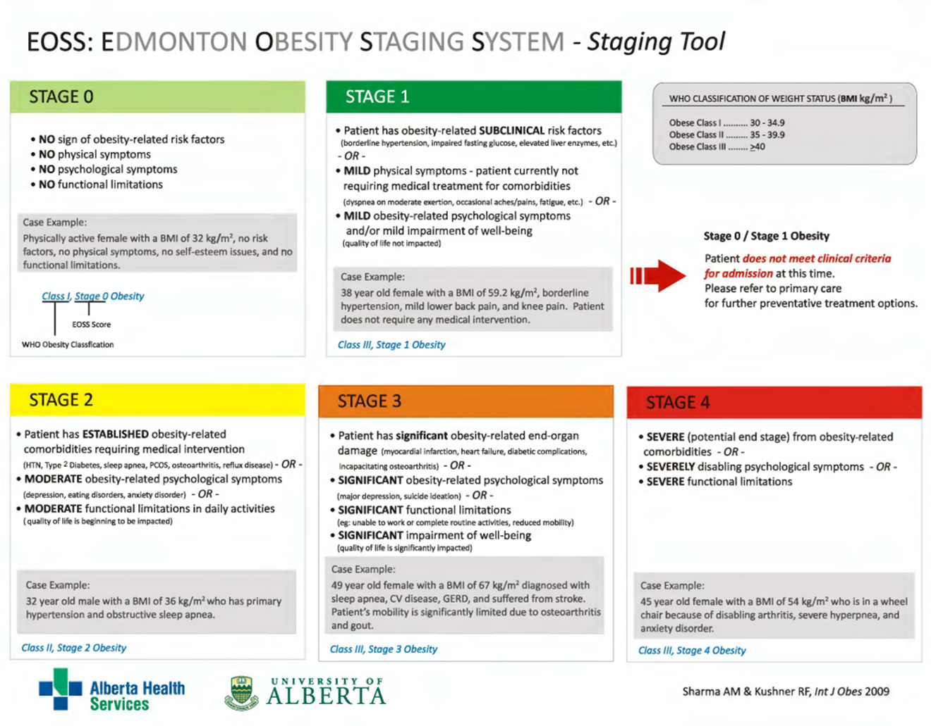
Notes:
The Edmonton Obesity Staging system is presented as a reminder of the differing stages of obesity
In Stages 3 & 4 obesity… mobility, movement and handling challenges are likely greater. Hospitalisation of the Person with Stage 3 or 4 Obesity for an acute illness or trauma can present significant challenges in terms of providing equitable and effective healthcare.

Slide 5
Ergonomics as it relates to PwO
  Ergonomics is the scientific discipline of designing workplaces, products and systems to fit the physical and cognitive capabilities of the users, maximising efficiency and safety while minimising injury, strain and fatigue. It is also referred to as human factors.
  Bariatric Ergonomics – refers to ergonomics as it relates to a person with obesity across settings.
  https://www.hsa.ie/eng/topics/human_factors/overview_of_human_factors/
Notes:
Ergonomics is the scientific discipline of designing workplaces, products and systems to fit the physical and cognitive capabilities of the users, maximising efficiency and safety while minimising injury, strain and fatigue. It is also referred to as Human Factors.
Bariatric Ergonomics – refers to ergonomics as it relates to a person with obesity across settings - understanding interactions between PwO , other people and other elements of a system

Slide 6
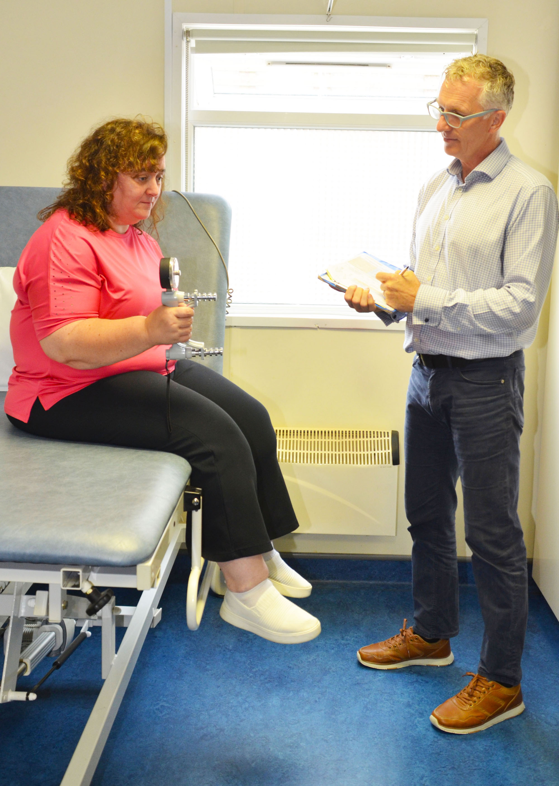
Practice settings
  Physiotherapists provide rehabilitation for people with obesity (PwO)in many healthcare & community settings
    Out-patient settings
    Community settings, i.e., gym, workplace, sports settings
    Acute hospitals
    Nursing homes
    Person’s own home
    PwO will have varying levels of mobility, which present differing ergonomic issues in different settings.
Source: ECPO Image Bank
Notes:
People with obesity will engage with health services in multiple settings.
For Physiotherapy common settings include:
Out-patient settings
Community settings i.e. gym, workplace, sports settings
Acute hospitals
Nursing homes
Person’s own home
Each setting will have its own ergonomic considerations for the person with obesity, which may impact their movement and function.

Slide 7
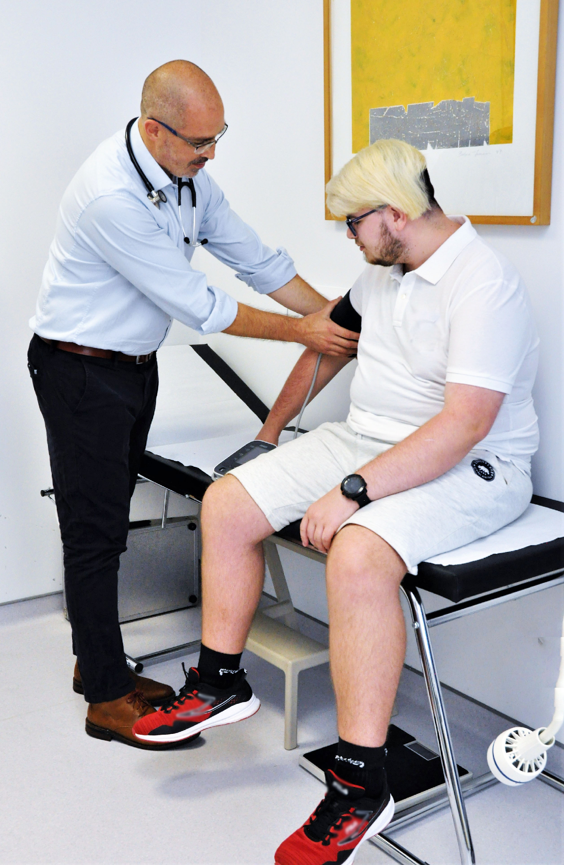
Ergonomics: physical environment
Having an appropriate physical environment, with appropriate equipment is critical to ensuring non-stigmatising, evidence based, effective healthcare for people living with obesity.
Healthcare organisations may not be adequately designed or equipped, leading to staff taking unacceptable risks or patients at risk of not receiving the care they need.
Preplanning with universal design of healthcare spaces and equipment required - incorporating bariatric considerations, e.g., door widths, room dimensions, optimum location in hospital, emergency evacuation plan, etc.
Source: ECPO Image Bank
Notes:
Having an appropriate physical environment, with appropriate equipment is critical to ensuring non-stigmatising, evidence based, effective healthcare for people living with obesity
Healthcare organisations may not be adequately designed or equipped, leading to staff taking unacceptable risks or patients at risk of not receiving the care they need
Preplanning with universal design of healthcare spaces and equipment is essential for safe delivery of therapy for all including People with obesity

Slide 8
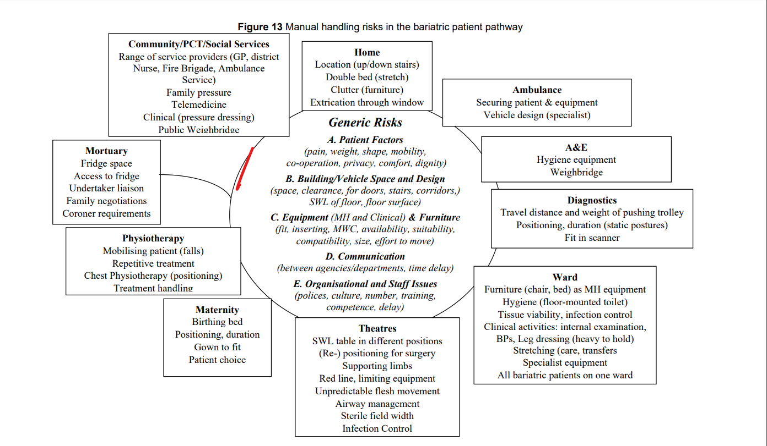
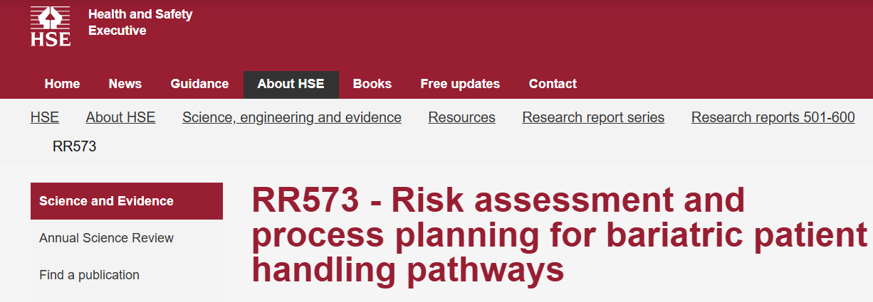
Notes:
This diagram outlines some of the settings where a PwO may engage with healthcare and gives an overview of the bariatric risk factors to be considered in each of these health care settings.
Some risk factors are related to the PwO – their shape & mobility, the skin condition
others are related to spaces, equipment and the need for transport across settings, including ambulance, outpatient ,emergency room, hospital ward setting – The diagram helps illustrate the planning required for the journey of a PwO through a healthcare system in relation to movement and manual handling
Reference https://www2.healthservice.hse.ie/files/139/
Original source Risk assessment and process planning for bariatric patient handling pathways Prepared by Loughborough University for the Health and Safety Executive (HSE) 2007 RR573

Slide 9
Physiotherapist role as it relates to bariatric ergonomics
Physiotherapists have unique expertise to contribute to bariatric ergonomics in healthcare and to act as advocates for PwO.
  Providing solutions for safe dignified mobility and transfers for the PwO to enable effective healthcare and optimise physical function of the PwO.
For example:
  Planning moving, handling, mobilisation pathway in healthcare system for PwO.
  Procuring bariatric equipment.
  Providing guidance on movement and therapeutic handling for individual PwO, their family & carers.
  Balancing manual handling risks for staff with healthcare needs of PwO.
Notes:
Physiotherapists have unique expertise to contribute to bariatric ergonomics in healthcare and to act as advocates for PwO
This involves providing solutions for safe dignified mobility and transfers for the PwO to enable effective healthcare and optimise physical function of the PwO
For example
Planning a moving, handling, mobilisation pathway in the healthcare system for a PwO
Procuring the necessary bariatric equipment
Helping to balance manual handling risks for staff with the healthcare needs of the PwO

Slide 10
Occupational Health - Ergonomic Physiotherapist Role
Physiotherapists may also play a key role in occupational health as it relates to healthcare workers providing care and rehab for PwO.
Occupational Health Physiotherapy service delivery generally fits into three broad categories:
- promoting work ability and workplace wellbeing,
- preventing work disability,
- managing work disability.
Promoting health and safety of Healthcare Workers:
Reducing risks of occupational injury in healthcare environment/preventing occupational injury, e.g., reducing risk of musculoskeletal injury during manual handling tasks with PwO.
Reducing work disability of healthcare staff with health issues, through finding ergonomic solutions when providing care and rehab for PwO.
IFPOHE 2024
Notes:
Physiotherapists may play a key role in occupational health as it relates to healthcare workers providing care and rehab for PwO
The International Federation of Physiotherapists in Occupational Health and Ergonomics (IFPOHE 2024) published
Standards for Physiotherapy Practice
Occupational Health Physiotherapy service delivery generally fits into three broad categories:
-promoting work ability and workplace wellbeing
-preventing work disability
-managing work disability.
Examples of this are
Physiotherapists engaging in promotion of health and safety of Healthcare Workers to reduce the risk of occupational injury in the healthcare environment Eg. reducing manual handling risks/ the risk of a musculoskeletal injury for staff when working with a PwO
Or
Reducing work disability of helathcare staff with health issues through finding ergonomic solutions when providing care and rehab for all patients and this included the PwO
.

Slide 11
Physiotherapists - Providing Guidance & Training
Providing training in movement, mobilisation and handling as it relates to PwO for other Healthcare staff and also carers and family members.
This may occur as part of daily work routine, working with other healthcare workers.
or
Specialist physiotherapists may deliver dedicated training programmes for healthcare staff.
‘
Notes:
Physiotherapists may also provide training in movement, mobilisation and handling as it relates to the PwO for other Healthcare staff and also carers and family members
This may occur as part of daily work routine, working with other healthcare workers in relation to a specific patient e.g. with obesity
or
Specialist Physiotherapists may deliver dedicated training programmes re moving, handling and ergonomics or specialist training in bariatric ergonomics

Slide 12

Psychological Considerations
Risk factors for obesity are complex with psychological wellbeing a particular concern for PwO.
Psychological effects of obesity can be deeply intertwined with emotional and behavioral factors, where psychological vulnerabilities may predispose individuals to obesity and vice versa.
Additionally having obesity can lead to psychological issues like low self esteem, low self efficacy, feelings of self blame and embarrassment.
Segal & Gunturu, 2024
Notes:
Risk factors for obesity are complex with psychological well being a particular concern
Psychological effects of obesity can be deeply intertwined with emotional and behavioral factors, where psychological vulnerabilities may predispose individuals to obesity and vice versa.
Additionally having obesity can lead to lots of psychological issues like low self esteem, low self efficacy, feelings of self blame and embarrassment.

Slide 13
Psychological Considerations
Episodes of care and rehab which involve moving, handling and mobilisation are potentially high-risk situations for PwO feeling stigmatised by healthcare professionals. E.g.: throw away remarks re lack of suitable equipment, clothing, a lack of space or use of equipment that is not appropriately designed for people with obesity.
The PROMINENCE OPEN EDUCATION RESOURCE has a section dedicated to reducing obesity bias and stigma and promoting psychological well-being of PwO when engaging with healthcare professionals.
Physiotherapists need to be aware of their own internal bias, their language in general conversation, as well as in direct delivery of care. People first language is important.
Notes:
Episodes of care and rehab which involve moving, handling and mobilisation are potentially high risk situations for PwO feeling stigmatised by healthcare professionals. eg. throw away remarks regarding a lack of suitable equipment or clothing, a lack of space or struggling using equipment that is not appropriately designed can lead to feelings of stigmatisation
Physiotherapists need to be aware of their own internal bias and their language in general conversation as well as in direct delivery of care. People first language is important.
Please note that PROMINENCE OPEN EDUCATION RESOURCE has a Section 2,dedicated to reducing bias and stigma and promoting psychological wellbeing of PwO when engaging with healthcare professionals

Slide 14
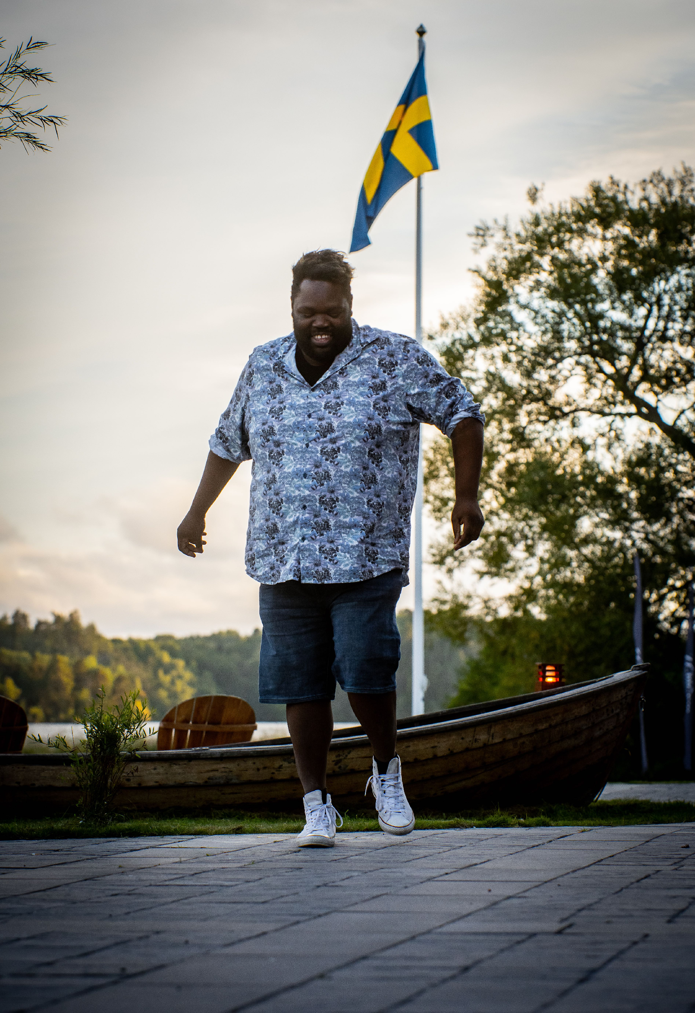
Physiotherapy ethos
  Encourage - Independence, Autonomy and Empowerment in a supportive environment
  Optimise physical function
Therapeutic Handling Definition implies facilitating & empowering a person to actively engage in a movement task to the best of their ability.
Shared Goal Setting is important for physiotherapists engaging with PwO.
Source: ECPO Image Bank
Notes:
It is important that physiotherapists encourage and promote independence are autonomy supportive and aim to empower the PwO in a supportive environment an this applies to moving, handling and mobilisation
The Physio ethos is to optimise Physical Function of all irrespective of ability or disease
Therapeutic Handling Definition therefore refers to facilitating & empowering person to actively engage in movement task to the best of their ability rather than simply moving and handling

Slide 15

Manual handling (MH) risk assessment as part of a clinical assessment
Chartered Society Physiotherapists (UK) guidance on MH suggest the following steps:
  Assess patient clinically.
  Consider realistic goals and functional outcomes with patient
  Does the proposed treatment involve hazardous MH?
  Can the hazardous MH reasonably be avoided?
  If not, complete a risk assessment, rate risk and consider benefits versus risk.
  Identify solutions to reduce risk; if satisfied proceed if not consider competence to proceed/reconsider goals.
Notes:
The Chartered Society of Physiotherapy UK guidance advocates that a MH risk assessment should be included in all clinical assessments for all therapeutic interventions. The key steps are:
Assess patient clinically
Consider realistic goals and functional outcomes with patient
Consider does the proposed treatment involve hazardous MH?
Decide if the hazardous MH can reasonably be avoided?
If MH cannot be avoided, complete a risk assessment, rate risk and consider benefits of treatment which requires MH versus risk of proceeding with MH task
Identify solutions to reduce risk; if satisfied proceed and if not consider competence to proceed and /or reconsider goals

Slide 16
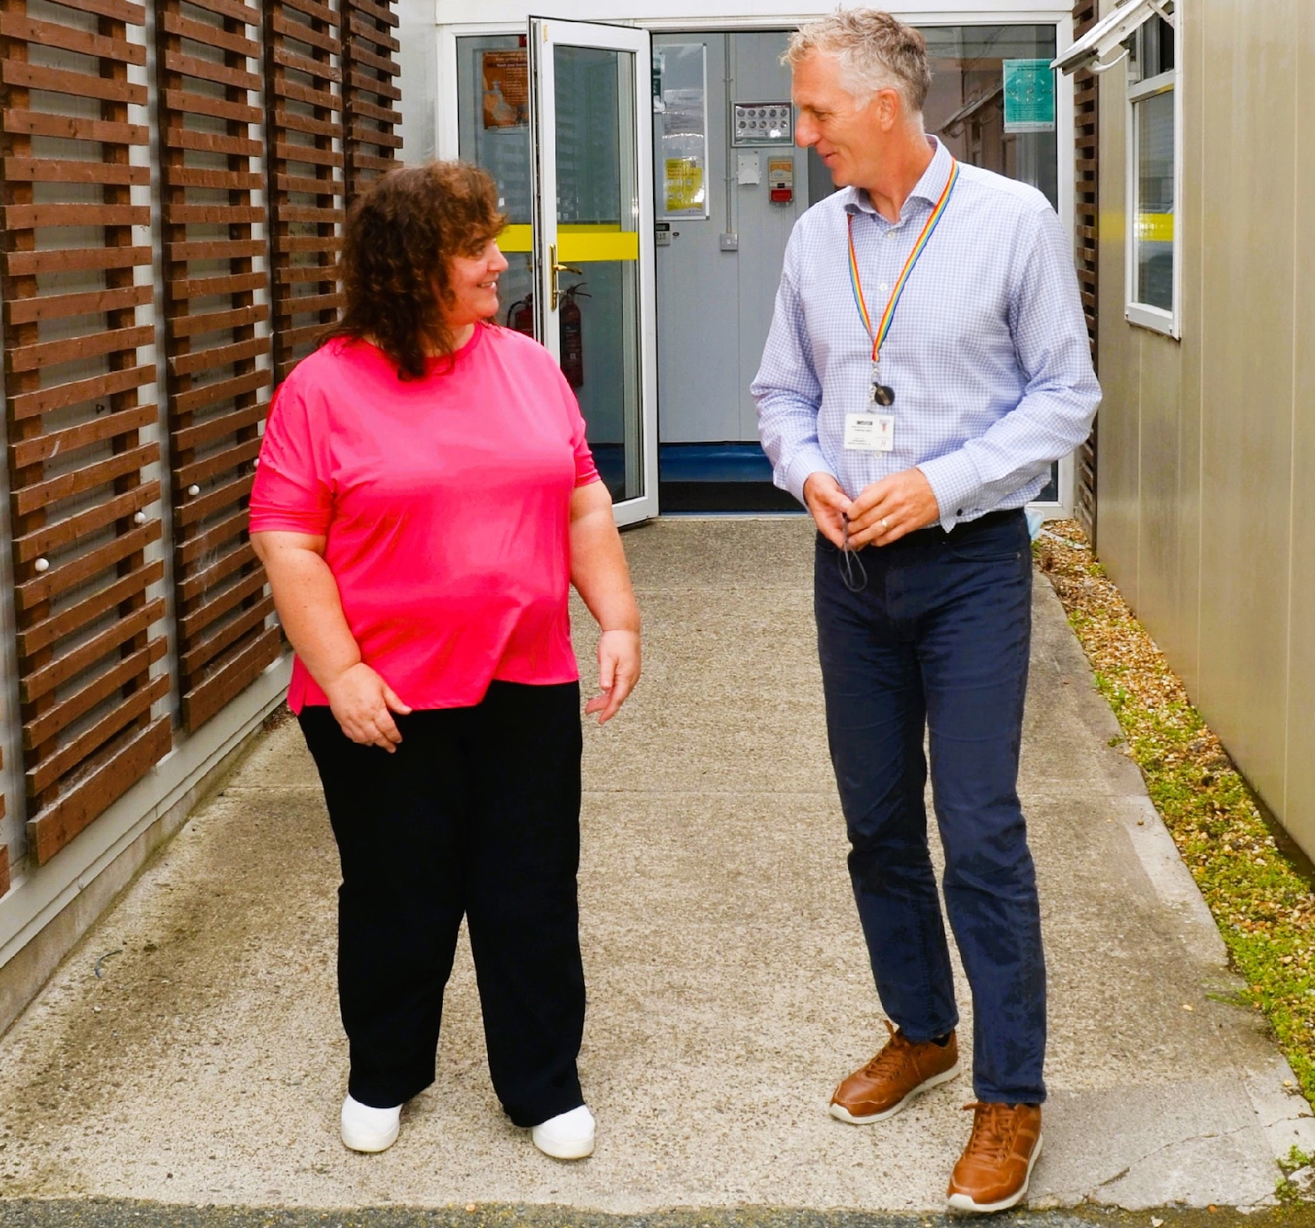
Physiotherapy movement/mobility assessment
Clinical Assessment tailored to individual
Identify stage on EOSS
How is weight distributed? How will this affect movement?
Establish baseline mobility
  How does the patient turn in bed, move up bed, sit over side of bed and sit to stand
  How is their walking and gait pattern?
What are the high-risk components to treatment? Consider how can you manage this?
Ask if the patient is using any specific equipment at home? and consider how you might access appropriate equipment to deliver appropriate treatment
Source: ECPO Image Bank
Notes:
For a Physiotherapy movement/mobility assessment with a patient in bed
Establish baseline mobility
Ask if the patient is using any specific equipment at home? And How you might access appropriate equipment to deliver appropriate treatment?
Identify the stage of obesity on the EOSS
Assess how is weight distributed? Consider how this may affect movement
Assess how the patient turns in bed, moves up bed, sits over side of bed and goes from sit to stand
Assess their walking ability and gait pattern ?
Consider what are the high-risk components to treatment? Ask how you can manage this?

Slide 17
Physiotherapy movement/mobility assessment
What additional issues need to be considered with PwO?
  Number of staff needed to safely assist patient
  Safe Workload of existing equipment – beds, chairs, walking frames, crutches, etc.
Does the bed go low enough to return to sitting without lifting the patient if patient fatigues?
What are the alternative options for sit to stand?
  Use hoist to transfer to chair or raiser recliner chair and attempt to stand from there
  Bring PwO to gym and use floor mounted parallel bars
  Viking hoist - suitably sized
  Options to hire bariatric equipment
Notes:
What additional issues need to be considered for the PwO?
What number of staff are needed to safely assist patient?
What’s the Safe Workload of existing equipment – beds, chairs, walking frames, crutches etc
Does the bed go low enough to return to sitting without lifting the patient if they fatigue?
What if any are the alternative options for sit to stand
Could a hoist be used to transfer to chair ?
or
could a raiser recliner chair be used and attempt to stand from there
Is it better for the person to come to gym and then can use floor mounted parallel bars
Is a Viking hoist- suitably sized required ?
Is there an option of hiring bariatric equipment?

Slide 18
Physiotherapy movement/mobility assessment
  How to create a dignified environment
  Develop shared achievable goals
  Tissue viability and skin condition – how this affects mobility
Consider footwear
Is the patient at risk of a fall?
Problem solving skills critical – thinking laterally to solve complex issues
Notes:
Other issues to be considered
How to create a dignified environment
Developing shared achievable goals with the PwO
Tissue viability and skin condition and how this might affect mobility
Footwear needs to be considered
Is the person at risk of a fall?
Physiotherapist’s problem solving skills are critical – and thinking laterally to resolve complex issues is often required

Slide 19
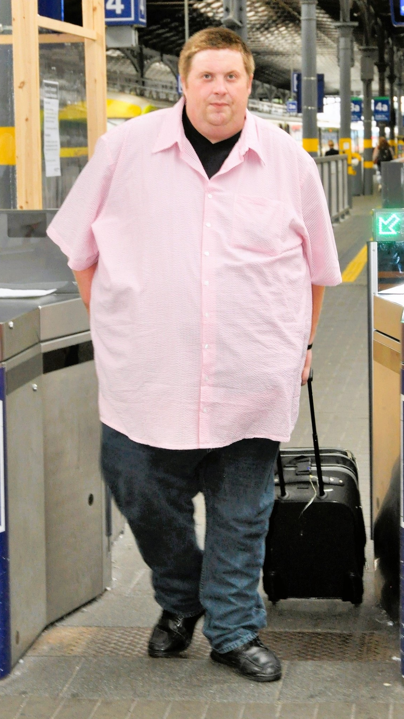
Body shape - distribution
of weight
Understanding body shape gives a clearer focus on the issues that may be limiting the patient's mobility and independence and help develop more effective treatment programmes. Some body shapes are:
Weight carried high, abdomen may be rigid due to fluid retention
  This can limit trunk flexion - difficult to lie flat - shortness of breath – if there is significant weight around neck consider swallowing and respiratory issues. May prefer get out of bed using side lying rather than sitting forward in bed, may prefer reclined chair.
Weight carried high, abdomen mobile pannus (apron) hanging
(when excess skin and fatty tissue hang down from the abdomen)
  This can obstruct lymphatic drainage; patient may need lower height bed to have feet flat on floor and use rocking motion to stand. High risk of moisture lesions.
Source: ECPO Image Bank
Notes:
Weight Distribution is an important consideration
Understanding body shape gives a clearer focus on the issues that may be limiting the patient's mobility and independence and help develop more effective treatment programmes
Some examples
Weight may be carried high, abdomen may be rigid due to fluid retention
This can limit trunk flexion - it can be difficult to lie flat - There may be Shortness of breath – if there is significant weight around neck consider swallowing and respiratory issues. Person may prefer to get out of bed using side lying rather than sitting forward in bed, they may prefer a reclined chair
Weight carried high, abdomen mobile pannus (apron) hanging where excess skin and fat begin to hang down from the abdomen.
This can obstruct lymphatic drainage; the patient may need lower height bed to have feet flat on floor and use rocking motion to stand. High risk of cellulitis, limb oedema

Slide 20
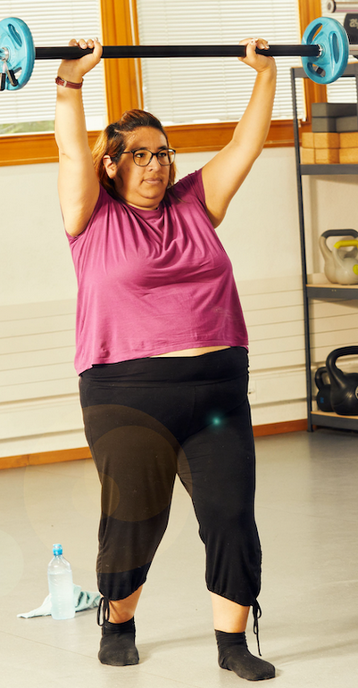
Body shape – distribution of weight
Weight stored around the waist
Hip flexion may be limited.
Weight carried below waist; tissue bulk between thighs
  Hip and knee flexion limited – tend to sit with knees extended. Get out of bed (egress) via long sit or roll.
Weight carried below waist; tissue bulk on hips and outside of thighs
  Rolling difficult, tend to sit with legs extended and abducted – egress bed with long sit.
Weight stored around hips and glutes
Difficulty with personal hygiene, can obstruct lympathic drainage, oedematous legs,
risk of cellulitis and leg ulcers.
Weight distribution more general and comparable to the person’s tall height
Patient needs longer beds, higher back rest on chair, as well as
higher Safe Working Load (SWL).
Source: ECPO Image Bank
Notes:
Weight stored around the waist – this can limit forward flexion
Weight carried below waist leads tissue to bulk between thighs
Hip and knee flexion may be limited – person may tend to sit with knees extended. Getting out of bed using long sit or roll may be best
Weight carried below waist; tissue bulk on hips and outside of thighs
legs abducted. Rolling may be difficult, tend to sit with legs extended and abducted – get out of bed with long sit
Weight Stored around hips and gluteus
Difficulty with personal hygiene, can obstruct lympathic drainage, oedematous legs, risk of cellulitis and leg ulcers
A weight distribution proportionally comparable to the person’s height – patient needs longer beds, higher back rest on chair as well as higher Safe Working Load (SWL)
Anasarca refers to severe generalised oedema

Slide 21
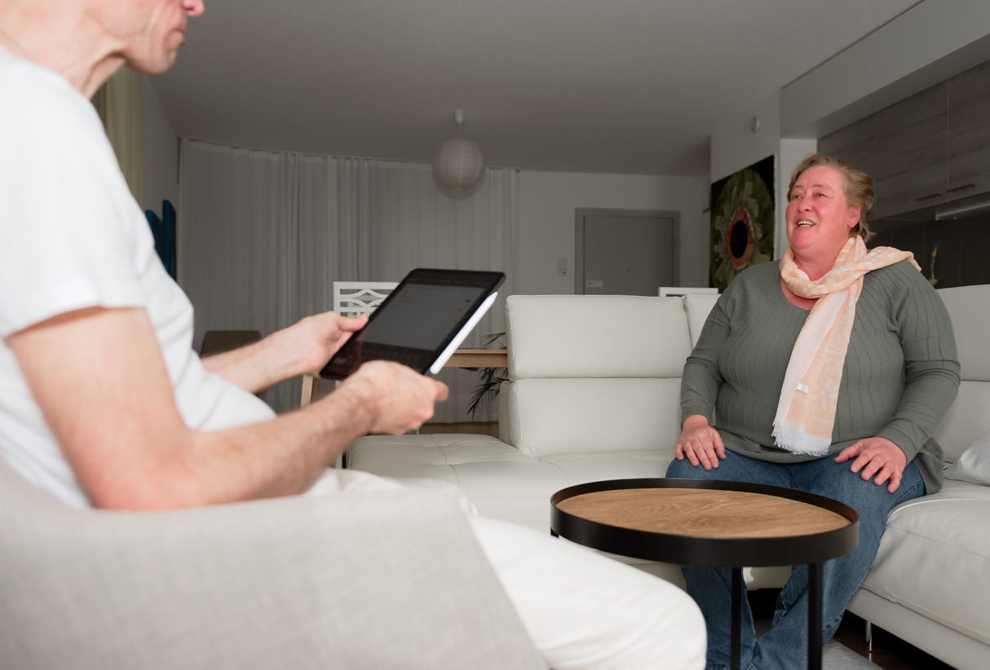
Developing a patient handling care plan
Also need to plan for transfer/discharge to another setting/home
Use body shape/weight distribution to help choose options that maximise bed mobility
Side rails, bariatric monkey poles, sliding sheets to aid mobility in bed
Choose bariatric bed
  In general, low bariatric bed with retractable sides is best option
Select chair, commode and wheelchair
Bariatric hoists
HoverJack is main option to lift patient off floor
Source: ECPO Image Bank
Notes:
Developing a patient handling care plan is critical
If in acute care – also need to consider discharge planning – immediate liaison with community services – set expectations around discharge so that plans can be put in place
Again, consider body shape to help choose options that maximise bed mobility
Consider side rails, bariatric over head handling poles, sliding sheets to aid mobility in bed
Choose a bariatric bed
In general, a low bariatric bed with retractable sides is best option
Select chair, commode and wheelchair if required
Bariatric hoists may be required
A Hoverjack inflatable air mattress is the main option to lift a person off the floor

Slide 22
Equipment - Safe Working Load (SWL)
Having appropriate mobility devices and moving and lifting equipment (bariatric equipment) for PwO is critical.
SWL - Safe Working Load (sometimes referred to as Normal Working Load or NWL): maximum weight that a piece of lifting equipment-such as a crane, hook, or sling is designed to lift, suspend or lower safely without risking failure.
Safe Working Load also exists for equipment such as crutches, walking frames, parallel bars, transfer boards, wheelchair, portable steps, beds.
Hospital Beds:
Usual to consider both
Safe Working Load
and
Safe Patient Load - refers to the actual weight of patient it can accommodate.
Notes:
Having appropriate mobility devices and moving and lifting equipment when required for the PwO is critical- Such equipment is known as bariatric equipment
SWL stands for Safe Working Load, sometimes also referred to as Normal Working Load or NWL, is defined as the maximum weight that a piece of lifting equipment—such as a crane, hook, or sling is designed to lift, suspend or lower safely without risking failure.
A Safe Working Load also exists for equipment such as crutches, walking frames, parallel bars, transfer boards, wheelchair, portable steps, beds
Bariatric equipment generally refers to equipment that is capable of accommodating in excess of 150 kg (25 stone)
Hospital Beds:
Usual to consider both
Safe Working Load
and
Safe Patient Load - refers to the actual weight of patient it can accommodate.

Slide 23
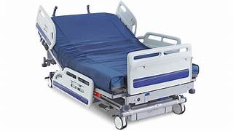
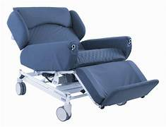
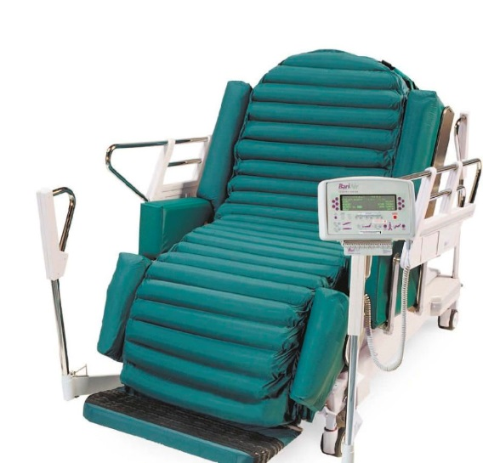
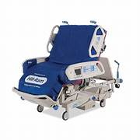
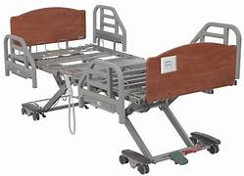
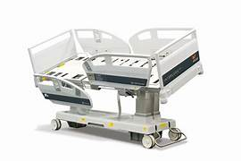
Consider bed choices
23
Notes:
Gives pictorial examples of bed types
Physiotherapists may need to work closely with occupational therapists and equipment companies in making decisions and obviously working with the PwO and possibly family members and carers

Slide 24
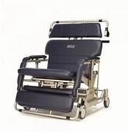
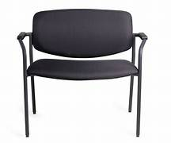
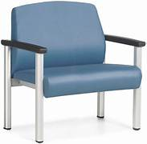
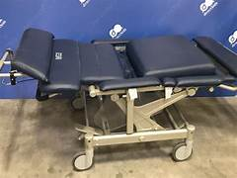
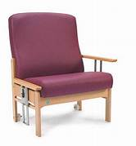
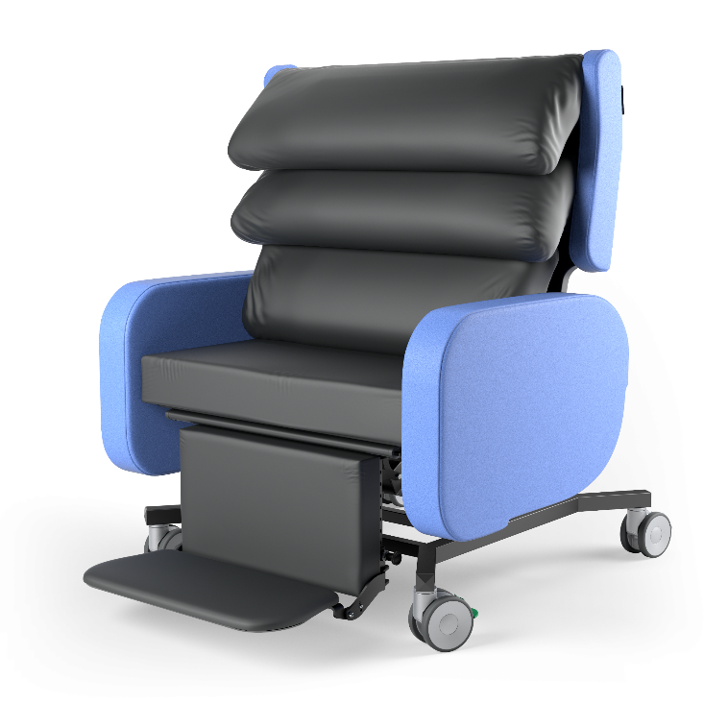
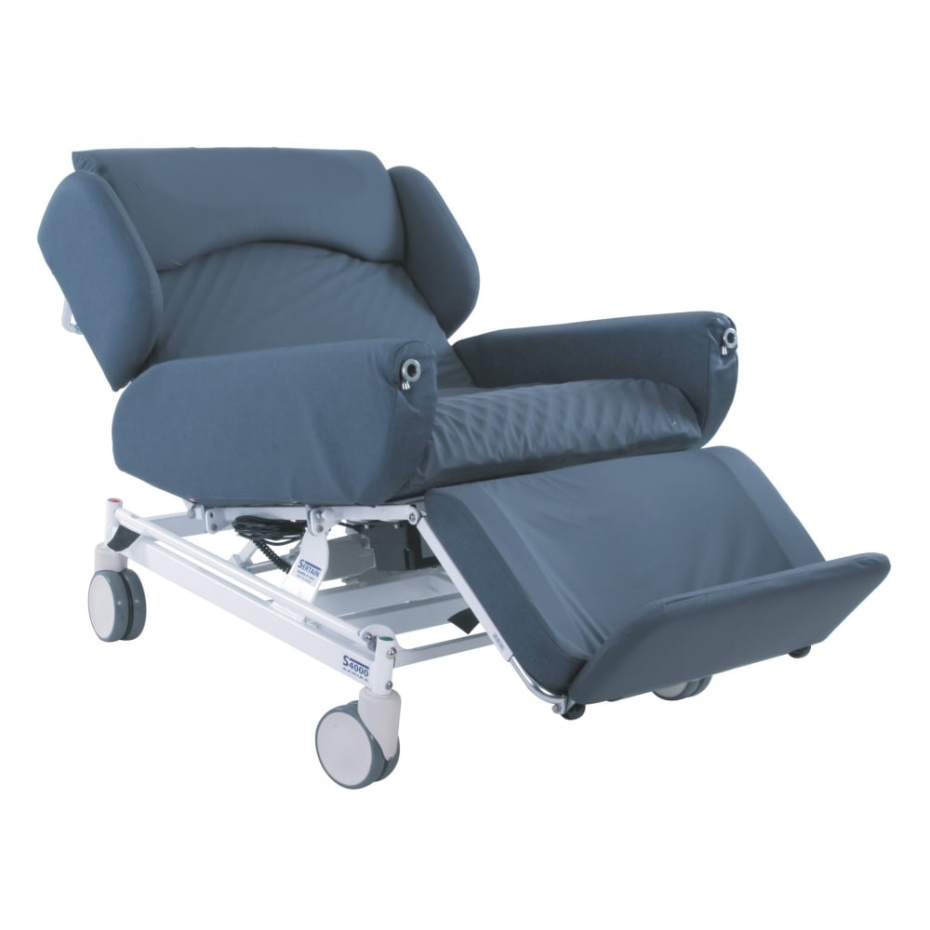
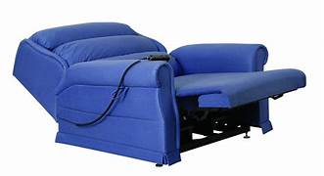
Consider chair choices
24
Notes:
Here are some examples of chair types again with lots of factors to be considered

Slide 25
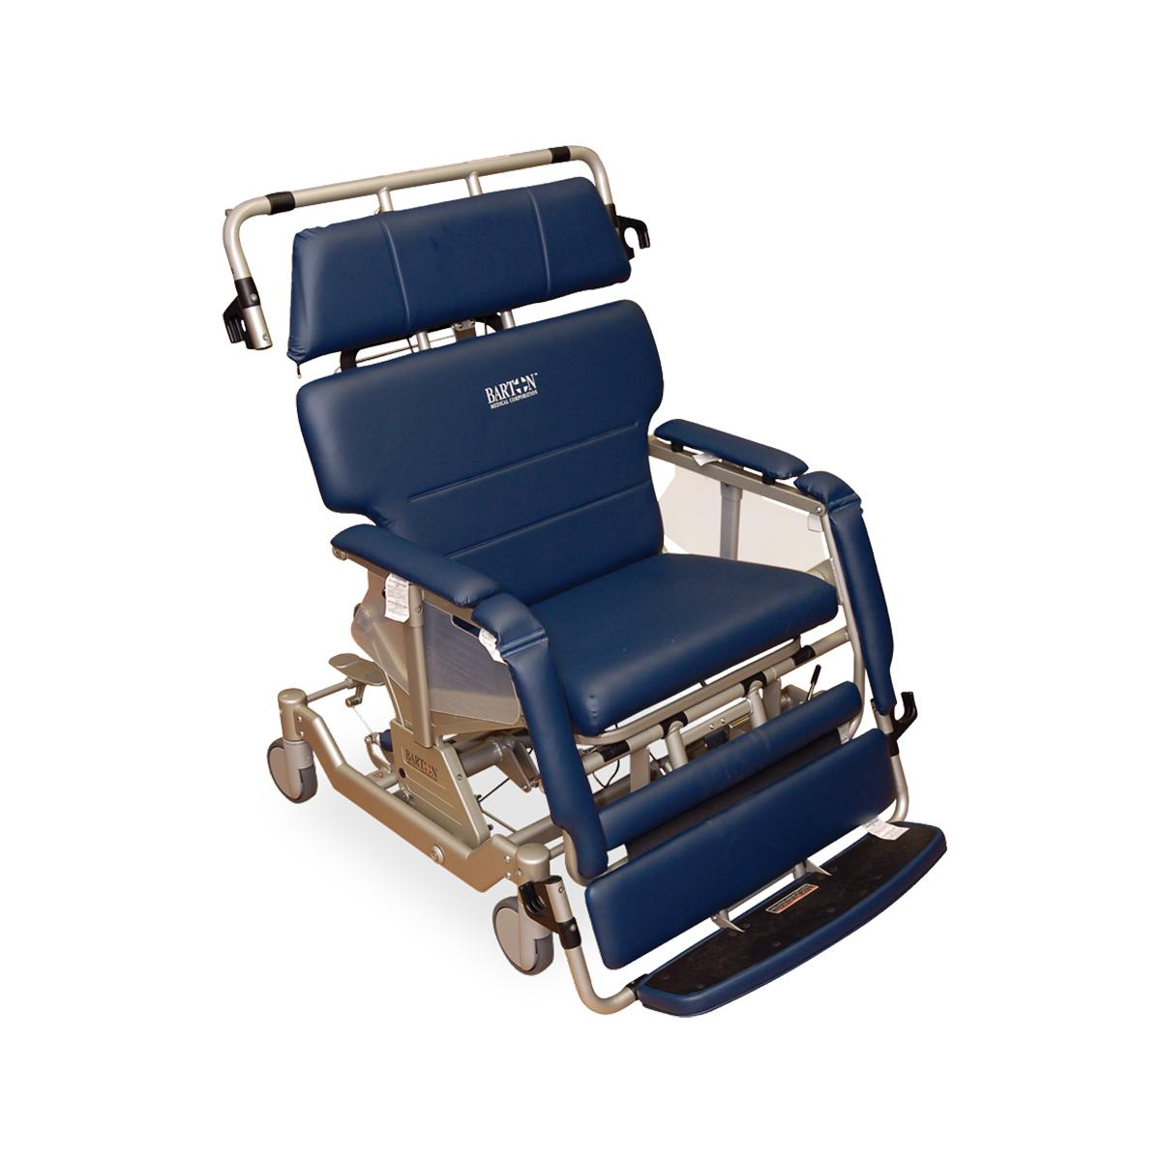
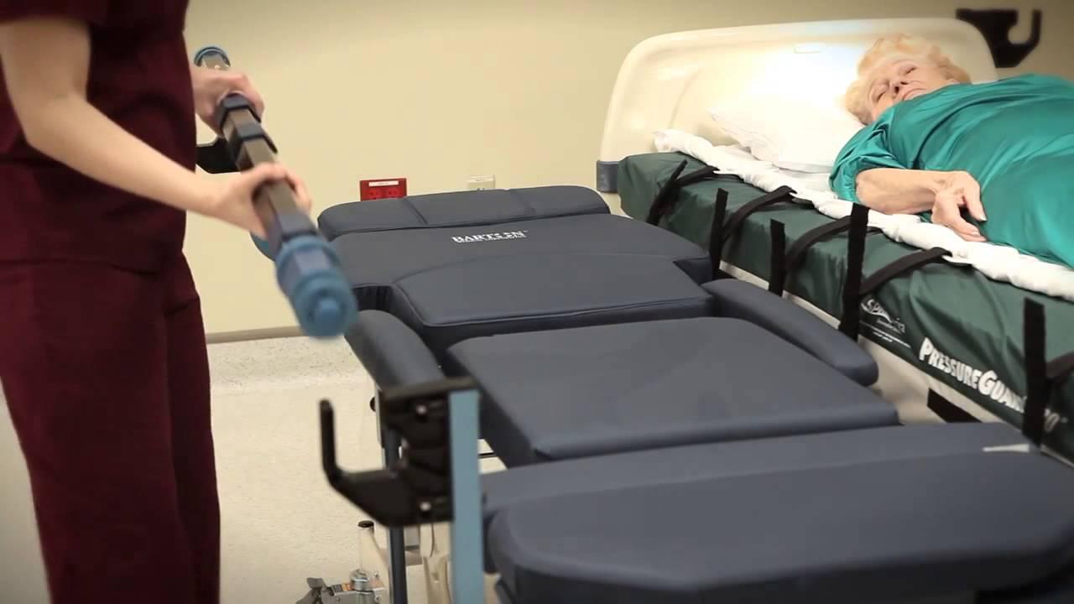
Barton reclining chair
Notes:
Heere we see just one example of a Barton Bariatric high dependency reclining chair. This has an additional feature of a lateral transfer system that reduces the effort in conducting a supine transfer from bed to chair.

Slide 26
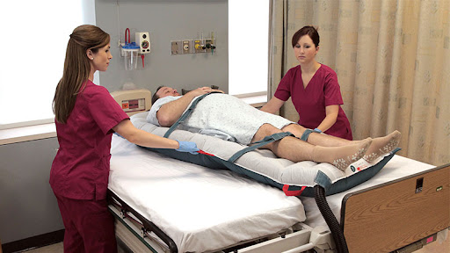
Hovermatt lateral transfer
Notes:
and here we see a hovermatt transfer being conducted – when the mat is inflated the person is raised on a cushion of air, thus decreasing the effort involved in lateral transfer from one flat surface to another

Slide 27
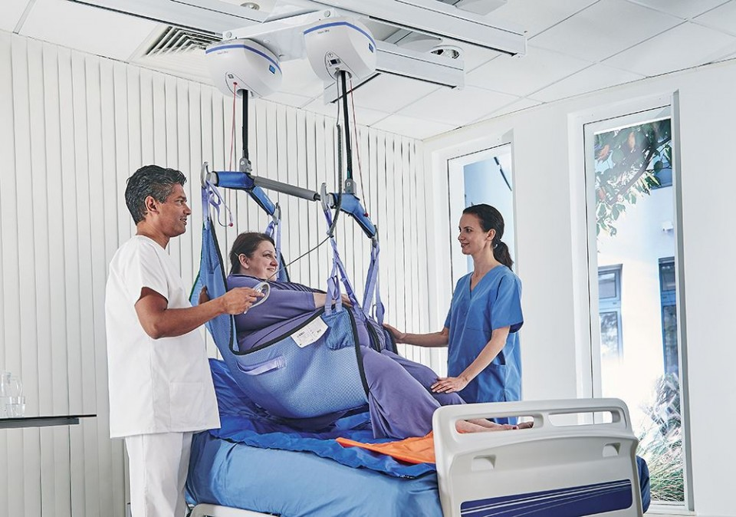
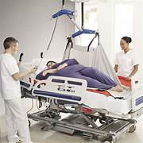
Hoists
Notes:
and here are some images of hoists that may be used for patient transfers

Slide 28

Case studies
  Please use the following case studies for an in-class Learning Activity
  Discussion with or without
    Demonstrate practical skills for mobility assessment, moving and handling and mobilisation
Notes:
Finally 2 Case studies are presented which may be used for an In class learning activity
These cases can act as the basis for discussion and/or demonstration of practical skills for mobility assessment, moving and handling and mobilisation
In addition some key resources are presented in the final slides
Thankyou for listening

Slide 29
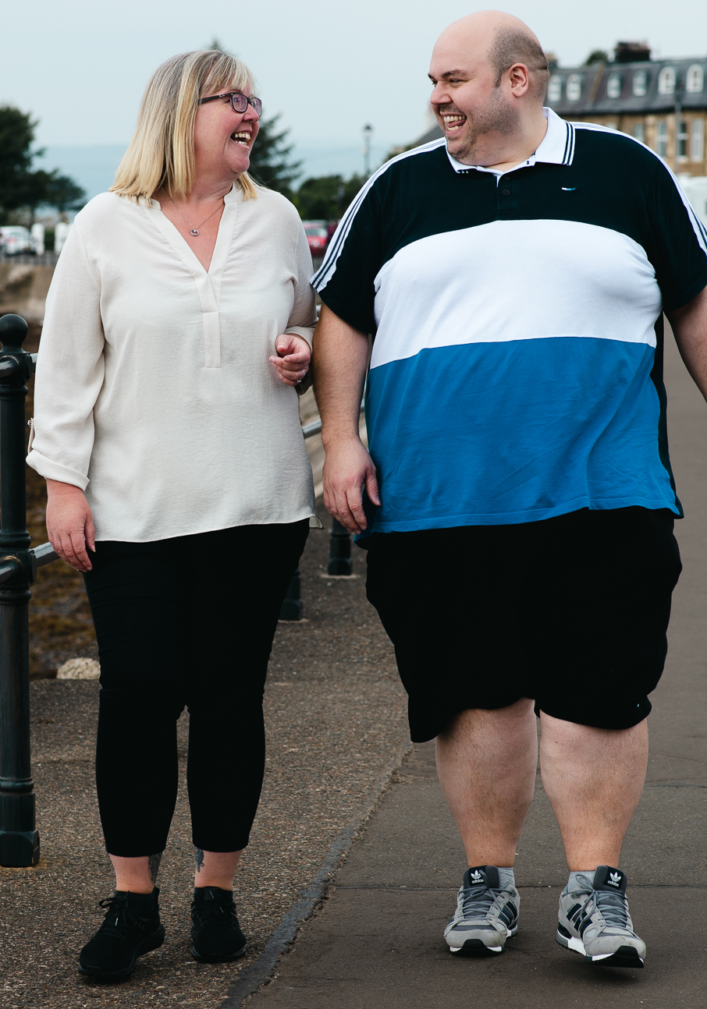
Case study 1
33-year-old male fell and fractured his fibula. He weighs 200kg and is 1.98 m tall (6 foot 6 inches).
He has been treated conservatively with below knee cast and needs to be Non-Weight Bearing for 6 weeks.
He works as a hospital porter and lives in an apartment with his partner. Door widths are too narrow for a bariatric frame and he sits on a low couch at home. Apart from his job, he does not participate in any physical activity.
His weight is distributed proportionally.
Source: ECPO Image Bank

Slide 30
Case study 2
A 55-year-old patient was admitted to hospital following a fall from her chair. She has a bruise on her hip but no fracture but has a chest infection. She weighs 260kg.
Her hips are fixed in external rotation. She has severe leg ulcers that need to be dressed 3 times a week. She has agoraphobia.
This is her second admission. Her last admission was approx. 18 months ago and was 11 months duration due to barriers accessing her home. She lives alone with carers coming
in 3 times a day. She has refused to have a hospital bed and the compromise is a reclinable chair which she now sleeps in. She stands and takes a few steps to transfer to commode and stands for some elements of dressing for her legs. She has one step into the house and access and egress is very difficult, so she only leaves the house in an emergency with
an ambulance crew.
Her bariatric reclining chair has broken and primary care are working on getting it repaired. She moves in bed pulling with her arms on the side rails or top of bed. She is now off her baseline and is unable to stand independently. She has now recovered from her chest infection and needs to start sitting out and stand to take a few steps with bariatric walking frame and sit into recliner chair to allow her to return home with primary care support.

Slide 31
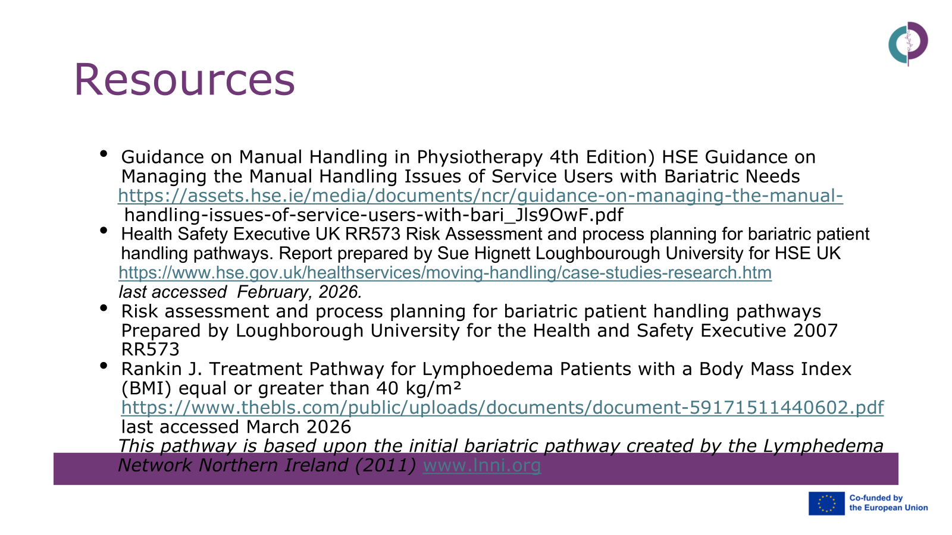
References
Dockrell, S. and Hurley, G. Moving and handling care of bariatric patients: a survey of clinical nurse managers. Journal of Research
in Nursing. 2021 Jun;26(3):194-204.
Human Factors in Irish Healthcare https://www2.healthservice.hse.ie/organisation/nqpsd/featured-articles/human-factors-in-irish-healthcare-2018-2023/
International Ergonomics and Human Factors Association last accessed March 2026
International Federation of Physiotherapists in Occupational Health and Ergonomics, Standards for Occupational Health Physiotherapy Practice 2024 https://acpohe.csp.org.uk/system/files/documents/2024-08/ifpohe_newsletter_august_2024.pdf
Occupational Health Ergonomics https://world.physio/subgroups/occupational-health-ergonomics last accessed March 2026
Segal Y, Gunturu S. Psychological Issues Associated With Obesity. [Updated 2024 May 2]. In: StatPearls [Internet]. Treasure
Island (FL): StatPearls Publishing; 2025 Jan-. Available from: https://www.ncbi.nlm.nih.gov/books/NBK603747/

Slide 32
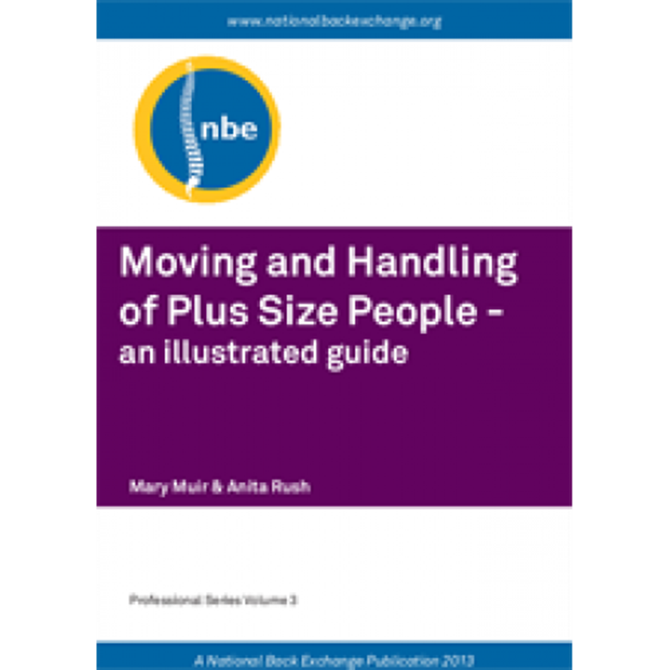
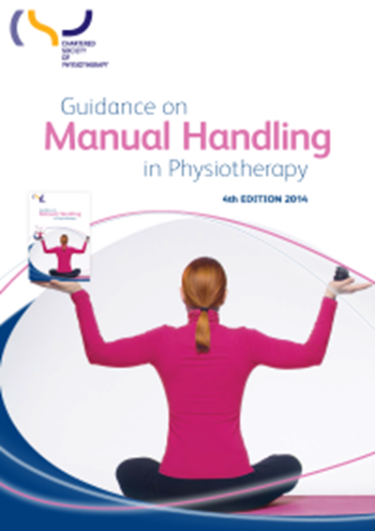
Note: different language used in this publication
First-person language - person with obesity is a preferred term now.
National Back Exchange UK https://www.nationalbackexchange.org/
Chartered Society of Physiotherapists Guidance UK: https://www.csp.org.uk/publications/guidance-manual-handling-physiotherapy-4th-edition
Introduction to Plus Size Moving & Handling, MIP UK:
https://www.youtube.com/watch?v=xDO7JdZCsQY

