Slide 1
Behaviour Change Models and Theories
This lecture was developed by senior lecturers at Tampere University of Applied Sciences in Finland for the Prominence Project, September 2025.

Slide 2
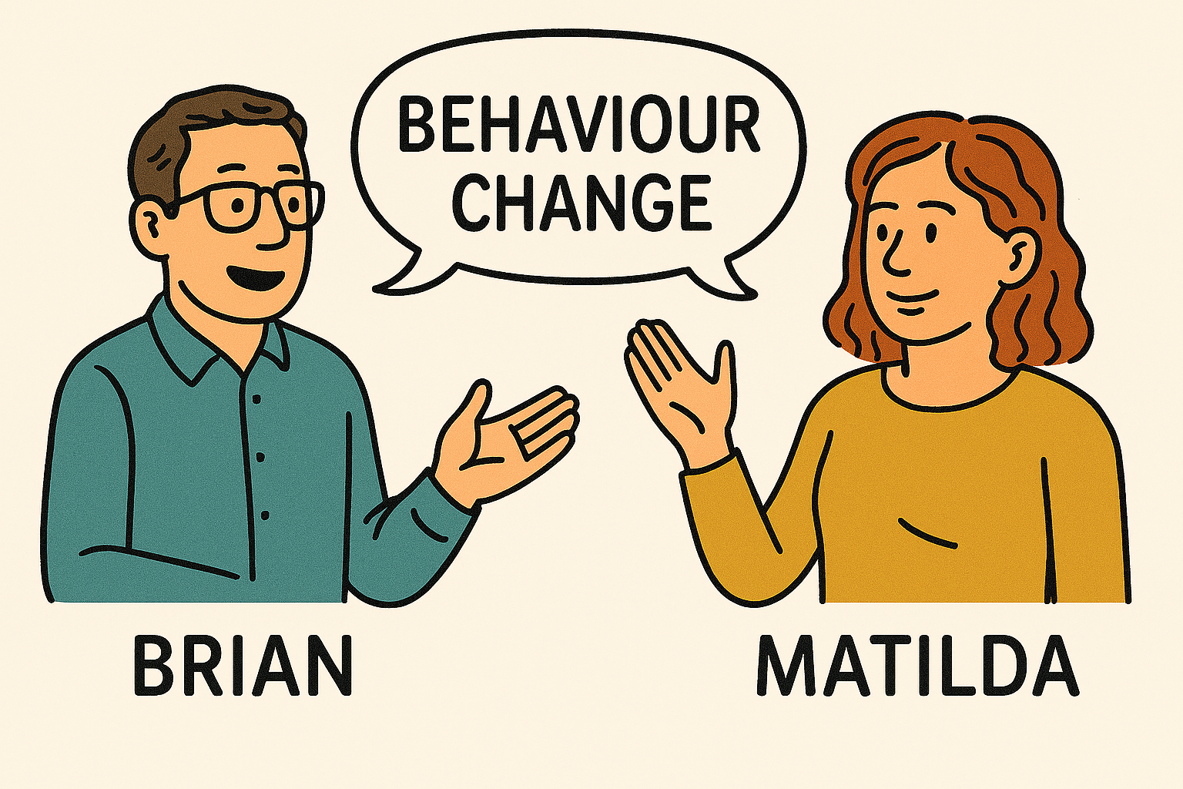

Notes:
Brian: Hello, and welcome. My name is Brian. Matilda: And I’m Matilda. We’re here together to introduce some of the key models of behaviour change. Brian: These models can help us understand the challenges and opportunities in supporting people living with obesity. Matilda: And they offer physiotherapists practical tools to guide patients toward healthier, more sustainable changes. Brian: We’re excited to share these ideas with you. Let’s get started.

Slide 3
Table of Contents
Introduction
Health Belief Model
Transtheoretical Model
Self-Determination Theory
Social Cognitive Theory
Theory of Planned Behaviour
Behaviour Change Wheel, COM-B Model
Closing
Additional material for learning
References

Slide 4
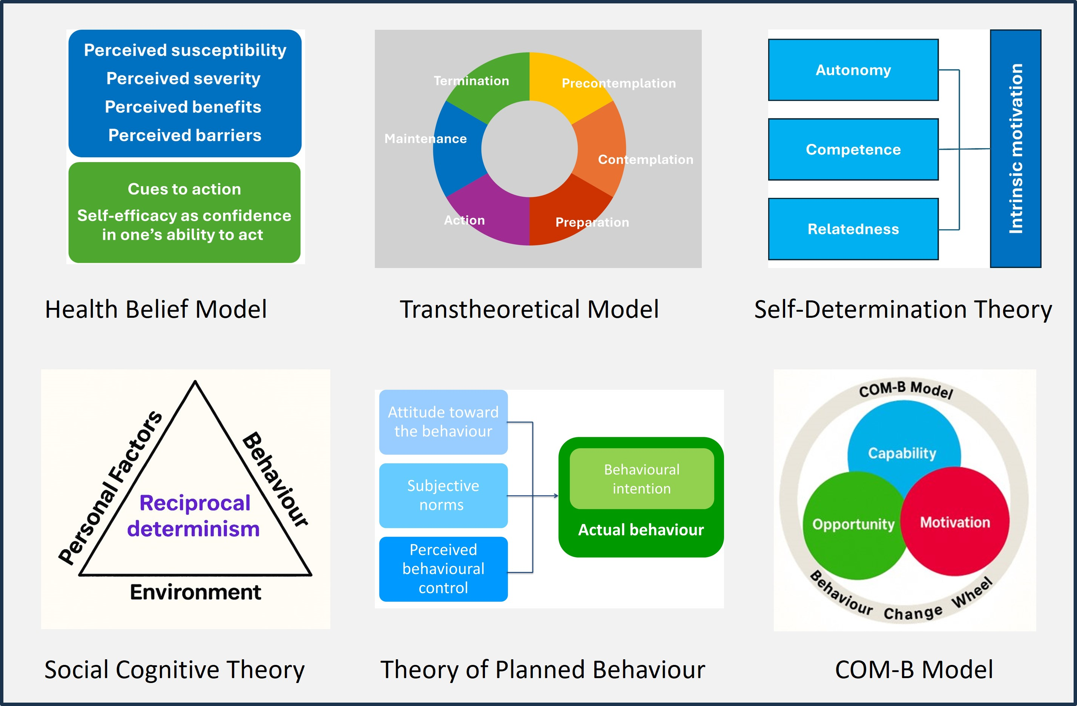
Introduction
Notes:
Matilda speaking:
Understanding behaviour change is essential in physiotherapy, because achieving positive health outcomes often depends on more than just treatment techniques. Patients may struggle with motivation, adherence to exercise programs, or making lifestyle adjustments that support recovery and long-term well-being. Behaviour change models and theories provide structured ways to understand why people act as they do, and what factors influence their decisions to adopt or maintain healthier habits. For physiotherapists, this knowledge is valuable in tailoring interventions, communicating effectively, and supporting patients in overcoming barriers. In this presentation, several well-established models and theories of behaviour change — including the Health Belief Model, the Transtheoretical Model, Self-Determination Theory, Social Cognitive Theory, the Theory of Planned Behaviour, and the COM-B model from the Behaviour Change Wheel — are introduced briefly. They serve as useful tools to strengthen clinical practice and improve patient outcomes.

Slide 5
Health Belief Model (HBM)
Perceived susceptibility
Perceived severity
Perceived benefits
Perceived barriers
Cues to action
Self-efficacy as confidence in one’s ability to act
Health Belief Model explains health behaviors based on individual beliefs.
The HBM is often used in public health campaigns.
Irwin M. Rosenstock and Marshall H. Becker developed the Health Belief Model during the 1960s and 1970s.
Notes:
Brian speaking:
The Health Belief Model, originally developed by Rosenstock and later expanded by Becker and others, is a psychological framework that explains why people choose to engage in health-related behaviours. At its core, the model suggests that individuals first perceive a threat: they believe they are at risk of developing a health condition and that the consequences could be serious. At the same time, they evaluate whether taking a specific action will be effective, meaning they see clear benefits in following through. However, they also recognise barriers, such as costs, inconvenience, or side effects, that might discourage them from acting. Behaviour is further shaped by cues to action, which can be internal signals like symptoms or external prompts such as advice, media campaigns, or reminders from healthcare professionals. Finally, self-efficacy plays a crucial role: people are more likely to adopt and maintain a behaviour when they feel confident in their ability to successfully perform it. Together, these elements provide a useful framework for understanding and predicting how individuals make decisions about their health. The Health Belief Model is widely used in public health campaigns to encourage positive behaviour change.

Slide 6
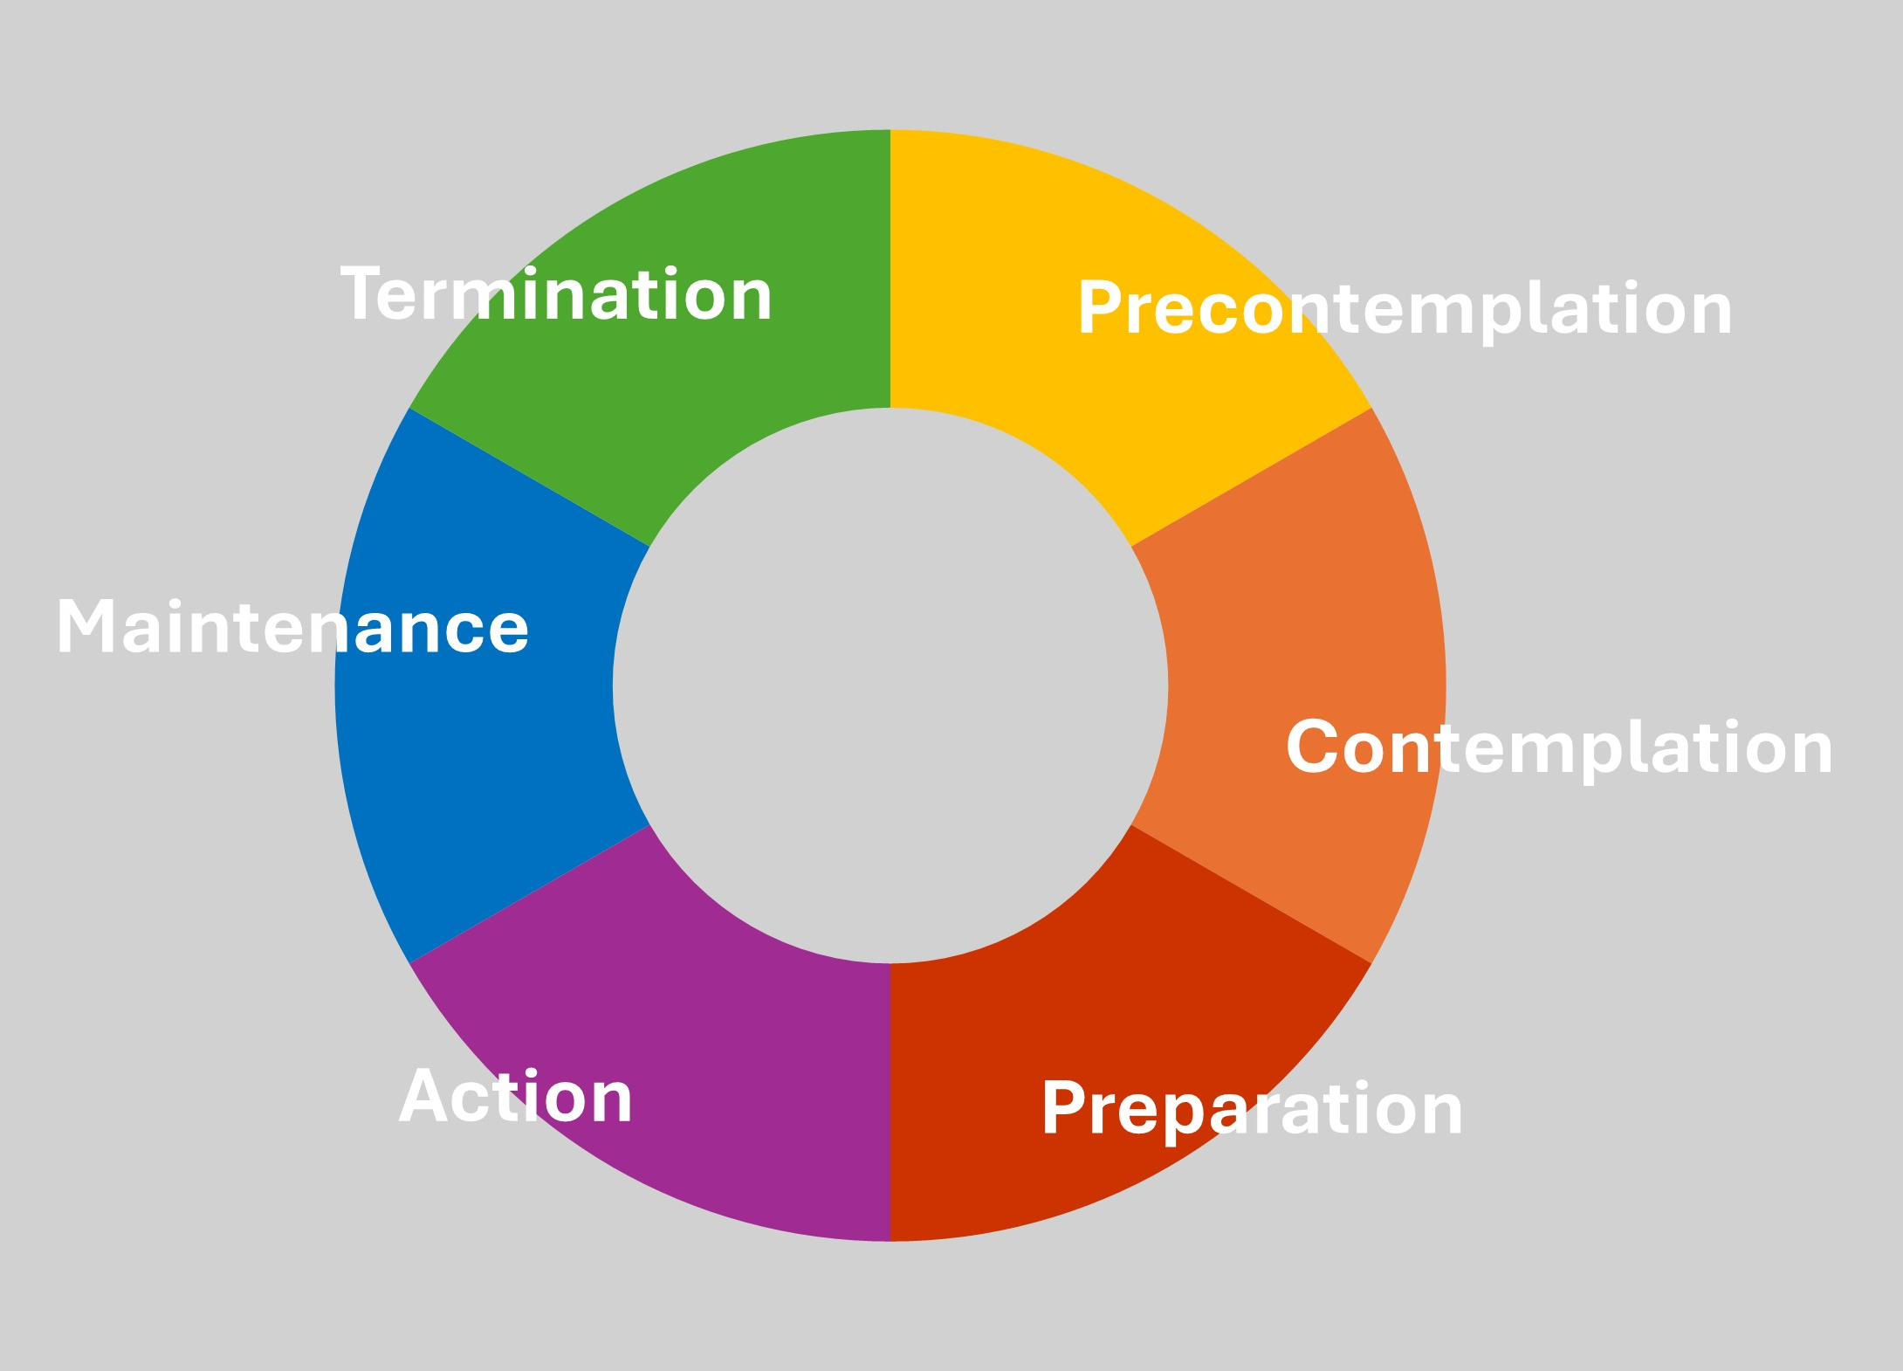
Transtheoretical Model (Stages of Change)
The TTM outlines six stages of change.
The TTM emphasises that change is a process, not a one-time event.
James O. Prochaska and Carlo DiClemente developed TTM in 1970s – 1990s.
Notes:
Matilda speaking:
Transtheoretical Model of Behaviour Change was developed by Prochaska and DiClemente, and it outlines different stages of behaviour change.
Behaviour change doesn’t happen all at once. It’s a journey through six stages.
– At Precontemplation stage, the person isn’t even thinking about change yet. They may not see the behaviour as a problem.
– Within Contemplation they’re starting to consider it, weighing pros and cons. They’re becoming more aware but still undecided.
– During Preparation phase they’re getting ready, making plans and setting goals. Small steps toward change may already be happening.
– Action is where change begins — they’re actively doing things differently. New behaviours are being practiced consistently.
– Within Maintenance they’ve made the change and are working to keep it going. The focus is on preventing relapse and staying motivated.
– Finally, in the Termination phase the change is complete. There’s no desire to go back. The new behaviour feels natural and permanent.
The TTM emphasizes that change is a process, not a one-time event.

Slide 7
Self-Determination Theory (SDT)
Intrinsic motivation
Self-Determination Theory focuses on motivation.
It emphasises intrinsic motivation as key to sustainable behaviour change.
Edward L. Deci and Richard M. Ryan developed SDT in 1985s, and later versions in 2010s
Autonomy
Competence
Relatedness
Notes:
Brian speaking:
Self-Determination Theory, developed by Deci and Ryan, is a broad framework for understanding human motivation and what drives people to engage in or avoid certain behaviours. The theory emphasises that the quality of motivation is more important than the quantity. At its heart are three basic psychological needs that must be satisfied for motivation and well-being to flourish. The first is autonomy, which means feeling that one’s actions are self-chosen and aligned with personal values, rather than controlled by external pressure. The second is competence, the need to feel capable, effective, and able to master challenges in everyday life. The third is relatedness, the desire to feel connected, cared for, and valued by other people. When these needs are met, individuals are more likely to experience intrinsic motivation — a natural, internal drive to act out of interest, enjoyment, or personal meaning. According to the theory, this kind of motivation is the most powerful and sustainable driver of behaviour change, because it fosters long-term engagement, resilience, and personal growth, rather than temporary compliance based on rewards or punishments.

Slide 8
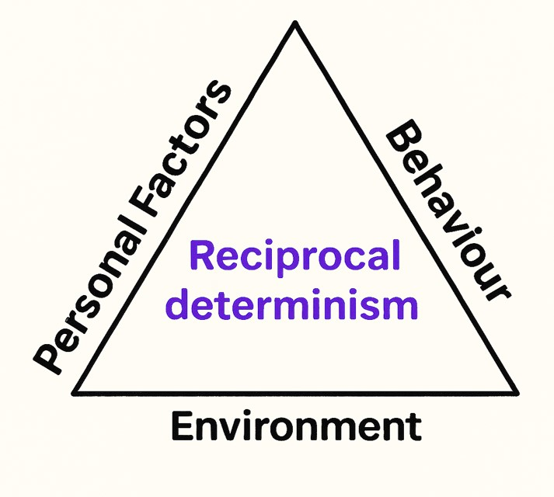
Social Cognitive Theory (SCT)
Social Cognitive Theory emphasises reciprocal determinism which means interaction between person, behaviour, and environment.
SCT is useful in understanding how social environments influence behaviour.
Albert Bandura developed SCT in 1970s and 1980s.
Notes:
Matilda speaking:
Social Cognitive Theory, developed by Albert Bandura, explains how people learn and change behaviour through the dynamic interaction of personal, behavioural, and environmental influences, a principle known as reciprocal determinism. One of its central ideas is observational learning, meaning that people can acquire new skills or behaviours simply by watching others, without direct experience. Another key concept is self-efficacy, the belief in one’s ability to succeed in performing a specific behaviour. When individuals feel confident, they are more likely to initiate and persist in challenging tasks. The theory also emphasises that motivation is shaped not only by direct rewards or punishments but also by vicarious experiences and internal self-regulation. Taken together, these ideas show that behaviour is not determined solely by the environment or by personal traits, but by their constant interaction with each other.

Slide 9
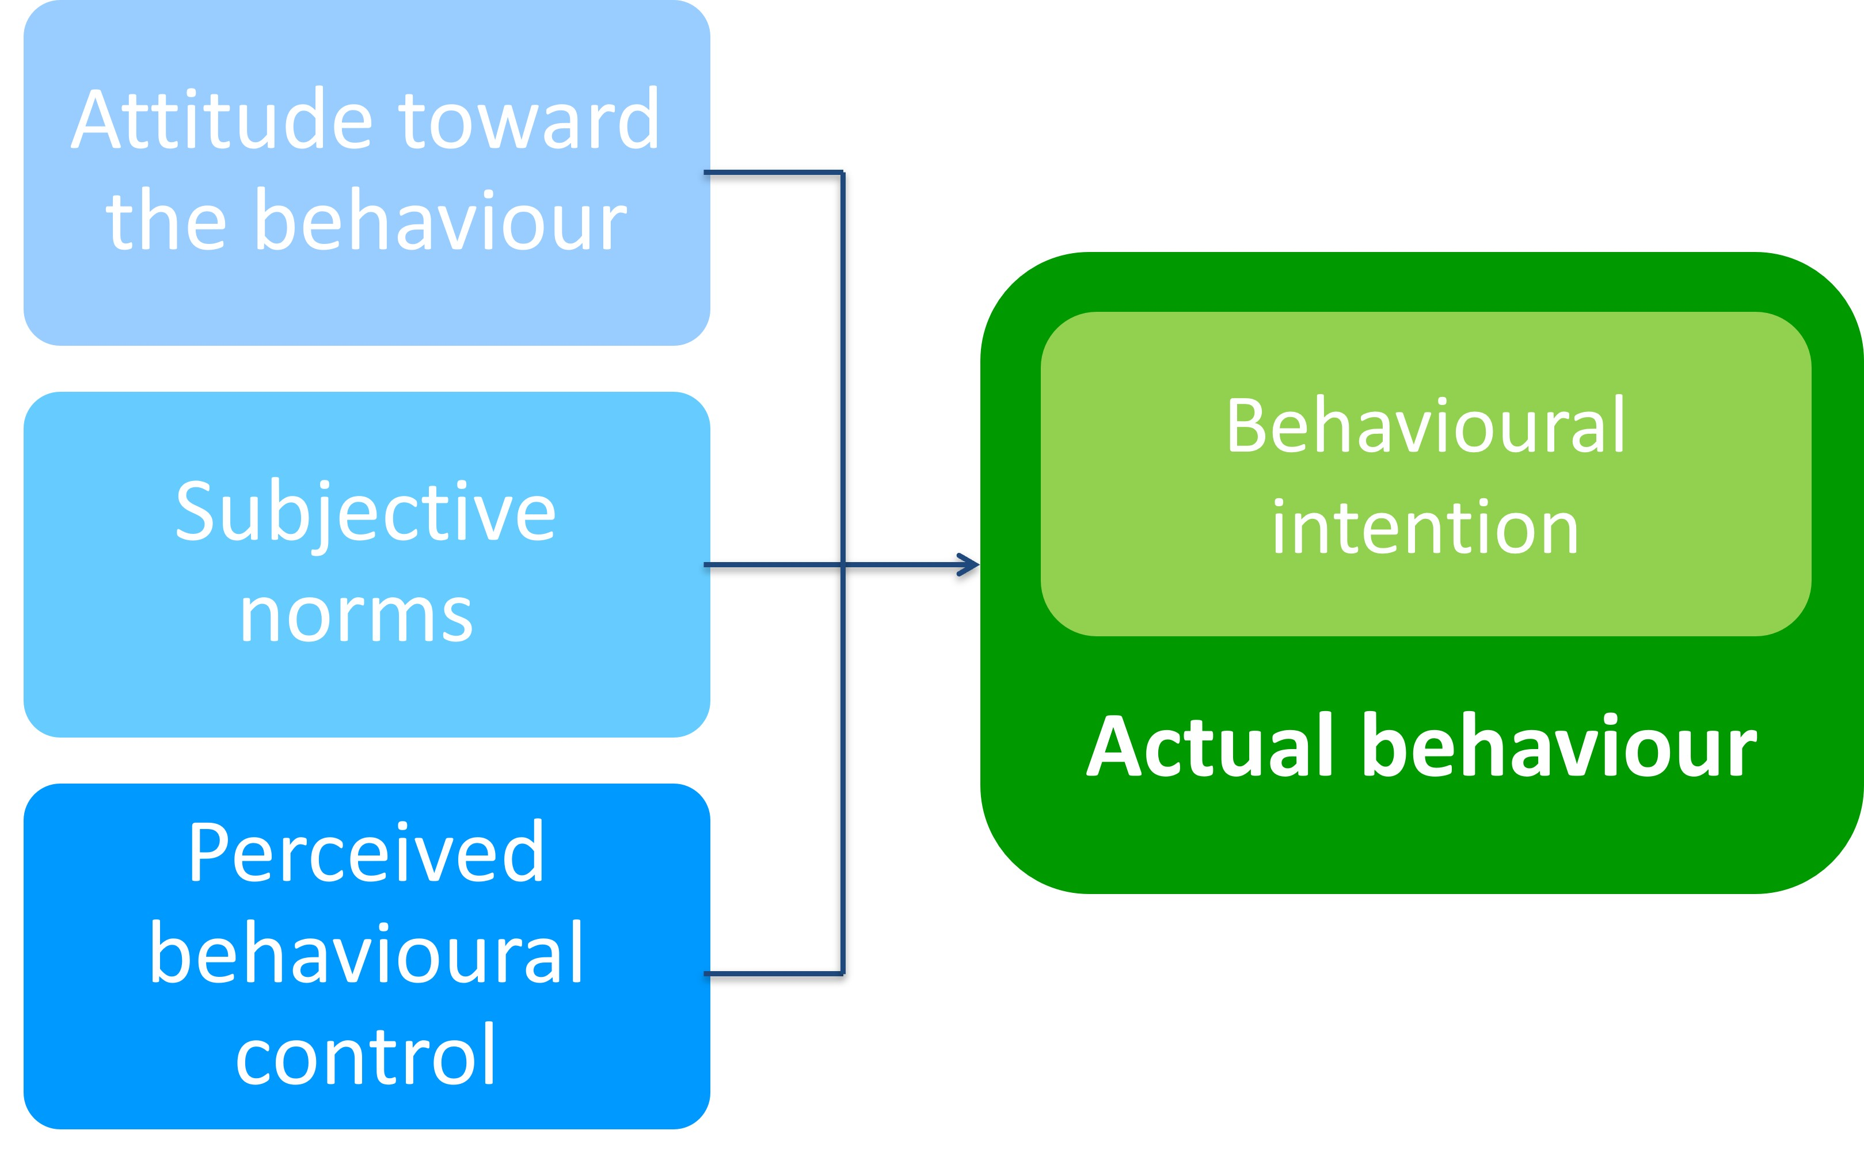
Theory of Planned Behavior (TPB)
Theory of Planned Behaviour links beliefs and behavior.
The TPB is often applied in contexts where we want to understand, predict, or influence intentional human behavior.
Icek Ajzen developed TPB in 1990s – 2010s.
Notes:
Brian speaking:
The Theory of Planned behaviour, developed by Ajzen, is a widely used framework for understanding how attitudes, intentions, and control shape human behaviour. It begins with the idea that the most immediate predictor of behaviour is a person’s intention to act. Intention itself is influenced by three key factors. The first is attitude toward the behaviour, meaning whether an individual views the action as positive or negative. The second is subjective norms, which reflect the perceived social pressure from family, friends, or society to perform or avoid the behaviour. The third is perceived behavioural control, which is the belief in one’s own ability to successfully carry out the action, even when obstacles exist. This sense of control not only shapes intention but can also directly affect behaviour. Together, these elements explain why some people follow through on health-related actions while others do not. The theory is particularly valuable for designing interventions, since it highlights the importance of addressing attitudes, strengthening supportive social norms, and increasing confidence and skills to perform the desired behaviour. The TPB is often applied in contexts where we want to understand, predict, or influence intentional human behaviour.

Slide 10
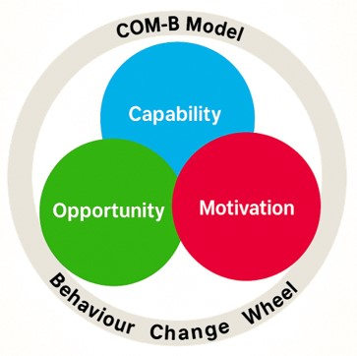
Behaviour Change Wheel, COM-B Model
The COM-B is a newer model used in behavior change interventions. COM-B is part of the Behavior Change Wheel, a framework for designing interventions.
Susan Michie introduced the COM-B Model, and the Behavior Change Wheel in the early 2010s and has continued to refine and expand them in subsequent years.
Notes:
Matilda speaking:
The Behaviour Change Wheel, developed by Susan Michie and colleagues, is a newer model designed to guide the development of behaviour change interventions. At the centre of the framework is the COM-B model, which proposes that three interacting components must be present for a behaviour to occur. The first is Capability, which refers to both the physical and psychological ability to perform the behaviour. The second is Opportunity, which describes the external social and environmental factors that make the behaviour possible or provide the right conditions for it. The third is Motivation, which includes the internal processes — such as conscious decisions, habits, or emotional responses — that energise and direct behaviour. These three elements influence one another dynamically, meaning that a change in one can affect the others and ultimately shape whether a behaviour is carried out. Surrounding COM-B, the behaviour Change Wheel provides a systematic way to design interventions and policies, linking the understanding of behaviour to practical strategies such as education, persuasion, incentives, or regulation. By combining theory with applied tools, it offers a comprehensive and flexible approach to creating effective and sustainable behaviour change.

Slide 11
Closing
Take home messages:
Recognize the complexity and challenge of behaviour change.
Notice that change is shaped by the whole lived life of the client.
The models and theories are tools that help us reflect, plan, and adapt our work as physiotherapists.
Notes:
Brian speaking:
It is important to recognise the complexity and challenge of behaviour change. For physiotherapists, understanding this complexity is not only about applying exercise programs or giving advice, but about appreciating that change is shaped by the whole lived life of the client. Every individual brings their own experiences, habits, social context, and personal struggles into the therapeutic process. For people living with obesity, this means acknowledging that barriers may not be limited to physical health, but also include social stigma, emotional well-being, and environmental constraints. By keeping this in mind, physiotherapists can better support clients with empathy, realistic goal setting, and strategies that address both motivation and real-life challenges. The models and theories presented here are not recipes, but tools that help us reflect, plan, and adapt our work. Ultimately, the value lies in combining theoretical knowledge with compassionate practice to guide patients toward sustainable and meaningful change.

Slide 12
Additional material for learning
Approaches to Behaviour Change (2019)
Health Belief Model: Definition & Examples (Easy explanation, 2025)
Transtheoretical Model of Behaviour Change (2013)
Self-Determination Theory (Explained in 3 minutes, 2024)
Social Cognitive Theory (Explained in 3 minutes, 2024)
Theory of Planned Behaviour, Introduction (2013)
COM-B Model: What is COM-B model? (2021)
Notes:
Brian: That brings us to the end of our session on behaviour change models.
Matilda: We hope this overview has given you useful insights for supporting people living with obesity in physiotherapy practice.
Brian: On this last slide, you’ll find additional links and resources if you’d like to explore the models in more depth.
Matilda: We encourage you to keep learning and reflecting, because every patient’s journey is unique.
Brian: Thank you for joining us — and best of luck in your continued practice and studies.
Approaches to Behaviour Change (NHS England Workforce, Training and Education, 2019)
Health Belief Model: Definition & Examples (Easy explanation; Social Science Explainer, 2025)
Transtheoretical Model of Behaviour Change (Nathan Smith, University of Birmingham, 2013)
Self-Determination Theory (Explained in 3 minutes; Helpful Professor Explains!, 2024)
Social Cognitive Theory (Explained in 3 minutes; Helpful Professor Explains!, 2024)
Theory of Planned Behaviour, Introduction (Nathan Smith, University of Birmingham, 2013)
COM-B Model: What is COM-B model? (Active Break, 2021)

Slide 13
References
Ajzen, I. (1991). The theory of planned behavior. Organizational Behavior and Human Decision Processes, 50(2), 179–211. https://doi.org/10.1016/0749-5978(91)90020-T
Ajzen, I. (2011). The theory of planned behaviour: Reactions and reflections. Psychology & Health, 26(9), 1113–1127. https://doi.org/10.1080/08870446.2011.613995
Bandura, A. (1977). Social learning theory. Englewood Cliffs, NJ: Prentice-Hall.
Bandura, A., & National Inst of Mental Health. (1986). Social foundations of thought and action: A social cognitive theory. Prentice-Hall, Inc.

Slide 14
Becker, M. H. (1974). The Health Belief Model and personal health behavior. Health Education Monographs, 2(4), 324–508. https://doi.org/10.1177/109019817400200407
Deci, E. L., & Ryan, R. M. (1985). Intrinsic motivation and self-determination in human behavior. New York, NY: Plenum. https://doi.org/10.1007/978-1-4899-2271-7
Michie, S., van Stralen, M. M., & West, R. (2011). The behaviour change wheel: A new method for characterising and designing behaviour change interventions. Implementation Science, 6(1), 42. https://doi.org/10.1186/1748-5908-6-42
Michie, S., Atkins, L., & West, R. (2014). The behaviour change wheel: A guide to designing interventions. London: Silverback Publishing.
Prochaska, J. O. (1979). Systems of psychotherapy: A transtheoretical analysis. Dorsey.

Slide 15
Prochaska, J. O., & Velicer, W. F. (1997). The transtheoretical model of health behavior change. American journal of health promotion : AJHP, 12(1), 38–48. https://doi.org/10.4278/0890-1171-12.1.38
Rosenstock, I. M. (1966). Why People Use Health Services. The Milbank Memorial Fund Quarterly, 44(3), 94–127. https://doi.org/10.2307/3348967
Ryan, R. M., & Deci, E. L. (2017). Self-determination theory: Basic psychological needs in motivation, development, and wellness. New York, NY: Guilford Press. https://doi.org/10.1521/978.14625/28806

Slide 16

This lecture was developed by physiotherapy senior lecturers at Tampere University of Applied Sciences in Finland for the Prominence Project, September 2025.
Voices of Matilda and Brian are developed by using elevenlabs.io text-to-speech generator (https://elevenlabs.io/app/home)
and picture of them by using Microsoft Copilot AI (https://copilot.Microsoft.com).

