Slide 1
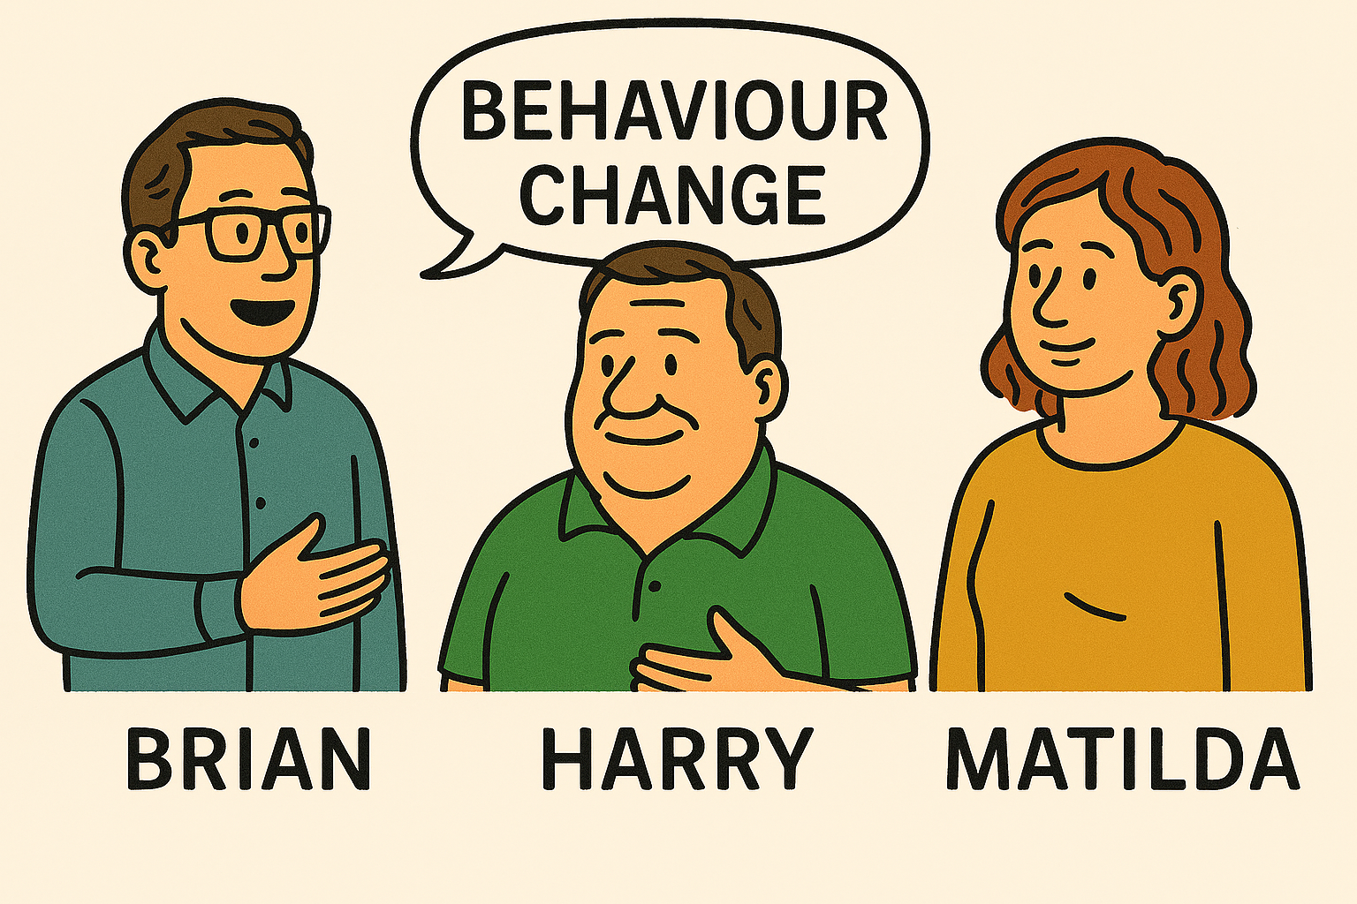
Podcast Series
Physiotherapy and Behaviour Change in People Living with Obesity
These podcast were developed by senior lecturers at Tampere University of Applied Sciences in Finland for the Prominence Project, September 2025

Slide 2
Table of Contents
Episode 1: Physiotherapists’ Role in Behaviour Change, 5 min
Episode 2: Stigma in Healthcare, 3 min
Episode 3: Motivational Interviewing and the 5A Model, 5 min
Episode 4: From Small Wins to Big Progress, 4 min
Episode 5: From Theoretical Models into Practical Physiotherapy, 6 min

Slide 3
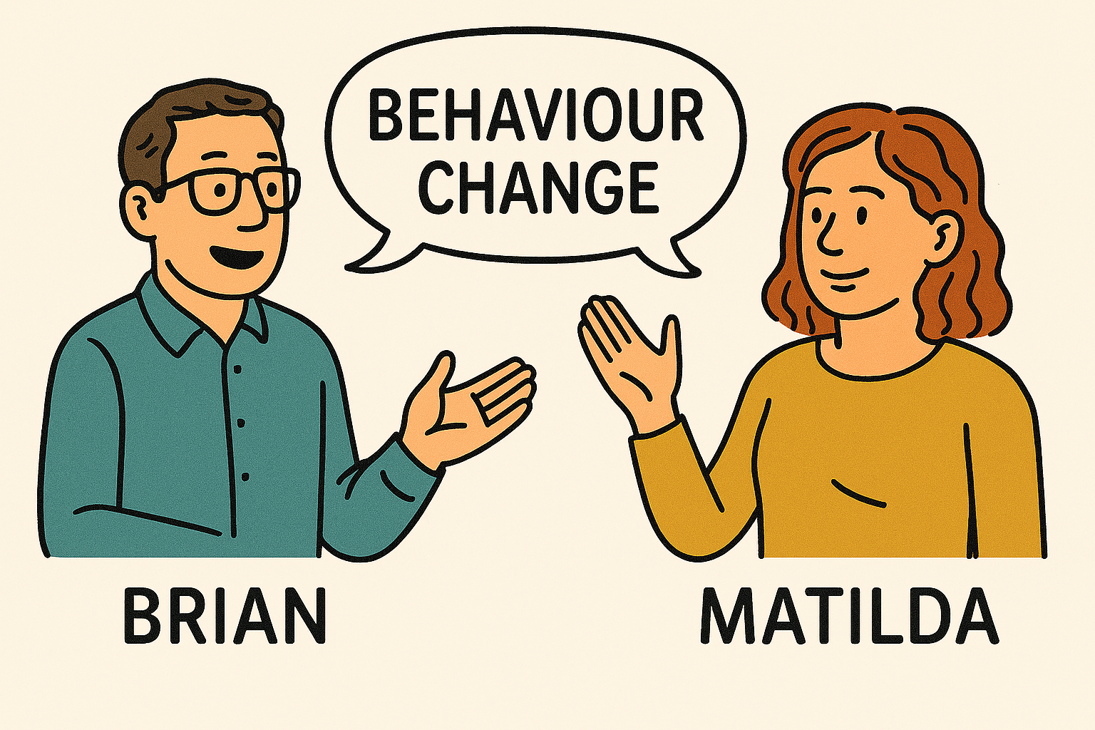

Episode 1:
Physiotherapists’ Role in Behaviour Change
In this episode, Brian and Matilda explore key theories such as the Health Belief Model, Transtheoretical Model, Self-Determination Theory, Social Cognitive Theory, Theory of Planned Behaviour, and COM-B.
The main point: these models are not rigid recipes but tools to understand the complexity of behaviour change. For physiotherapists, they highlight factors like motivation, confidence, and environment that influence a client’s journey.
Duration: 5 min

Slide 4
Episode 2:
Stigma in Healthcare
In this conversation with Harry, who lives with obesity and metabolic syndrome, the focus turns to the role of stigma in healthcare.
Harry share his experiences of living with obesity and facing stigma. Stigma creates barriers by making clients feel judged, dismissed, or unwelcome. The lesson: physiotherapists must see the person, not the weight. Respect, empathy, and listening are essential for building trust and supporting engagement.
Duration 3 min

Slide 5
Episode 3:
Motivational Interviewing and the 5A Model
In this episode, Brian and Matilda introduce Motivational Interviewing (MI) as a client-centred communication style, and the 5A model (Ask, Advise, Assess, Assist, Arrange) as a structured framework.
Combined, they help physiotherapists guide conversations with empathy, collaboration, and respect. This approach fosters ownership and increases the likelihood of lasting change.
Duration 5 min

Slide 6
Episode 4:
From Small Wins to Big Progress
This episode highlights the critical role physiotherapists play in supporting clients living with obesity through realistic and meaningful goal-setting.
Meaningful goals provide direction, while small steps make progress achievable. Linking goals to what matters most in a client’s life strengthens motivation and self-efficacy. Physiotherapists should celebrate every small success, reinforce progress and build momentum toward sustainable change.
Duration 4 min

Slide 7
Episode 5:
From Theoretical Models into Practical Physiotherapy
In this final episode, Brian, Matilda and Harry discuss about practical meaning of theoretical models of behaviour change. They revisit all key lessons: theory as a lens, empathy as a foundation, communication as a tool, goals as a guide, and small steps as the path forward.
Their take-home message is that physiotherapists are not just prescribing treatment but walking alongside clients, reducing stigma, fostering trust, and supporting meaningful, sustainable change.
Duration 6 min

Slide 8

These podcasts were developed by physiotherapy senior lecturers at Tampere University of Applied Sciences in Finland for the Prominence Project, September 2025.
ChatGPT was used to modify theories into discussion (https://chatgpt.com).
Voices of Matilda, Brian and Harry are developed by using elevenlabs.io text-to-speech generator (https://elevenlabs.io/app/home)
and picture of them by using Microsoft Copilot AI (https://copilot.Microsoft.com).

