Slide 1
Student preparation
Before this practical introduction and workshop, it is recommended that the students read and watch the following:
1. Physical activity recommendations for people with overweight and obesity:
EUPAP FYSS-short (page 56 -57)¹
2. Introduction to the trans-theoretical model: https://www.youtube.com/watch?v=oO80XyBDrl0
3. Introduction to the social-cognitive theory: Social Cognitive Theory (Explained in 3 Minutes)
¹ Public Health Agency of Sweden, on behalf of the EUPAP Consortium. FYSS-short – Physical Activity in the Prevention and Treatment of Disease. Eds: Emtner M, Hagströmer M, Jansson E (YFA) and coordinating editor Friberg M (Public Health Agency of Sweden). Solna: Public Health Agency of Sweden, 2019.
1

Slide 2

Physical Activity on Prescription (PAP) tailored to people with overweight and obesity: - a practical introduction and workshop
This lecture was developed by researchers at Mälardalen University in Sweden for the Prominence Project, August 2025
2

Slide 3
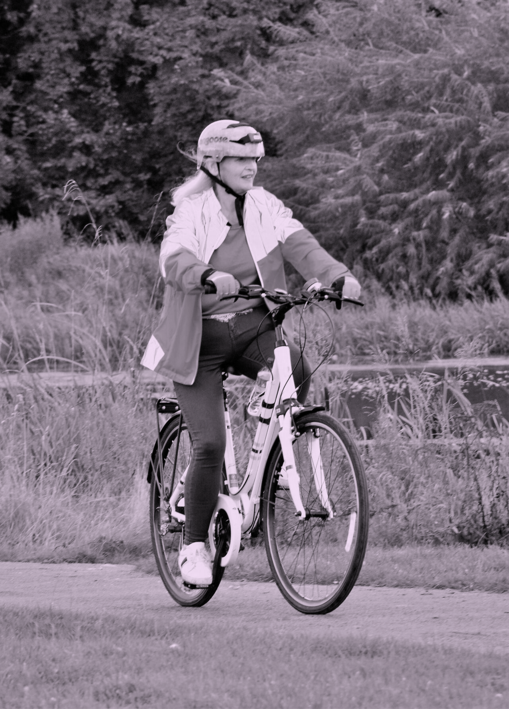
Objectives
Introduction to Physical Activity on Prescription (PAP)
Practice prescribing PAP to individuals with overweight and obesity
Practice to tailor physical activity to individuals' needs and motivation
Reflect on communication and interaction skills
Reflect on how PAP can be applied in your own professional context
3

Slide 4

Overview of content
1. Introduction to PAP
2. Role play exercise
Practices prescribing PAP
Group reflection
3. Provided materials & recommended literature/references
4

Slide 5
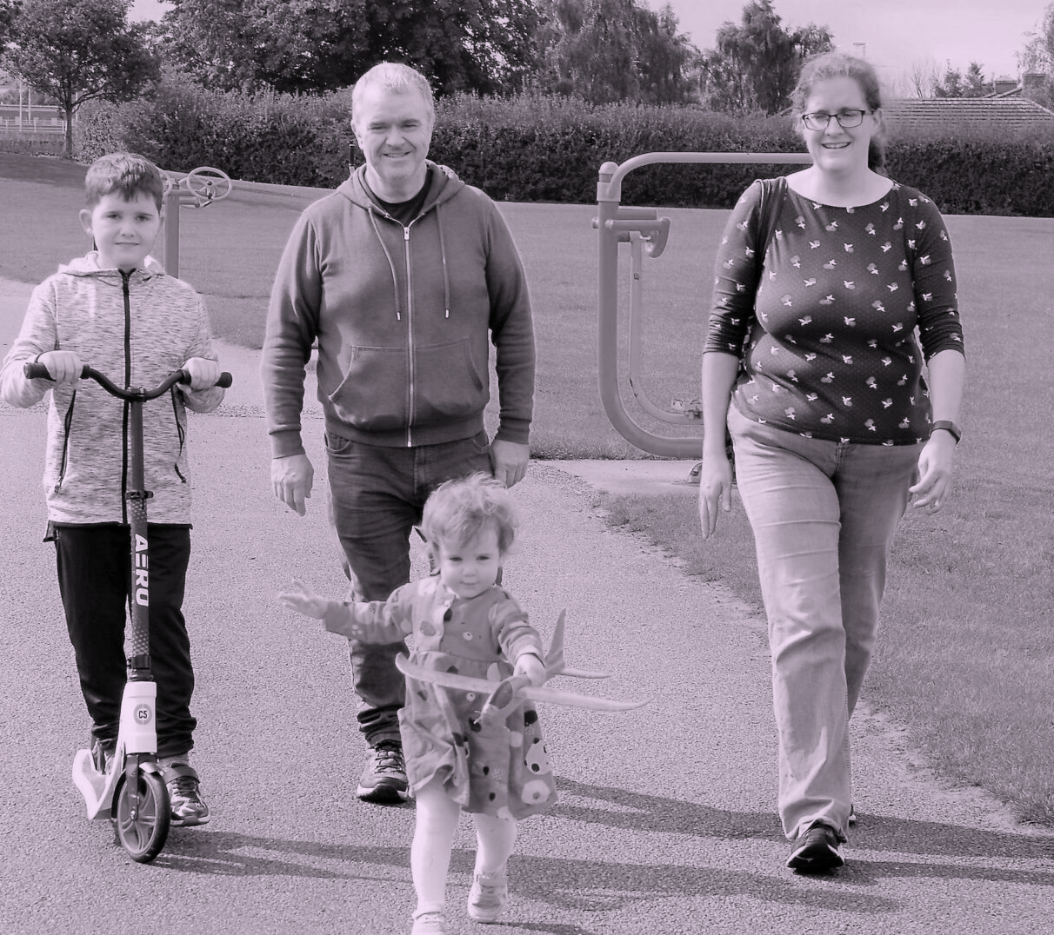

Part 1. 1.1 Introduction to Physical Activity on Prescription (PAP)
5

Slide 6
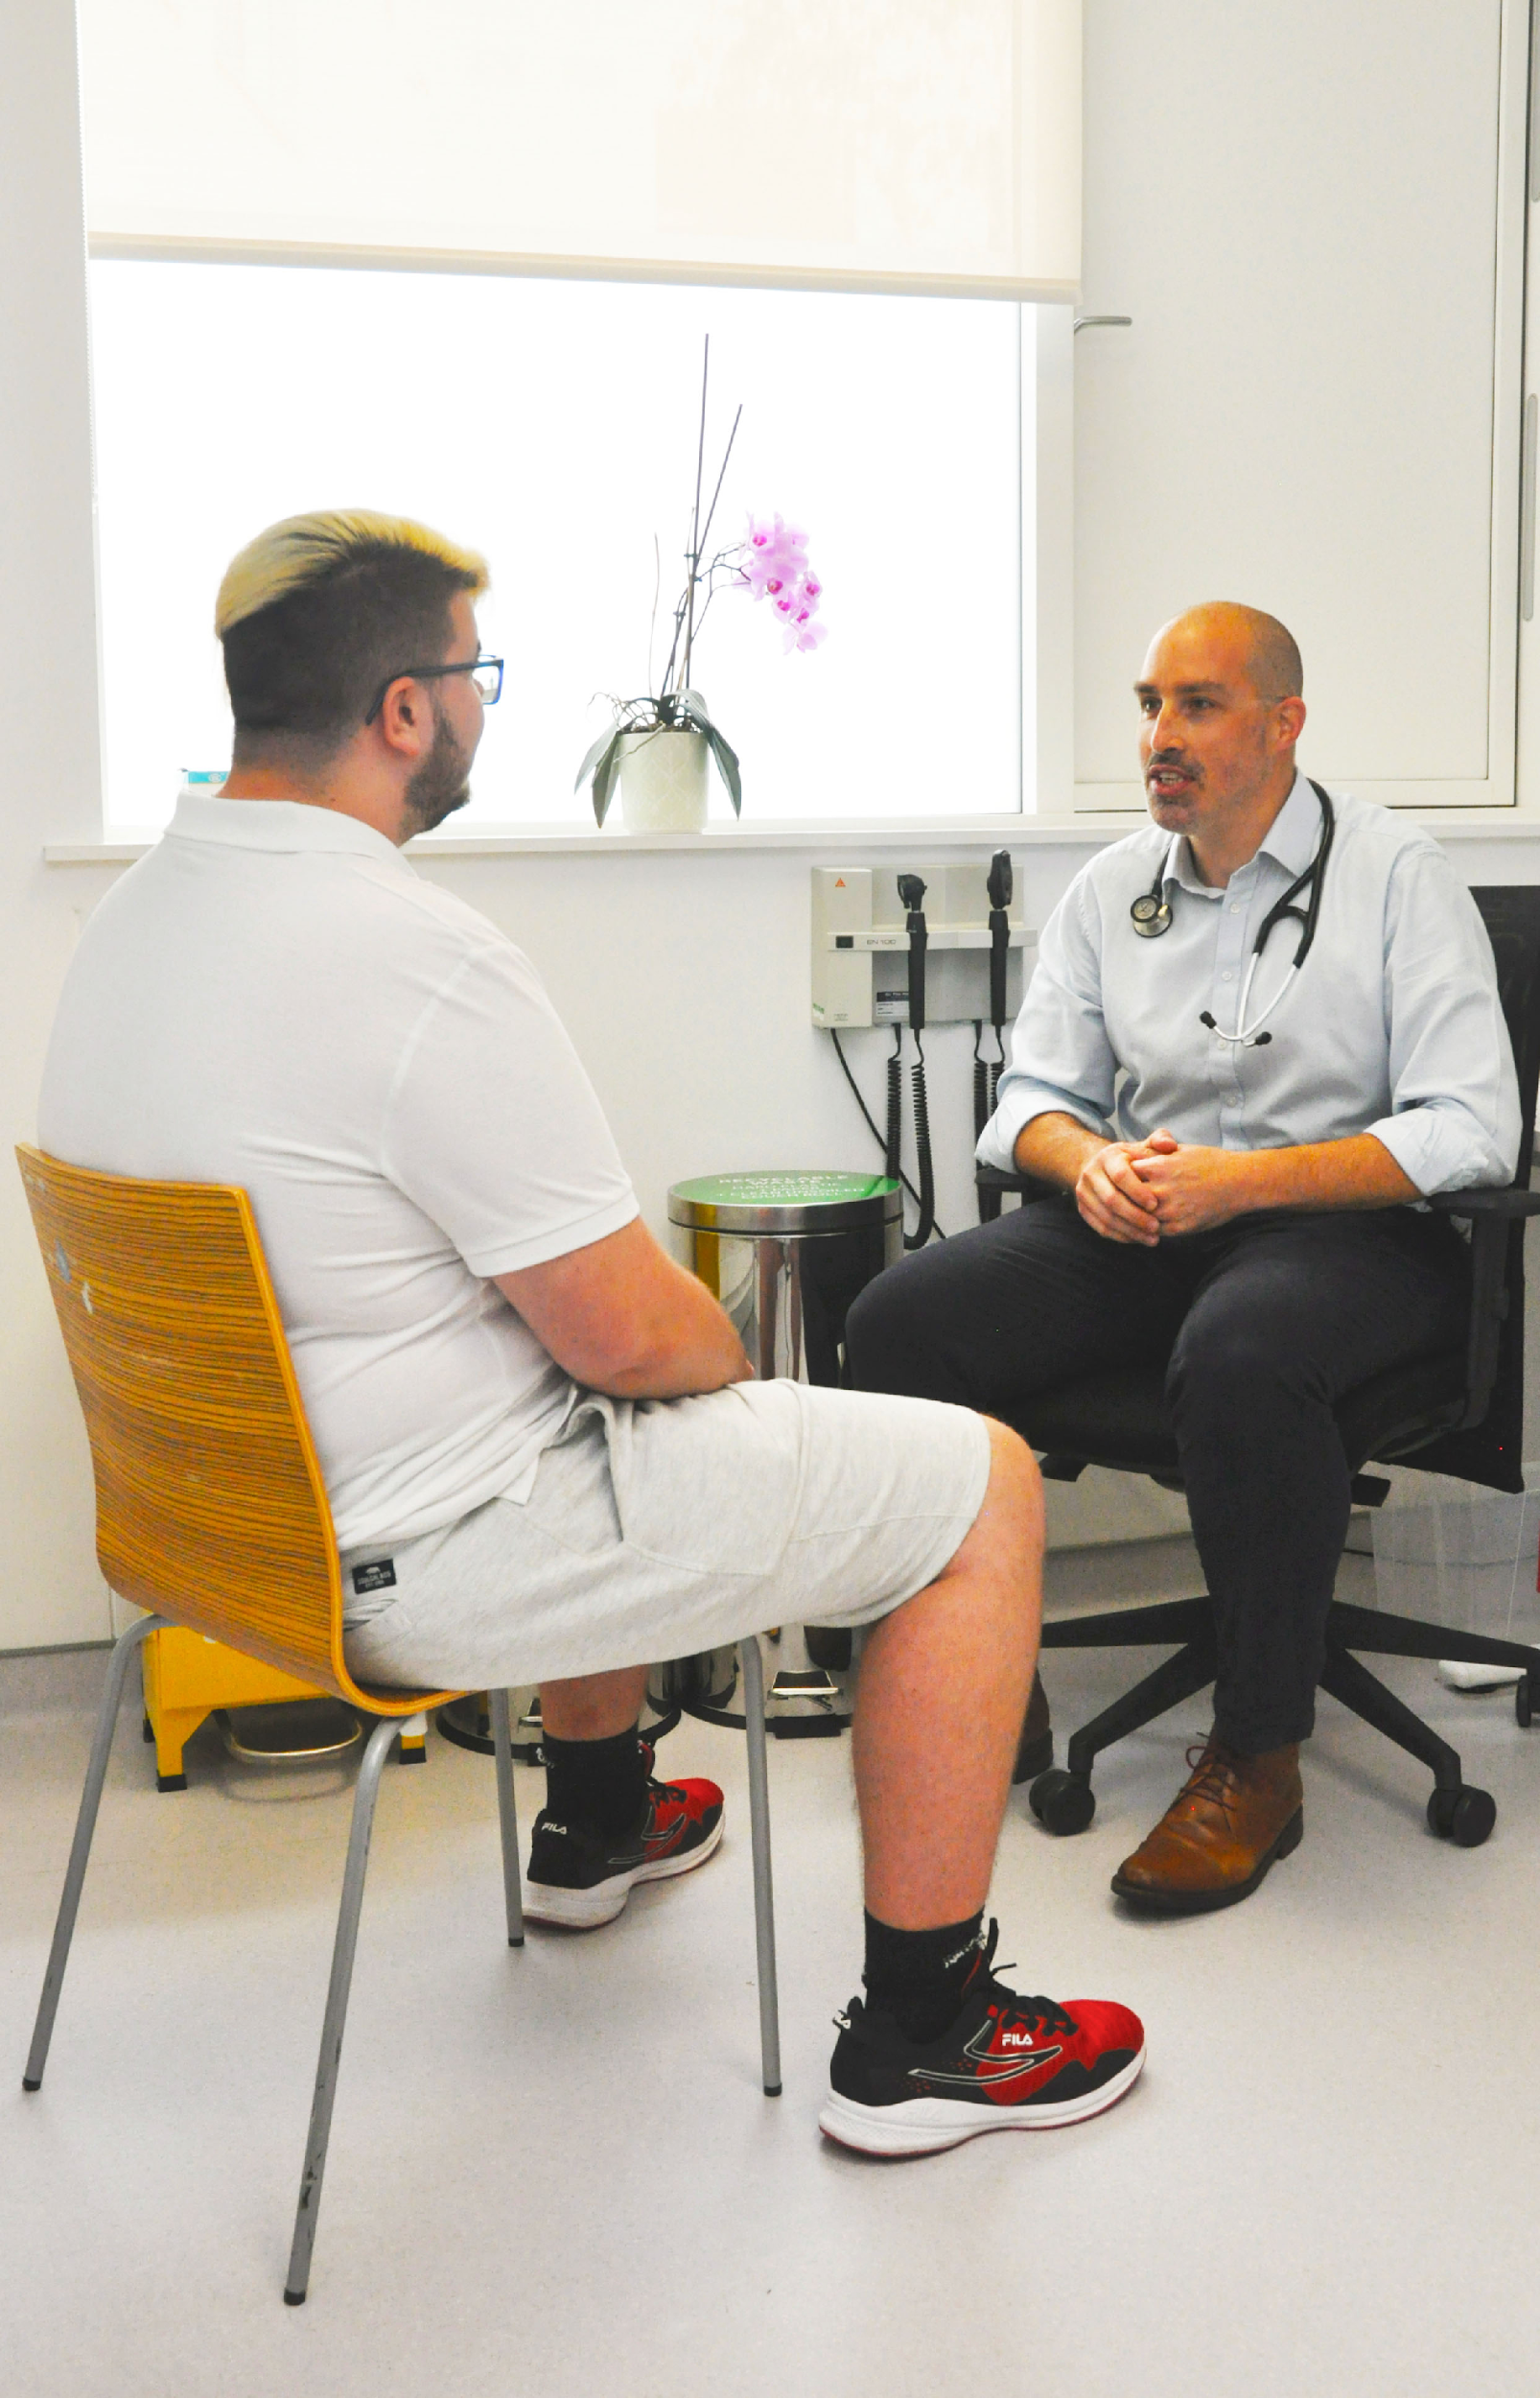



Part 1. 1.2 Introduction to Physical Activity on Prescription (PAP)
Person-centred
A written prescription
Individual consultation
Follow-up
6

Slide 7

Part 1. 1.3 Introduction to Physical Activity on Prescription (PAP)
Person-centred
A written prescription
Individual consultation
Follow-up
Evidence-based
7

Slide 8
Part 1. 1.4 Introduction to Physical Activity on Prescription (PAP)
Aim:
To increase the motivation for physical activity
To increase the physical activity level
8

Slide 9
Part 1. 1.5 Introduction to Physical Activity on Prescription (PAP)
Theoretical frameworks
Social cognitive theory
Trans-theoretical model
Personal factors
Environmental factors
Behaviour
Pre-contemplation
Contemplation
Preparation/ determination
Action
Maintenance
9

Slide 10

1
2
3
Part 1. 1.6 Introduction to Physical Activity on Prescription (PAP)
The 3 core components
of PAP
Individual
consultation
PA with a written prescription
Individualised follow-up
Person-centred perspective
10

Slide 11

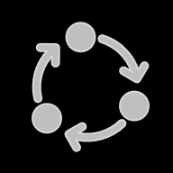
1
3
2
Part 1. 1.7 Introduction to Physical Activity on Prescription (PAP)
The 3 core components
of PAP
Individual
consultation
PA with a written prescription
Individualised follow-up
Person-centred perspective
11

Slide 12

1
3
2
Part 1. 1.8 Introduction to Physical Activity on Prescription (PAP)
The 3 core components
of PAP
Individual
consultation
PA with a written prescription
Individualised follow-up
Evidence-based
Person-centred perspective
12

Slide 13
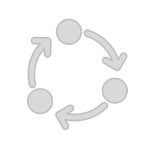
1
3
2
Part 1. 1.9 Introduction to Physical Activity on Prescription (PAP)
The 3 core components
of PAP
Individual
consultation
PA with a written prescription
Individualised follow-up
Evidence-based
Person-centred perspective
13

Slide 14

Part 1. 1.10 Introduction to Physical Activity on Prescription (PAP)
Does it work?
Increased physical activity levels
Decreased sedentary time
Reduce cardio metabolic risk factors
Improves quality of life
Best practice according to the WHO and the EU
14

Slide 15
Part 1. 1.11 Introduction to Physical Activity on Prescription (PAP)
Does it work?
- Positive attitude towards PAP among patient
85-95% of the patients who have gotten
a prescription are positive towards PAP
- Higher compliance for PAP
compared to long-term drug treatment
Long term drug treatment compliance in Sweden: 50%
PAP compliance in Sweden: up to 73%
15

Slide 16
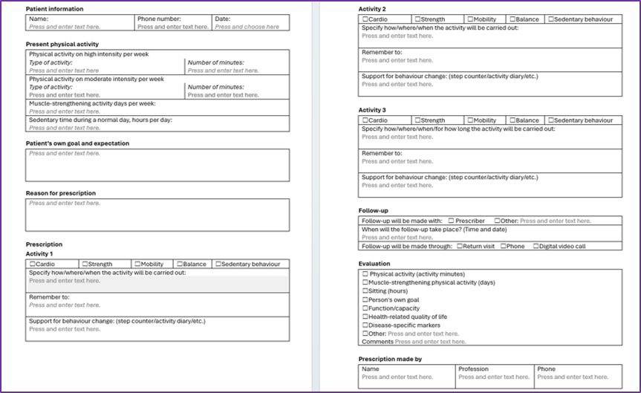
Part 1. 1.12 Introduction to Physical Activity on Prescription (PAP) An example of the PAP template
16

Slide 17
Part 1. 1.13 Introduction to Physical Activity on Prescription (PAP) An example of the PAP template
17

Slide 18
Part 1. 1.14 Introduction to Physical Activity on Prescription (PAP) An example of the PAP template
18

Slide 19
Part 1. 1.15 Introduction to Physical Activity on Prescription (PAP) An example of the PAP template
19

Slide 20
Part 1. 1.16 Introduction to Physical Activity on Prescription (PAP)
PAP is more than just writing a prescription
The conversation is central:
- Building trust and tailoring the activity to the individual
- Evidence-based choices strengthen the intervention
- Support and follow-up are key to long-term behaviour change
20

Slide 21
Part 2. The role play exercise
21

Slide 22
Part 2. The role play exercise
2.1 Structure
Divide into groups of three
One physiotherapist (PT)
One patient
One observer
Each participant will rotate through all roles (PT, patient, observer)
10 minutes per role +5 minutes small group reflection → 45 minutes total
Patient: Use a provided case (or create own)
Physiotherapist: Leads a structured conversation aiming to create a PAP prescription and set goals with the patient using the PAP-template
Observer: Manages time and uses a checklist to note:
How the patients own motivation is supported
If goals are set, how concrete and realistic are they
Something good the PT said/something that the PT can say in a different way in the future
22

Slide 23
Part 2. The role play exercise
2.2 Small group reflection
After each role is played, reflect in the small groups of three in 5 minutes:
How was it to play the PT?
How was it to be the patient?
What did you notice as an observer?
What went well in this specific conversation?
Was there something that was difficult?
Could something have been done differently?
How well was the prescription adapted to the patients’ needs, motivation and circumstances?
23

Slide 24
Part 2. The role play exercise
2.3 Whole group discussion
After everyone has played each role, gather and reflect in the whole group for 15 minutes:
1. What was the most challenging aspect of your role as the physiotherapist?
2. What will you take with you into future meetings with real patients with obesity?
3. How can you further improve your ability to support lifestyle changes?
4. How can you apply the concept of Physical Activity on Prescription in a clinical context you have worked/are working in?
24

Slide 25
Part 3. Provided materials
3.1 Patient cases
3.2 PAP-template
3.3 References/Literature recommendations
25

Slide 26
Part 3. Provided material 3.1 Patient cases
Nora, 73 years old
Nora is a retired librarian, 73 years old, living in a suburban area with her husband. She enjoys reading, visiting museums, and spending time with her grandchildren. Although she occasionally goes for short walks, her activity level has decreased since retirement. She has never considered herself athletic but appreciates being outdoors. Her BMI is 33, and she has been diagnosed with prediabetes and mildly elevated blood pressure. Nora has tried many dieting methods without success. Her goals are to stay mobile and independent, prevent further health decline, and remain able to travel with her husband. Her motivation is high, but she feels uncertain about how to get started.
Marko, 33 years old
Marko is a 33-year-old IT technician working full-time in the public sector. He lives alone in a mid-sized town and has struggled with overweight since childhood. Although he has tried several diets over the years, he has never received long-term support focused on physical activity. His job is sedentary, and in his free time he enjoys gaming and watching football. His BMI is 35. He often feels tired after work. His older brother has type 2 diabetes, which Marko sees as a warning sign. Marko's goal is to feel more energetic in daily life and reduce his risk of future illness. His motivation is low; he finds it hard to imagine himself as someone who exercises.
Sofia, 45 years old4
Sofia is 45 years old and works part-time as a preschool teacher. She is a single mother of two and describes her life as constantly busy. Over the past ten years, she has gradually gained weight, especially after the birth of her children. She does not prioritise physical activity in her spare time due to fatigue and lack of time. Her BMI is 31. Sofia used to attend dance classes before becoming a parent and still enjoys music and movement but does not feel comfortable going to a gym. Her main goal is to feel stronger and have more energy, and she wants to be a good role model for her children. Her motivation is moderate—she wants to make a change but is unsure how to find the time or energy.
26

Slide 27
Physical Activity on Prescption (PAP)
Part 3. Provided material 3.2 The PAP template
27

Slide 28
Part 3. Provided material 3.3 References
WHOs information on obesity and overweight: Obesity and overweight
WHO guidelines on physical activity and sedentary behaviour: at a glance: WHO guidelines on physical activity and sedentary behaviour: at a glance
Björk, M., & Bernhardsson, S. (2024). Physical activity on prescription in Swedish primary care: a survey on use, views, and implementation determinants amongst general practitioners. Scandinavian journal of primary health care, 42(1), 61–71. https://doi.org/10.1080/02813432.2023.2288126
Rödjer, L., H. Jonsdottir, I., & Börjesson, M. (2016). Physical activity on prescription (PAP): self-reported physical activity and quality of life in a Swedish primary care population, 2-year follow-up. Scandinavian Journal of Primary Health Care, 34(4), 443–452. https://doi.org/10.1080/02813432.2016.1253820
Lundqvist, S., Börjesson, M., Larsson, M. E. H., Cider, Å., & Hagberg, L. (2019). Which patients benefit from physical activity on prescription (PAP)? A prospective observational analysis of factors that predict increased physical activity. BMC public health, 19(1), 482. https://doi.org/10.1186/s12889-019-6830-1
Onerup A, Arvidsson D, Blomqvist Å, et al
Physical activity on prescription in accordance with the Swedish model increases physical activity: a systematic review
British Journal of Sports Medicine 2019;53:383-388.
Public documents - The Public Health Agency of Sweden
https://www.folkhalsomyndigheten.se/contentassets/e7bed29b2a7c44c4865395bb08bf0158/physical-activity-prescription-sweden.pdf
28

Slide 29
This lecture was developed by researchers at the Physiotherapy Department at Mälardalen University in Sweden for the Prominence project.
Recorded by Johanna Zetterlund, B Physio, MSc, PhD,
Mälardalen University, Sweden
29

