Slide 1

Exercise prescription in adults with obesity
prof. dr. Dominique Hansen – Hasselt University

Slide 2

Table of Contents
Will any exercise do the job?
Precision exercise prescription for adults with obesity
Case study
References

Slide 3

Will any exercise do the job?

Slide 4
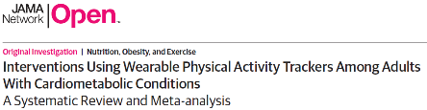
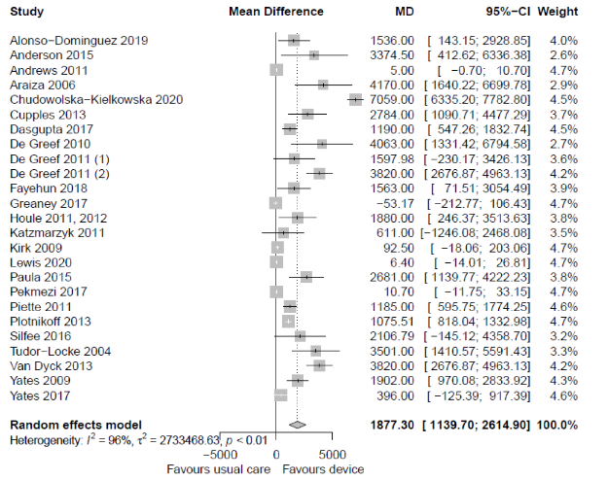
Will any exercise do?
There were no associations of wearable activity tracker interventions with:
systolic nor diastolic blood pressure
total cholesterol, high-density nor low-density lipoprotein cholesterol level
body weight nor body mass index
Only minor impact on glycaemic control (glycated haemoglobin)
Hodkinson A, et al. JAMA Netw Open. 2021 Jul 1;4(7):e2116382.

Slide 5
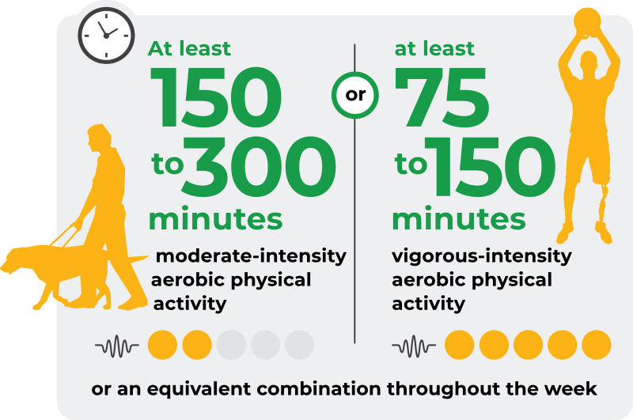


What do guidelines say on exercise in obesity?
General adult population
Individuals with overweight or obesity
‘All scientific guidelines recommend that at least 150 min/week of moderate aerobic exercise (such as brisk walking) should be combined with three weekly sessions of resistance exercise to increase muscle strength.’
Yumuk V, et al; Obes Facts. 2015;8:402-24.
Oppert, J. M., et al. Obes Rev. 2021:22 Suppl 4, e13273.

Slide 6
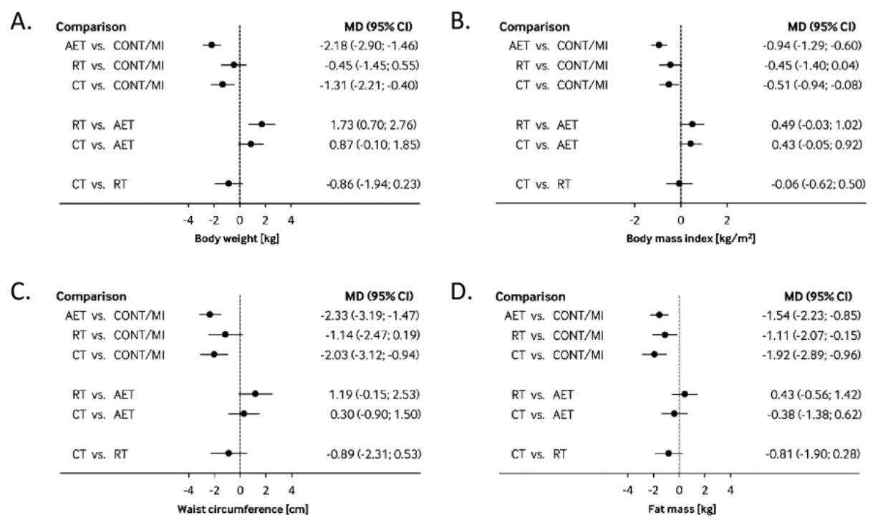
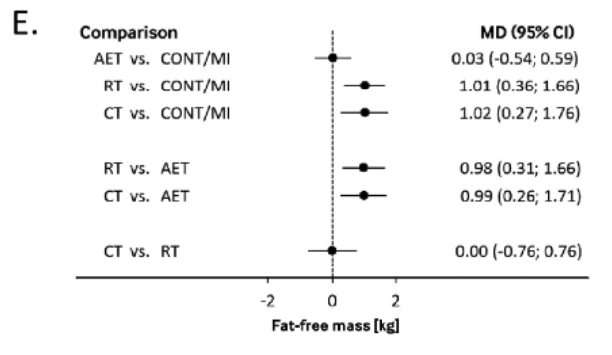
Does it work?
32 randomised controlled trials
4774 individuals with overweight/obesity
>6 months of interventions
AET: aerobic exercise training
RT: resistance exercise training
CT: combined training
MI: minimal intervention
CONT: control (no intervention)
Body weight (kg)
Body mass index (kg/m²)
Waist circumference (cm)
Fat mass (kg)
Fat-free mass (kg)
Morze J, et al. Obes Rev. 2021;22:e13218.

Slide 7
Precision exercise prescription for adults with obesity

Slide 8
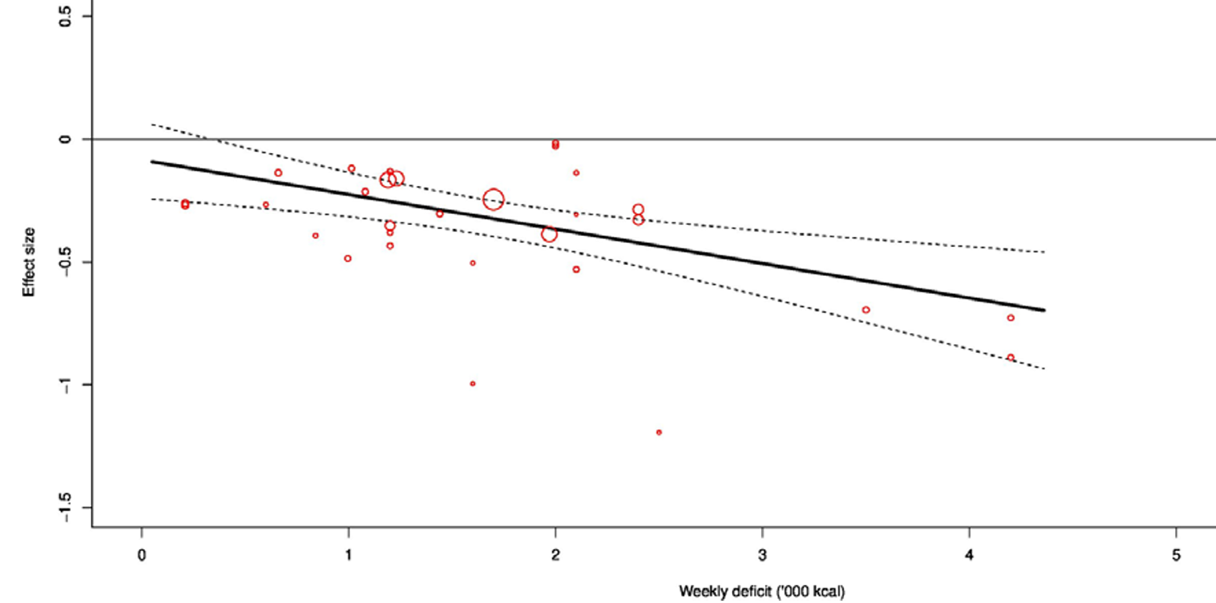
The (hard) road to clinically meaningful fat mass loss…
Exercise demonstrated a dose–response effect of −0.15 ((−0.23 to −0.07) on visceral fat mass per 1000 calories deficit per week
Clinically meaningful and detectable reduction in visceral fat mass is noticed at >2000 kcal/week of exercise-related energy expenditure
Recchia F, et al. Br J Sports Med. 2023;57:1035-41.

Slide 9
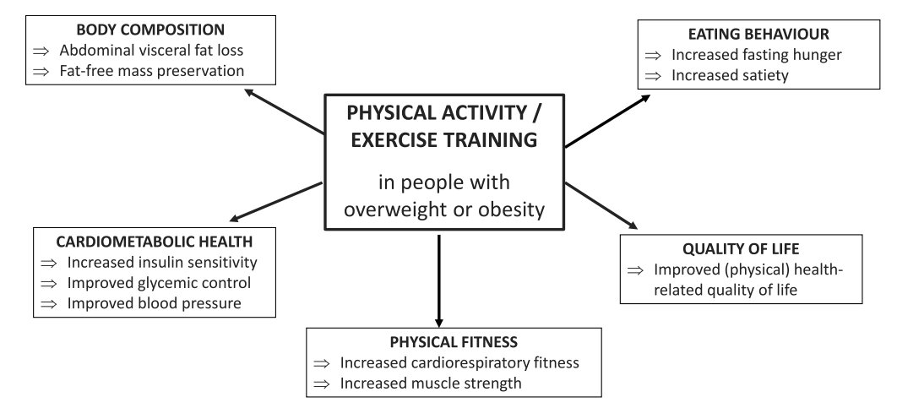
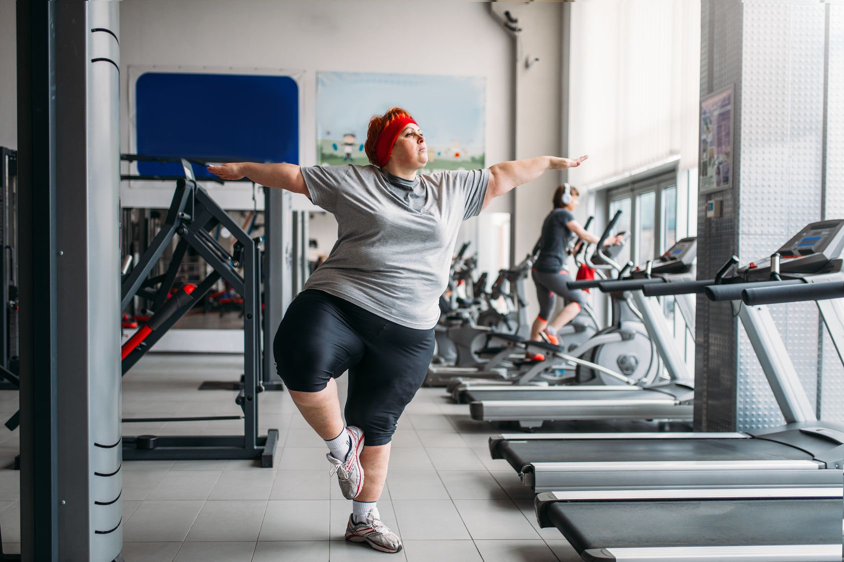
True role of exercise in adult obesity and what should be the content?
Oppert, J. M., et al. Int J Obes. 2025;49(2), 211–213 Verboven K, et al. Sports Med. 2021;51(3):379-89.

Slide 10
Targeted exercise in adult obesity
1. based on CVD risk & physical fitness:
exercise intolerance: HIIT (short term), high-volume endurance (long term)
dyslipidaemia: endurance exercise (>1200 kCal/week)
hypertension: endurance exercise (≥moderate intensity; ≥30-40min/session)
type 2 diabetes: endurance exercise (>250 min/week, 5-7 days/week)
resistance exercise (high volume: >21 sets)
muscle wasting/weakness: resistance exercise (higher intensity)
Hansen D, et al. Sports Med. 2018;48:1781-97 Hansen D, et al. Sports Med. 2023;53:2013-37.

Slide 11
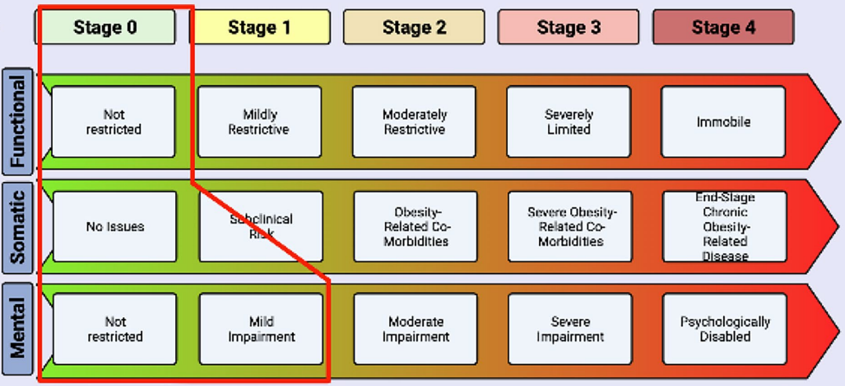
Tailored exercise in adult obesity
2. based on patient needs, consideration of safety precautions:
(including level of supervision)
Functional
Somatic
Mental
lower body joint pain
muscle pain
fatigue
limited endurance
inability to climb stairs
poor sleep
low strength
obstructive sleep apnea
high blood pressure
fatty liver
glucose dysregulation
low sex hormones
poor wound healing
low immune function
increased stress
increased nociception
depression
anxiety
hopelessness
poor memory
Edmonton Obesity Staging System
Sharma AM, et al. Int J Obes (Lond). 2009;33:289-95
Mathis BJ, et al. Current obesity reports. 2023;12(1), 36–60

Slide 12
Precision exercise prescription in adult obesity Case study

Slide 13

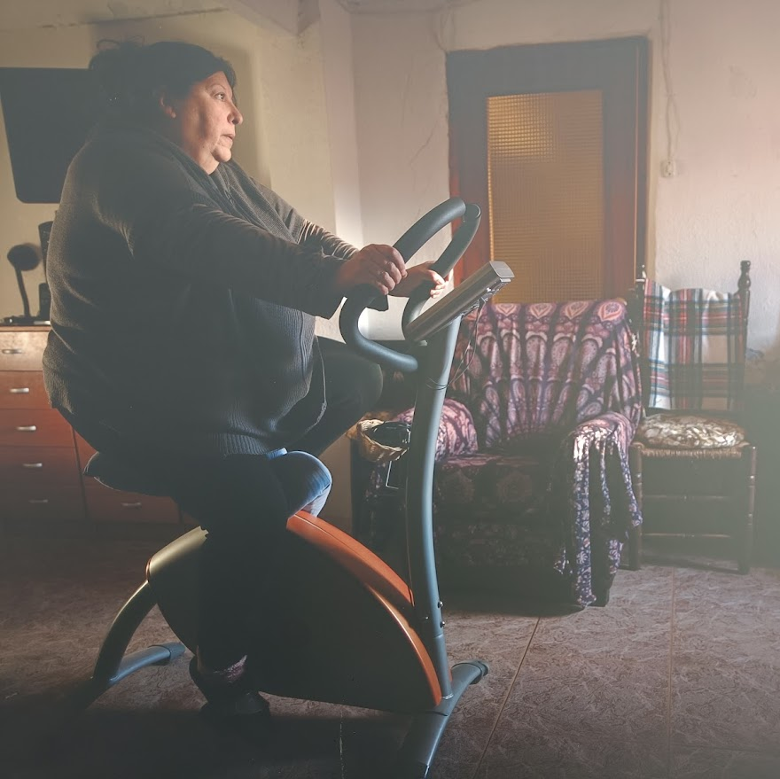

Case example
Age – 55 years
Height – 160 cm
Weight – 85 kg
Sex – female
VO_{2max} – 1600 ml/min, 18.8 ml/kg/min (108% predicted norm)
Resting heart rate – 102 bpm
Peak exercise heart rate – 151 bpm
Total cholesterol – 267 mg/dL
Fasting glucose – 108 mg/dL
Blood pressure – 115/72 mmHg
Medication intake – statin, ACE-inhibitor, orlistat, antiplatelet, metformin, sulfonylurea

Slide 14
Case example
At least 30 min of moderate-intensity endurance exercise for 5 days/week & moderate-intensity resistance exercise for 2-3 days/week (12-15 reps/set, 6-8 sets)
One size fits all approach
Tailored prescription
Obesity → aim to reach >2000 kcal/week by endurance training
Dysglycaemia → reach a sufficient aerobic exercise volume (>250 min/week) by a high exercise frequency (>5 days/week), add-in high-volume resistance exercise training (>7 muscle groups, with 3 sets/muscle group)
Dyslipidaemia → reaching an exercise volume of >1200 kcal/week & combine endurance + resistance exercise training
Hypertension → endurance training session should be sufficiently long (>30 min) & intense (≥ moderate-intense)
Safety precautions: sulfonylurea - execute glycaemia monitoring and/or consider carbohydrate intake during exercise
Hansen D, et al. Sports Med. 2018;48:1781-97 Hansen D, et al. Sports Med. 2023;53:2013-37.

Slide 15
References
Hansen, D., Niebauer, J., Cornelissen, V., Barna, O., Neunhäuserer, D., Stettler, C., Tonoli, C., Greco, E., Fagard, R., Coninx, K., Vanhees, L., Piepoli, M. F., Pedretti, R., Ruiz, G. R., Corrà, U., Schmid, J. P., Davos, C. H., Edelmann, F., Abreu, A., Rauch, B., … Dendale, P. (2018). Exercise Prescription in Patients with Different Combinations of Cardiovascular Disease Risk Factors: A Consensus Statement from the EXPERT Working Group. Sports Medicine, 48(8), 1781–1797.
Hansen, D., Beckers, P., Neunhäuserer, D., Bjarnason-Wehrens, B., Piepoli, M. F., Rauch, B., Völler, H., Corrà, U., Garcia-Porrero, E., Schmid, J. P., Lamotte, M., Doherty, P., Reibis, R., Niebauer, J., Dendale, P., Davos, C. H., Kouidi, E., Spruit, M. A., Vanhees, L., Cornelissen, V., … Coninx, K. (2023). Standardised Exercise Prescription for Patients with Chronic Coronary Syndrome and/or Heart Failure: A Consensus Statement from the EXPERT Working Group. Sports Medicine, 53(11), 2013–2037.
Hodkinson, A., Kontopantelis, E., Adeniji, C., van Marwijk, H., McMillian, B., Bower, P., & Panagioti, M. (2021). Interventions Using Wearable Physical Activity Trackers Among Adults With Cardiometabolic Conditions: A Systematic Review and Meta-analysis. JAMA network open, 4(7), e2116382.
Mathis, B. J., Tanaka, K., & Hiramatsu, Y. (2023). Metabolically Healthy Obesity: Are Interventions Useful?. Current obesity reports, 12(1), 36–60.
Morze, J., Rücker, G., Danielewicz, A., Przybyłowicz, K., Neuenschwander, M., Schlesinger, S., & Schwingshackl, L. (2021). Impact of different training modalities on anthropometric outcomes in patients with obesity: A systematic review and network meta-analysis. Obesity reviews, 22(7), e13218.
Oppert, J. M., Bellicha, A., van Baak, M. A., Battista, F., Beaulieu, K., Blundell, J. E., Carraça, E. V., Encantado, J., Ermolao, A., Pramono, A., Farpour-Lambert, N., Woodward, E., Dicker, D., & Busetto, L. (2021). Exercise training in the management of overweight and obesity in adults: Synthesis of the evidence and recommendations from the European Association for the Study of Obesity Physical Activity Working Group. Obesity reviews, 22 Suppl 4(Suppl 4), e13273.
Oppert, J. M., Ciangura, C., & Bellicha, A. (2025). Health-enhancing physical activity in obesity management: the need to (seriously) go beyond weight loss. International journal of obesity, 49(2), 211–213.
Recchia, F., Leung, C. K., Yu, A. P., Leung, W., Yu, D. J., Fong, D. Y., Montero, D., Lee, C. H., Wong, S. H. S., & Siu, P. M. (2023). Dose-response effects of exercise and caloric restriction on visceral adiposity in overweight and obese adults: a systematic review and meta-analysis of randomised controlled trials. British journal of sports medicine, 57(16), 1035–1041.
Sharma, A. M., & Kushner, R. F. (2009). A proposed clinical staging system for obesity. International journal of obesity, 33(3), 289–295.
Verboven, K., & Hansen, D. (2021). Critical Reappraisal of the Role and Importance of Exercise Intervention in the Treatment of Obesity in Adults. Sports Medicine, 51(3), 379–389.
Yumuk V., et al (2015). Obesity Management Task Force of the European Association for the Study of Obesity. European Guidelines for Obesity Management in Adults. Obes Facts, 8:402-24.

