Slide 1
Food & Nutrition in Adult Obesity Care
Developed by: Dr Sarah Browne
Assistant Professor/Lecturer, Registered Dietitian, University College Dublin, Ireland
Notes:
Hello, my name is Sarah Browne. I am a registered dietitian in Ireland, and I'm going to present Food and Nutrition in Adult Obesity Care.

Slide 2
Overview
The role of the dietitian and food and nutrition in adult obesity care
When is a dietitian needed?
Key nutrition messages for adults
Evidence for food and nutrition approaches in adult obesity care
Resources
References
Notes:
To give you a sense of what will be covered, I include a background on the role of the dietitian in adult obesity care. I will highlight where a dietitian is needed, and how that might differentiate from brief interventions and general healthy eating advice that can be given by non-nutrition professionals. I will outline the key nutrition messages for adults with obesity. Finally, I will summarise the current evidence for food and nutrition approaches in adult obesity care.

Slide 3
The role of food & nutrition
in adult obesity care
The registered dietitian is a healthcare professional specialising in food and nutrition and has undertaken formal training in healthcare settings
Improving diet and nutrition quality is important for everyone
Individualised dietary support can improve health and weight outcomes
Dietary support is an essential part of preventing complications and treatment
People living with obesity will have mixed experiences of ‘diets’ therefore a thorough assessment and history will help to assess their needs for food and nutrition advice and dietetic referral
Notes:
So, the role of a dietitian or in some countries may be called a registered nutritionist or clinical nutritionist. A dietitian is a healthcare professional specialising in food and nutrition, and they've undertaken formal training in clinical education and within healthcare settings. Regulation of dietitians or nutritionists is different by country and it's always important to find out who the regulated nutrition professional is in your own region and healthcare setting so that the right HCP is involved in helping someone with food and diet.
Food, nutrition and diet is important for everyone’s health, regardless of body size or weight loss. Individualised dietary support can be very helpful in obesity. Dietary support is an essential part of preventing complications and treatment. People living with obesity can have had very mixed or complicated experiences of diets and diet or weight loss culture. A thorough assessment and history are important, therefore, to help assess needs for food and nutrition advice and dietetic referral.

Slide 4
When is a dietetic assessment needed?
ASK AND ASSESS
↓
Is the individual interested in making further nutrition changes OR
Does the individual request additional support to make/sustain changes?
↓
AGREE AND ASSIST
Explore options and refer to a registered dietitian / clinical nutritionist
Breen, Browne & Donovan (2022)
Notes:
The 5 As are important in dietary approaches. We cannot always assume that diet is the priority for the patient, so first we can ask the person if they're interested in making food and nutrition changes, or perhaps they are already requesting additional support to make or sustain dietary changes. Once we know this, we can assist them in exploring options and refer to a registered dietitian or a clinical nutritionist, if that is what is needed.

Slide 5
When to refer to a dietitian
Severe and
complex obesity
Dietetic referral at a specialist obesity treatment centre with multidisciplinary input necessary
3
Obesity with complications
Dietetic referral helpful and may be available in multidisciplinary team
2
High body weight
without complications
Health promotion supports (e.g. community food, cooking and health programmes) and food based dietary guidelines
1
Notes:
It can be useful to know when a dietitian is required in obesity care. We can have a situation at the bottom of this pyramid where someone has very high body weight, however they have no complications or health issues. No psychological issues, no movement or functional issues, and no metabolic issues. Prevention of health risks is a goal here. In those cases, health promotion supports and advice can be useful. So, for example for food and nutrition, the food-based dietary guidelines in your own region, community health promotion supports, such as cooking and health programs, community food programmes are other examples that could be relevant here.
When we have obesity with complications a dietetic referral will be helpful, and they're able to tailor their intervention in the context of the health issues going on with the person. In severe and complex obesity at the very top of the pyramid, we do need a dietetic referral, ideally within a specialist obesity treatment centre, where there is a multidisciplinary input.

Slide 6
When to refer to a dietitian
Some situations are best supported by a registered dietitian with experience and training in obesity care.
Examples include:
Establishing nutritionally adequate diet alongside pharmacotherapy
Signs or disclosure of disordered eating behaviours or patterns, for example binge eating, excessive night time eating (which will also require psychological assessment)
Preparing for bariatric surgery or post-bariatric surgery
Notes:
There are certain situations that are definitely best supported by a registered dietitian or clinical nutritionist who has experience and training in obesity care, and that's very often at the middle and top of that pyramid, where we have obesity with complications. Examples include where someone would need to establish a nutritionally adequate diet alongside pharmacotherapy. Pharmacotherapy can compromise nutrition quality through limited dietary intake and that benefits from expert assessment and advice. Signs of or disclosure of disordered eating behaviours or patterns, for example, binge eating and excessive night time eating. That type of scenario would require both dietetic and psychological assessment and intervention. Someone who is preparing for bariatric surgery would usually have dietetic support and post-bariatric surgery. Patients will benefit from access to a registered dietitian who is experienced and trained in this speciality.

Slide 7
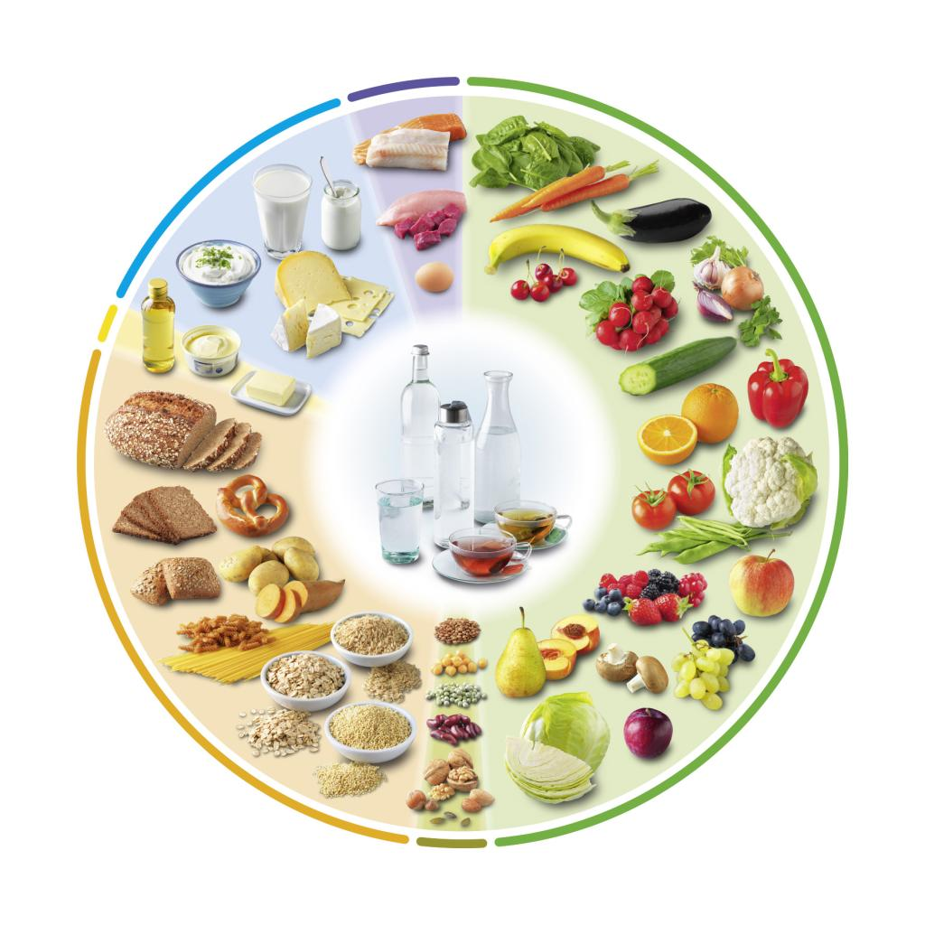
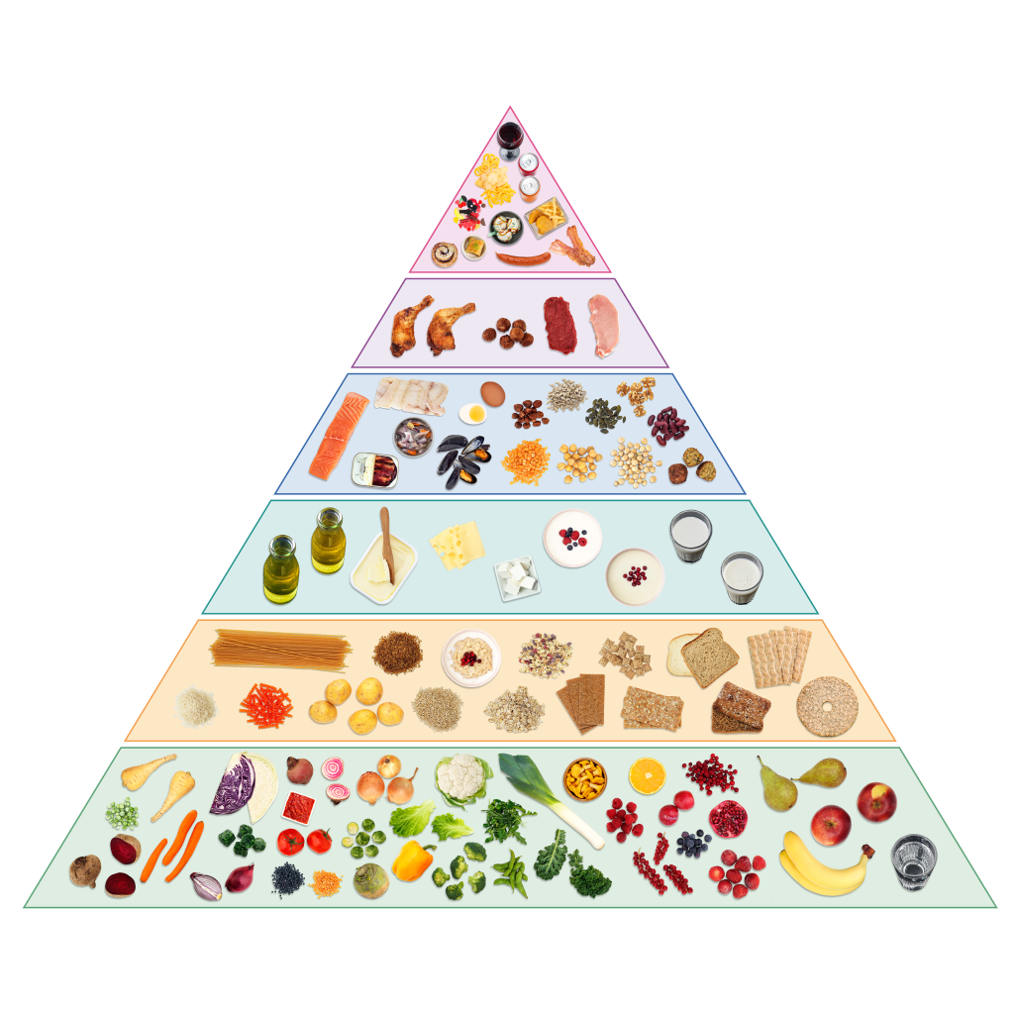
Key Nutrition Messages
Individual values, priorities, preferences that are culturally acceptable, affordable, and sustainable must underpin food and nutrition goals
Use person-first language, patient-centred and weight-inclusive approaches
Consider national or regional healthy eating guidelines as first line information (as relevant to the individual)
Many health outcomes are important to prevent obesity complications and weight loss is not always the target
Check the food and nutrition outcomes that are important to the individual
Source: Food Based Dietary Guidelines in Europe
Notes:
One of the first things to recognise in relation to food and nutrition issues is that our patients or clients come with their own set of values, priorities and preferences about food and diet and we need to be sensitive that how we approach advice giving is culturally acceptable, affordable, relatable and achievable. We always use person-first language, patient-centred, and weight-inclusive approaches. Many health outcomes are important to prevent and reverse obesity complications, and weight loss is not the only target within nutrition care. Healthcare professionals (HCP) can reassure patients or clients that positive changes to food and nutrition can lead to health outcomes, even in the absence of weight loss.
In terms of relatable and first-line nutrition messages, we can look to national or regional healthy eating guidelines. Examples I've put up here in the images are the food pyramid and the food plate, but you can usually easily find the ones that are relevant to your country. We might provide these to someone who doesn't present with any obvious complex food and nutrition issues.

Slide 8





Brief nutrition intervention:
Getting the basics right
Eating pattern - i.e. regular meals, no long gaps
Aligning feed/fast cycles with clock-regulated cycles (chrononutrition)
Diet quality and adequate fluid
Reducing low nutrient, energy dense foods & beverages
Increase fibre, lean and plant proteins, fruit, veg & unsaturated fat sources
Breen, Browne & Donovan (2022)
Notes:
Ask permission to raise the topic of food and nutrition. If the individual is willing to discuss this area, offer information about healthy eating and whether they are seeking additional supports to make dietary changes for their health.
Some more specific pieces of food and nutrition advice are detailed on this slide, and can be used as part of first-line advice or brief interventions. If someone is not having regular meals, a good starting place would be to establish a regular meal pattern, and ensure that they are aligning feed-fast cycles with the clock-regulated cycle. So, what that means is that someone would have a good overnight fast – no eating late at night or during the night and most foods are consumed for the usual waking hours. This can help to improve appetite and satiety regulation.
Of course, their overall diet quality is important, and an area where referencing the dietary guidelines in your country can be useful, because you can get the basics of what a healthy diet looks like, and ensuring that they have adequate fluid, mostly water or non-sweetened healthy beverages.
Reducing low-nutrient, energy-dense foods and beverages, means that someone would cut down and eliminate foods that are high in fat, salt or sugar. Particularly foods that don't contain a lot of other beneficial nutrients, such as highly processed savoury snacks, confectionary and baked goods, and sugar-sweetened beverages.
In terms of adding foods into the diet, high fibre foods, lean and unprocessed meats and fish, plant proteins and no restriction on whole fruits and vegetables that the person enjoys are important. Healthy oils and fats are also very important for overall health and unsaturated fat sources are usually found in plant and seed oils such as olive oil, rapeseed oils, whole nuts and seeds etc.

Slide 9
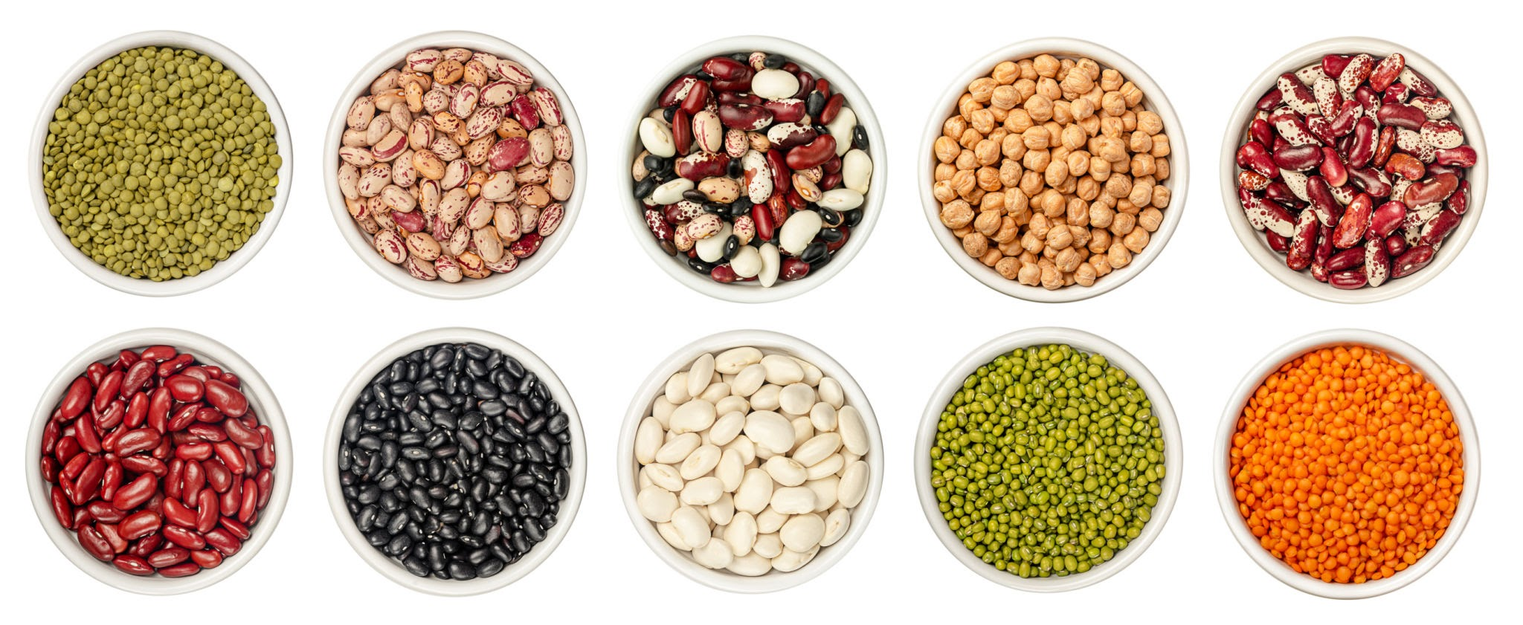

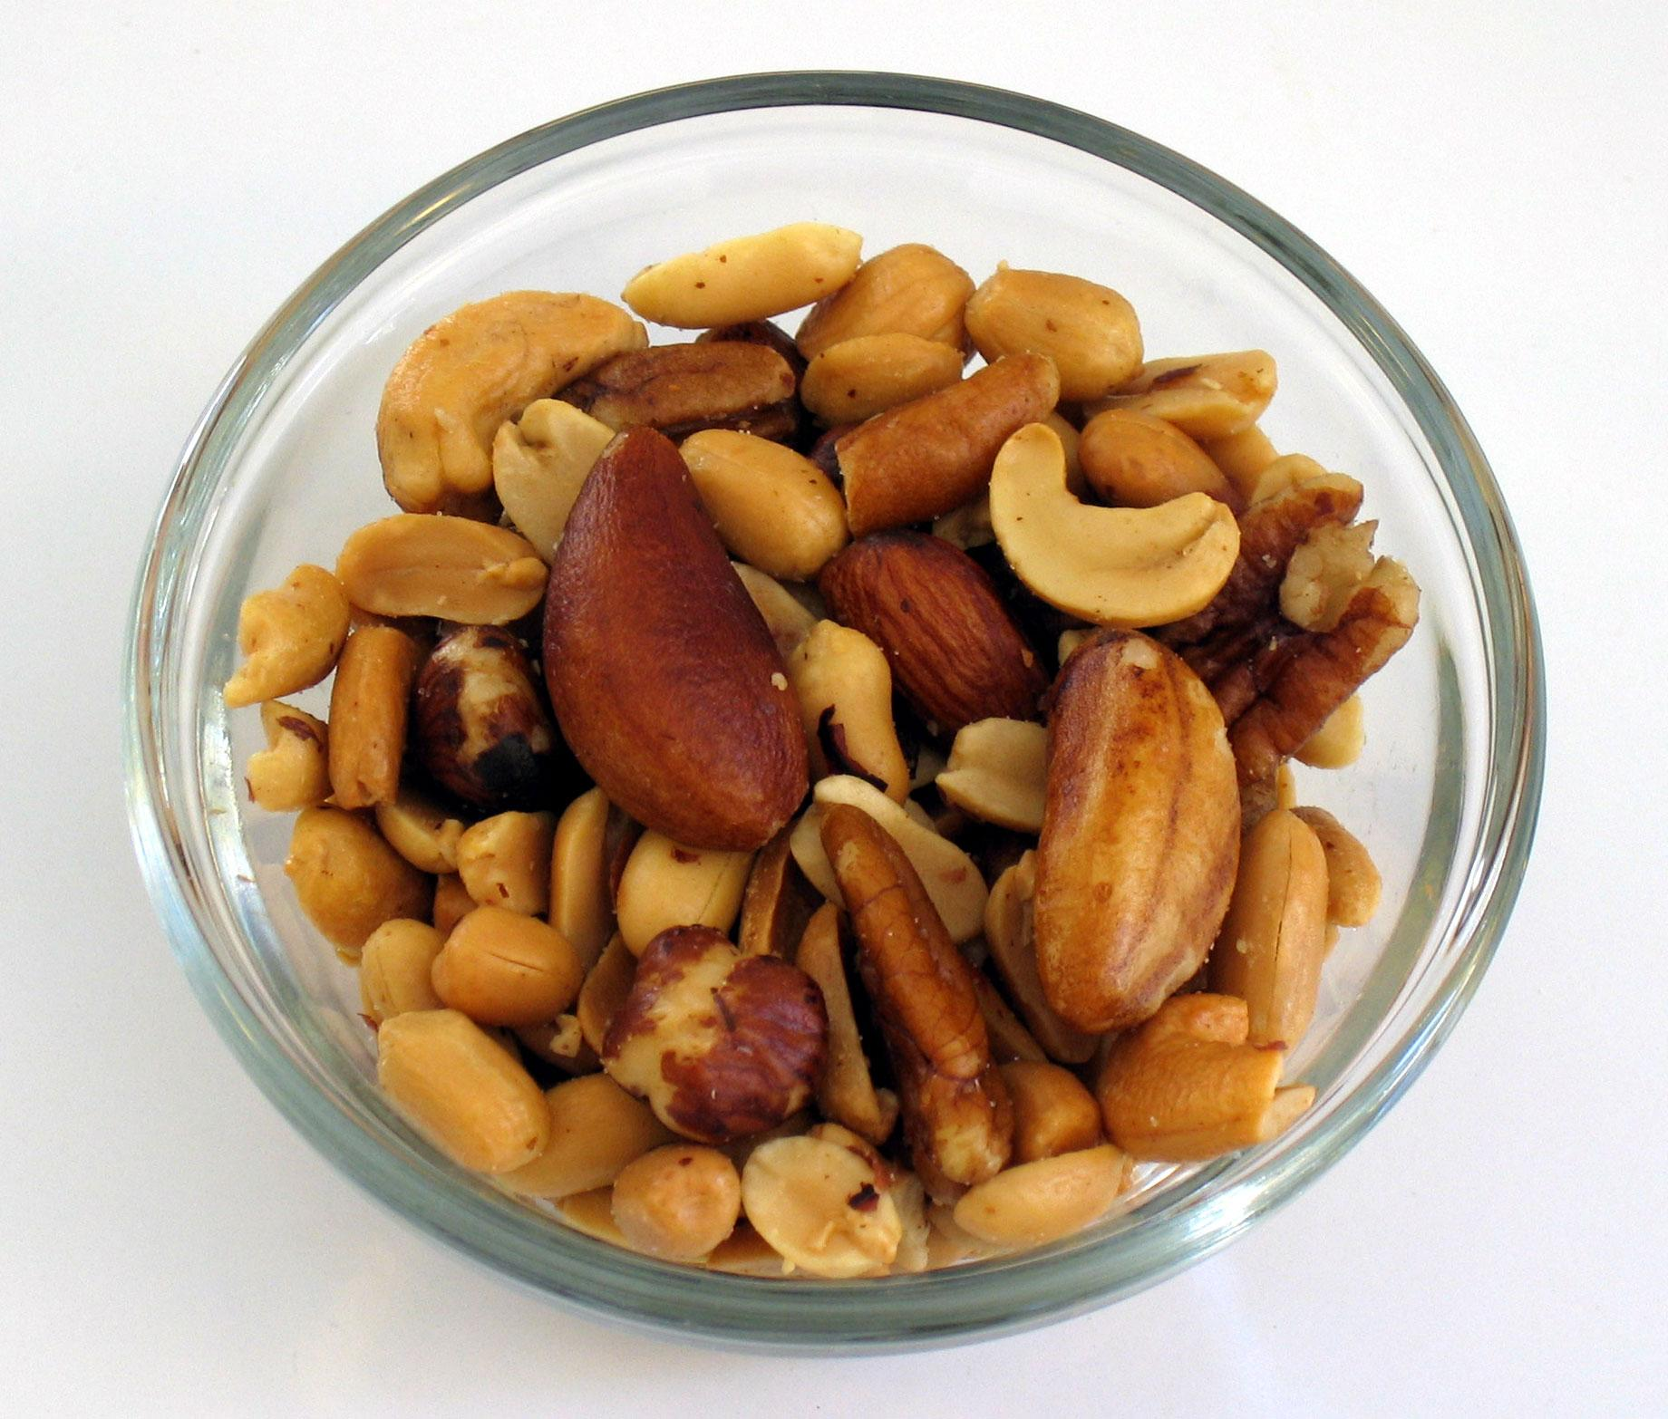
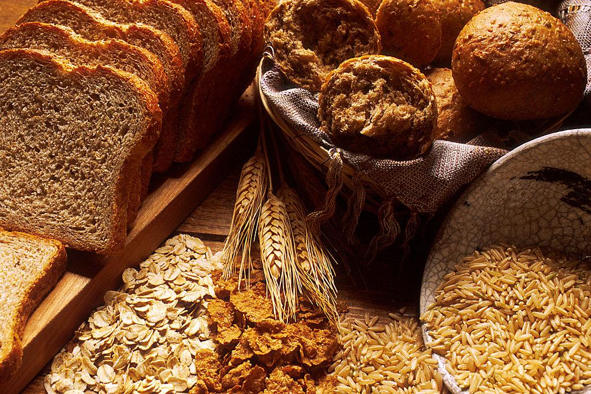
Adding specific food groups to the diet can improve health outcomes in obesity care
Dietary addition | Evidence for positive health outcomes
Pulses (legumes, pea, beans) | Weight loss, glycaemia, lipid profile, blood pressure
Fruit & vegetables | Glycaemia, lipid profile and blood pressure
Nuts | Glycaemia, lipid profile
Wholegrains (e.g., oats & barley) | Lipid profile
Breen, Browne & Donovan (2022)
Notes:
For the next two slides, I will discuss some of the current evidence for health benefits related to food and nutrition interventions in obesity care. Firstly, pulses - things like peas, beans, legumes - have been shown in the literature to contribute positively to weight loss, glycaemia, lipid profile, and blood pressure. More fruits and vegetables show an improvement in glycaemia, or blood glucose management, lipid profile and blood pressure.
Consuming unsalted nuts regularly can improve glycaemia and lipid profile, and whole grains, particularly oats and barley - which have a special type of fibre in them - can improve lipid profile, specifically reducing cholesterol.

Slide 10
Evidence for improving health outcomes with diet
Dietary pattern or approach | Evidence for positive health outcomes
Low Glycaemic Index | Weight loss, glycaemia, lipid profile, blood pressure
Mediterranean | Glycaemia, lipid profile
Vegetarian | Weight loss, glycaemia, lipid profile
Portfolio | Lipid profile, blood pressure
Dietary Approaches to Stop Hypertension | Weight loss, glycaemia, lipid profile, blood pressure
New Nordic | Weight loss, lipid profile, blood pressure
Partial Meal Replacements | Weight loss, glycaemia, blood pressure
Intermittent Fasting | Weight loss (short-term data)
Calorie restriction, variable macronutrient ranges | Weight loss (over 6-12 months)
Notes:
In terms of dietary patterns, there are many options for patients or clients to choose from. That is to say, there isn't just one diet that works for obesity, and why we work closely with someone's preferences. The Glycaemic Index Diet, for example, is a focus on slow-release carbohydrates, and that has positive health outcomes in terms of weight, glycemia, lipid profile, and blood pressure. The Mediterranean diet shows strong evidence for improvements in glycemia and reductions in risk of type 2 diabetes, and lipid profile, and cardiovascular disease risk reductions. A vegetarian diet would show benefits in terms of weight loss. The portfolio diet is a cardiovascular protective diet and shows improvements in lipid profile and blood pressure. The DASH diet, or the Dietary Approaches to Stop Hypertension, again, is designed for blood pressure, but also shows positive outcomes in terms of weight loss, glycemia, and lipid profile. In the literature, the New Nordic diet reports weight loss, lipid profile improvements, and blood pressure improvements.
Partial meal replacements are where someone would replace one or two meals a day with a protein bar or shake, usually commercial, and best when supported by a healthcare professional team. The literature shows evidence for weight loss and improvements in glycemia, and blood pressure.
For intermittent fasting, we have short-term data that shows improvements in weight loss outcomes.
The final row in this slide relates to general calorie restriction, with different types of macronutrient profile, that's the carbohydrate, protein, and fat distribution in the diet. We have data to show that, regardless of the macronutrient distribution, there is a positive weight loss outcome over 6 to 12 months when someone reduces their overall calorie intake.

Slide 11
Managing hunger / appetite / satiety
↑ protein
↑ fibre
↑ water
↑ food volume - fruits, vegetables and salads, high fibre foods
↓ glycaemic index….(carbohydrates that are slowly digested e.g. oats, wholegrains)
Non-distracted eating
Pace of eating (slow down if fast)
Breen, Browne & Donovan (2022)
Notes:
It’s important to remember that changing diet so that overall calories are restricted will have an impact on hunger and this is very relevant to people living with obesity, who can feel this hunger more acutely.
People need support and advice, therefore, to help manage appetite and satiety. These are some of the suggestions that dietitians use including advising clients to eat more protein and spread it evenly between meals, increase the volume or bulk of foods eaten through more fibre rich foods and fruits and vegetables, and drink water regularly.
Carbohydrates that are slowly digested, or low glycaemic index carbohydrates are useful to help with feeling fuller for longer. Meal time behaviour changes that can be helpful include non-distracted eating (for example, not eating in front of the TV or screen), and if they eat quickly to slow that down, which can help regulate satiety signals.

Slide 12

Valuing food culture and enjoyment
Food enjoyment is so important!
Family routines, culture and food tradition is part of eating well
Time for food planning and cooking
Social support: involving others
Mindful eating habits: notice hunger & fullness
ECPO Image Bank: Family in Czech Republic cooking together
Notes:
As I briefly mentioned earlier, it’s always good to remember when we talk to people about food that food is much more than fuel and nutrition.
It’s part of family and community routines, culture, tradition, and celebration. Food is meant to be enjoyed and very much part of the social fabric of our societies. Healthcare professionals can help normalise and de-stigmatise food for people living with obesity through positive, client-centred conversations.

Slide 13
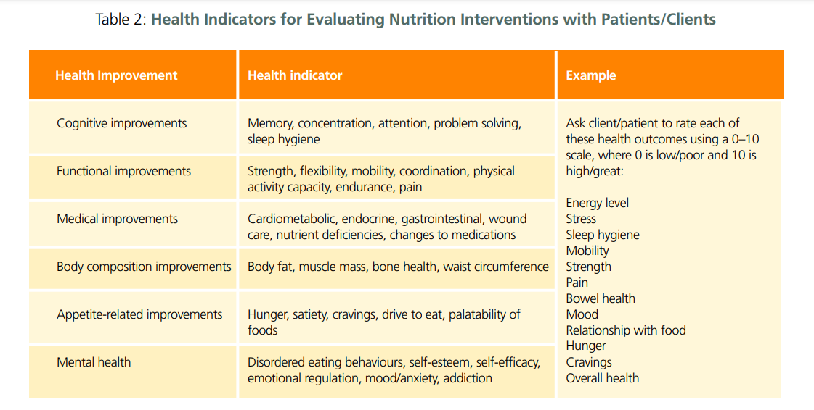
Breen, Browne & Donovan (2022)
Notes:
In this slide, health indicators for evaluating nutrition interventions with patients/clients are presented. The information emphasises the range of positive health outcomes someone can look to as a result of changing their diet. For example, improvements in hunger will assist someone in maintaining dietary changes as they feel more achievable.
An improved relationship with food is linked to mental health, and again contributes to sustainable, long-term changes which will have knock-on implications on physical and metabolic health.
We can support patients/clients by being invested in and aware of the range of health improvements that matter to them.

Slide 14
Resources
Guidelines
EASO Clinical Practice Guideline Resources - includes links to EU specific guidelines
ASOI Clinical Practice Guidelines: Medical Nutrition Therapy
Food Based Dietary Guidelines in Europe: Source Documents
Relevant Research
OBEDIS Core Variables for obesity interventions
STAR-LITE Core outcome set for behavioural weight management interventions
COMPARE-EU core outcome set for self-management interventions
Notes:
I encourage you to return to this slide to access resource links that are relevant to the content presented.

Slide 15
References
Breen C, Browne S, Donovan C. Medical Nutrition Therapy in ASOI Adult Obesity Clinical Practice Guideline adaptation (ASOI version 1, 2022); Chapter adapted from: Browne J, Clarke C, Johnson Stoklossa C, Sievenpiper J. Available from: https://asoi.info/guidelines/nutrition/
Breen C, O'Connell J, Geoghegan J,et al. Obesity in Adults: A 2022 Adapted Clinical Practice Guideline for Ireland. Obes Facts. 2022;15(6):736-752.
Hassapidou M, Vlassopoulos A, Kalliostra M, et al. European Association for the Study of Obesity Position Statement on Medical Nutrition Therapy for the Management of Overweight and Obesity in Adults Developed in Collaboration with the European Federation of the Associations of Dietitians. Obes Facts. 2023;16(1):11-28. doi: 10.1159/000528083.
Notes:
References informing the presentation are available here and clinical practice guidelines offer more detail on medical nutrition therapy in adult obesity care.
Thank you for listening.

