Slide 1

Musculoskeletal Considerations in Adults with Obesity
Developed by: Dr Mary E. Davis and Dr Caitriona Cunningham, University College Dublin, Ireland
Notes:
Welcome to this presentation where we will explore the musculoskeletal considerations relevant to adults living with obesity.
I’m Caitriona Cunningham from University College Dublin in Ireland, and this presentation was developed by myself and Dr Mary Davis.
The aim is to support you to develop clinically effective, evidence-informed, and person-centred approaches when working with this population.

Slide 2
Overview
Obesity and musculoskeletal pathology/pain and implications
Adiposity, inflammation and pain
Common MSK Conditions in Adults with Obesity
Clinical assessment considerations
Implications for physiotherapy practice
Rehabilitation with obesity and MSK pain
Notes:
This session will begin by outlining the relationship between obesity and musculoskeletal pathology, including how obesity contributes to pain, injury risk and long-term functional limitations.
We will then review some of the most common musculoskeletal conditions seen in adults with obesity.
The discussion will explore the role of adiposity, systemic inflammation and their contribution to pain sensitivity and chronic pain states.
From there, we’ll consider key clinical assessment considerations and the implications for physiotherapy practice and rehabilitation.

Slide 3
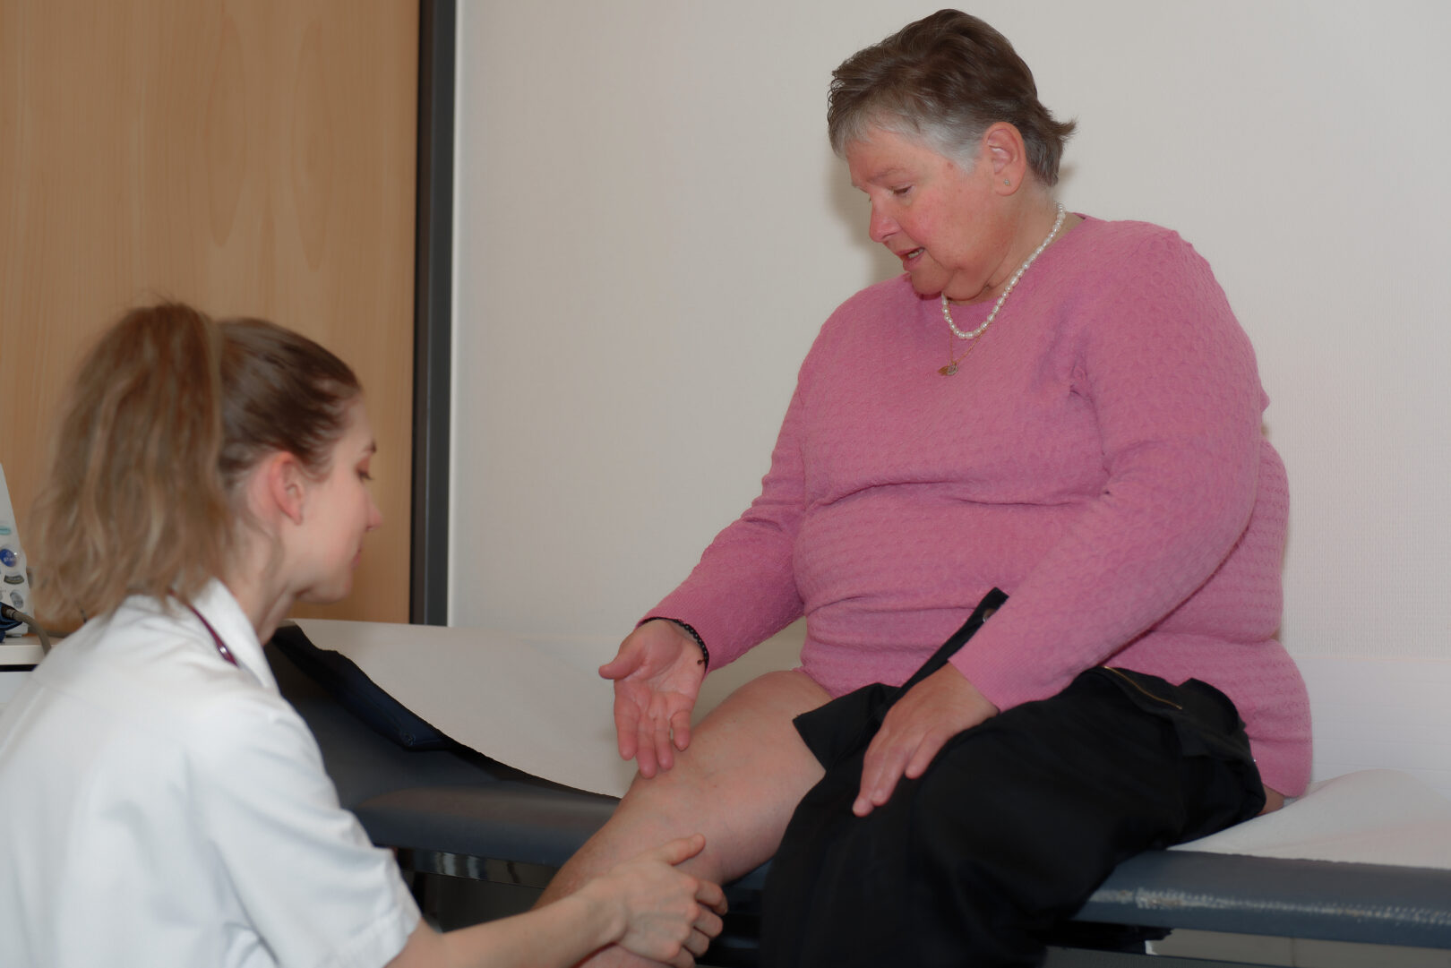
Obesity and musculoskeletal pathology/pain
Obesity is associated with the development of musculoskeletal pathology and pain
Obesity influences physiotherapy assessment, intervention selection, and rehabilitation outcomes in individuals with MSK impairments
Clinical guidelines exist for pain and for many MSK conditions, as well as separate guidelines for obesity management
However, clinical guidelines rarely address the combined presentation of obesity and MSK pain, despite this being common in clinical practice
(Menoth-Mohan et al, 2025)
Notes:
Obesity is strongly associated with the development and persistence of musculoskeletal pathology and pain. As physiotherapists, this means obesity can influence not only the conditions we see, but also how we assess patients, select interventions, and predict rehabilitation outcomes.
There are well-established clinical guidelines for the management of pain and for many individual musculoskeletal conditions, such as osteoarthritis or low back pain. Separate guidelines exist for obesity management. However, guidelines rarely address the combined presentation of obesity
and musculoskeletal pain, despite this being a very common clinical presentation.
To understand why obesity has such a significant impact on musculoskeletal health, it’s helpful to consider the key interacting mechanisms.

Slide 4

Obesity and MSK pathology/ pain
Obesity‑related MSK pain is not just driven by “wear and tear”
Mechanisms linking pain and obesity are complex, with many shared associations
Obesity can result in increased sedentary behaviour and decreased physical activity levels, both of which are also associated with pain
Need to consider psychosocial factors (e.g., depression, catastrophising, fear avoidance, reduced activity) that can influence pain
(Chin et al., 2020; Dzakpasu et al., 2021; Garcia et al., 2024; Law and Sluka, 2017; Malfliet et al., 2021;Narouze and Souzdalnitski 2015)
Notes:
It’s important to emphasise that obesity-related musculoskeletal pain and dysfunction are not simply the result of ‘wear and tear’ on joints and tissues.
While increased mechanical loading does play a role, the mechanisms linking obesity and pain are complex and multifactorial, with many shared and overlapping associations.
For example, obesity is often associated with increased sedentary behaviour and reduced physical activity levels. Both of these factors are independently associated with the development and persistence of musculoskeletal pain and deconditioning.
At the same time, pain itself can lead to further reductions in activity, reinforcing a cycle of inactivity, weight gain, and worsening pain.
Psychosocial factors also need to be carefully considered. Depression, pain catastrophising, fear avoidance, and reduced confidence in movement are more prevalent in people living with obesity and can significantly influence pain perception, behaviour, and recovery.
As physiotherapists, this highlights the importance of moving beyond purely structural explanations for pain and a need to adopt a biopsychosocial approach.

Slide 5

Adiposity, inflammation and pain
Adipose tissue is metabolically active and releases pro‑inflammatory cytokines (e.g., TNF‑α, IL‑6) and adipokines (e.g., leptin), creating chronic low‑grade systemic inflammation
Chronic low-grade inflammation → increased nociceptor sensitivity
Leptin linked with ↑ pain perception
This inflammation contributes to cartilage breakdown, altered pain processing, and central sensitisation
(Binvignat et al, 2024;Gao et al. 2025; Wang and He, 2018)
Notes:
Adipose tissue is not just passive fat storage — it is metabolically active and releases a range of pro-inflammatory molecules, including cytokines such as TNF-alpha and interleukin-6, as well as adipokines like leptin.
This creates a state of chronic, low-grade systemic inflammation, which has important implications for musculoskeletal health and pain perception.
One key effect of this inflammation is increased nociceptor sensitivity, contributing to heightened pain experiences.
Leptin, in particular, has been linked with increased pain perception, further linking excess adiposity to the experience of musculoskeletal pain.
Beyond pain sensitivity, chronic inflammation also contributes to cartilage breakdown in joints and can alter pain processing centrally, potentially leading to central sensitisation. This explains why musculoskeletal pain in adults with obesity can sometimes be more persistent, widespread, or difficult to manage than would be expected based on structural pathology alone.
Understanding these inflammatory mechanisms is crucial for physiotherapists, as it emphasises the need for holistic management that addresses tissue load, physical capacity, and systemic factors influencing pain.

Slide 6
Implications of MSK pathology/ pain
Movement and functional limitations
Reduced mobility and movement capacity
Kinesiophobia associated with the combination of obesity and MSK pain
Reduced activity tolerance and physical capacity
Difficulty with transfers and activities of daily living (ADLs)
Altered biomechanics and increased mechanical load on joints
Psychosocial impact of pain, obesity, and reduced mobility (e.g., decreased participation in physical activity and social roles)
(Gatto et al, 2025; Menoth-Mohan et al, 2025; Varallo et al, 2020)
Notes:
Adults living with obesity and musculoskeletal pain often experience reduced mobility and movement capacity. Simple tasks such as standing, walking, or bending may become more challenging, and over time, this can lead to further deconditioning.
Transfers and activities of daily living, such as getting in and out of a chair, dressing, or reaching overhead, may also be difficult, requiring careful consideration during assessment and rehabilitation.
Kinesiophobia, or fear of movement, is also common in this population. Pain, combined with concerns about injury, damage or discomfort, can lead to avoidance of activity, which reinforces weakness, stiffness, and causes further functional limitation.
Reduced activity tolerance and overall physical capacity are frequently observed. Even routine activities, like climbing stairs or carrying groceries, may cause fatigue or exacerbate pain.
Altered biomechanics are another key factor. Increased body mass changes movement patterns and increases mechanical load across joints, which can accelerate tissue stress and contribute to pain.
Finally, the psychosocial impact of this combination of pain, reduced mobility, and obesity can be significant. Participation in physical activity, social roles, and everyday life can all be affected, further influencing mood, confidence, and overall quality of life.
Understanding these functional implications is crucial for physiotherapists. Physiotherapy interventions should aim not just to reduce pain, but to improve movement, independence, and participation.

Slide 7

MSK system & GLP-1RA medications
Consider the effects of glucagon-like peptide-1
receptor agonists (GLP-1 RAs) on
musculoskeletal health:
Potential reductions in muscle mass and function
Emerging evidence of possible positive effects on
the MSK system
Notes:
Therapists also need to be aware of the impact of new pharmacological therapies on the musculoskeletal system. Glucagon-like peptide-1 receptor agonists, or GLP-1 RAs, are increasingly used to support weight management by regulating appetite and glucose metabolism. While they can be very effective for weight reduction, there are potential musculoskeletal implications that physiotherapists should consider.
Evidence suggests that GLP-1 agonists may contribute to reductions in muscle mass and function in certain individuals. This is an important consideration, because muscle strength and mass are key determinants of mobility, joint stability, and functional capacity.
At the same time, emerging research indicates there may also be potential positive effects on the musculoskeletal system, such as reduction in inflammation, reduced joint stress, though these findings are still preliminary and not fully understood.
As physiotherapists, this highlights the need for a holistic, multidisciplinary approach: monitoring functional capacity, incorporating targeted strength and mobility interventions, and collaborating with medical colleagues to optimise outcomes for patients using these new therapies.

Slide 8
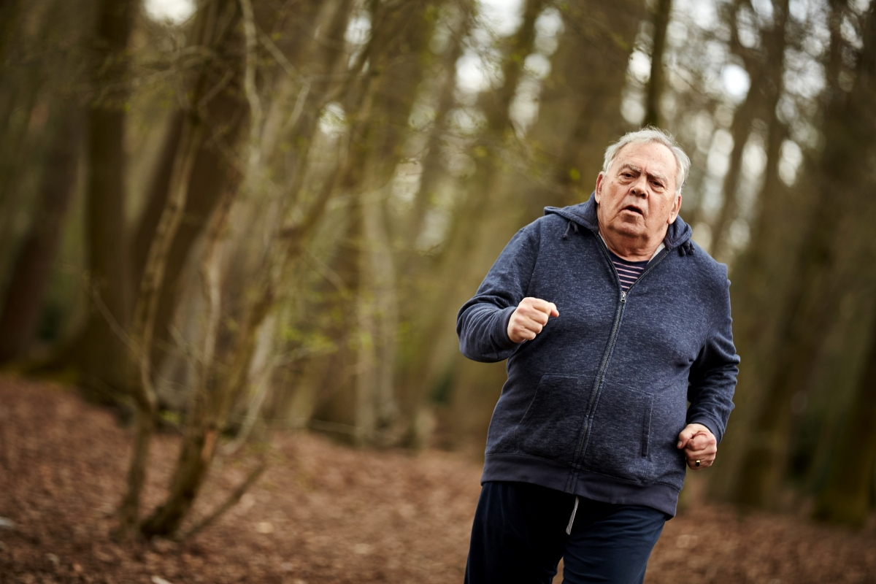
Common MSK Conditions in Adults with Obesity
Osteoarthritis (especially knee, hip)
Mechanical contributions: increased joint load, altered gait patterns
Biological contributions: inflammatory cytokines degrade cartilage
Clinical relevance: early OA onset, faster progression
Tendinopathies (including Achilles, patellar, rotator cuff)
Mechanical contributions: increased load on tendons
Biological contributions: impaired tendon healing due to inflammation and altered collagen metabolism
(Macchi et al., 2020; Mendonça et al., 2020; Menoth-Mohan et al., 2025; Nedunchezhiyan et al., 2022 )
Notes:
Let’s now look at some of the common musculoskeletal conditions seen in adults living with obesity, starting with osteoarthritis and tendinopathies.
Osteoarthritis, particularly affecting the knee and hip, is highly prevalent in this population. Mechanically, excess body weight increases joint load and can alter gait patterns, which accelerates cartilage wear and contributes to pain.
Biologically, obesity is associated with systemic inflammation. Adipose tissue releases inflammatory cytokines that can degrade cartilage and other joint tissues.
Clinically, this combination often leads to earlier onset of osteoarthritis and faster disease progression compared with adults of a healthy weight, making early recognition and targeted management especially important.
Tendinopathies are also commonly seen in people living with obesity, affecting the Achilles, patellar, or rotator cuff tendons. Increased mechanical load on tendons is a major factor, but biological mechanisms are also relevant. Inflammation and altered collagen metabolism can impair tendon healing, making recovery slower and sometimes more complicated.
Understanding both the mechanical and biological contributions to these conditions helps physiotherapists plan interventions that address tissue load, inflammation, and functional limitations in a holistic manner.

Slide 9
Common MSK Conditions in Adults with Obesity
Overweight and obesity increase the risk of low back pain (LBP), including chronic LBP and LBP requiring healthcare
Mechanical contributions: higher lumbar compressive forces, Reduced trunk muscle endurance, degenerative disc disease and facet joint pain due to increased axial loading and muscle deconditioning
Biological contributions: systemic inflammation → heightened pain sensitivity
Clinical relevance: obesity may predict poorer outcomes in conservative treatment
Foot and ankle pain (including plantar fasciitis):
Mechanical contributions: mid‑foot collapse and plantar fasciitis, due to altered foot biomechanics and high plantar pressures
Clinical relevance: impaired balance, decreased gait efficiency
(Liechti et al 2025; Macchi et al., 2020; Mendonça et al., 2020; Shiri et al, 2010)
Notes:
Continuing with common musculoskeletal conditions in adults with obesity, low back pain and foot and ankle pain are particularly important to consider.
Overweight and obesity increase the risk of low back pain, including chronic low back pain and cases that require healthcare intervention. Mechanically, higher body mass increases compressive forces on the lumbar spine, while reduced trunk muscle endurance and deconditioning further compromise spinal function. Over time, this can contribute to degenerative disc disease and facet joint pain.
Biologically, systemic inflammation associated with obesity can heighten pain sensitivity, making symptoms more persistent and severe.
Clinically, these factors may predict poorer outcomes from conservative treatment, highlighting the need for individualised, multimodal management strategies that address load, strength, and movement quality.
Foot and ankle pain are also common, including conditions such as plantar fasciitis. Excess body weight can contribute to mid-foot collapse and high plantar pressures, thus altering foot biomechanics.
These changes can impair balance, reduce gait efficiency, and increase the risk of further musculoskeletal injury.
Recognising the interplay of mechanical stress, tissue health, and functional impact is essential for designing effective physiotherapy interventions across the kinetic chain, from the spine to the feet.

Slide 10
Clinical assessment considerations
As part of the physiotherapy assessment, take a comprehensive pain history:
location(s), duration, and nature of pain
aggravating/relieving factors,
impact on function, sleep and participation
previous treatments and responses
Screen for psychosocial risk factors (yellow flags). Note the shared risk factors between obesity and chronic pain
Identify patient-centred goals:
Clarify the primary reason for presentation
If the MSK condition is the main concern, ensure assessment and management address this priority
Be aware of weight-related stigma in healthcare*:
People living with obesity commonly experience stigmatised and feel that their health concerns are not taken seriously and other health conditions being attributed only to weight
Notes:
When assessing adults living with obesity and musculoskeletal pain, a comprehensive and patient-centred approach is essential.
Start with a thorough pain history. Ask about the location, duration, and nature of the pain, as well as factors that aggravate or relieve it. Explore how pain impacts function, sleep, and participation in daily life, and review any previous treatments and their outcomes.
Screen for psychosocial risk factors, often referred to as yellow flags. Many risk factors for chronic pain, such as low mood, fear avoidance, or reduced self-efficacy, overlap with factors commonly seen in people living with obesity. Recognising these early can guide more effective management strategies.
Identify patient-centred goals. Clarify the primary reason the person is seeking care. If the musculoskeletal condition is the main concern, ensure your assessment and management prioritise this, while still considering other health factors.
Finally, be aware of weight-related stigma in healthcare. People living with obesity often experience stigma, which can include feeling that their health concerns have been dismissed or automatically attributed to weight. As physiotherapists, it’s important to create a respectful, supportive environment and to focus on the individual’s goals and functional priorities rather
than assumptions about body size.
A comprehensive, compassionate assessment not only improves clinical accuracy but also builds trust, engagement, and long-term adherence to physiotherapy interventions.

Slide 11
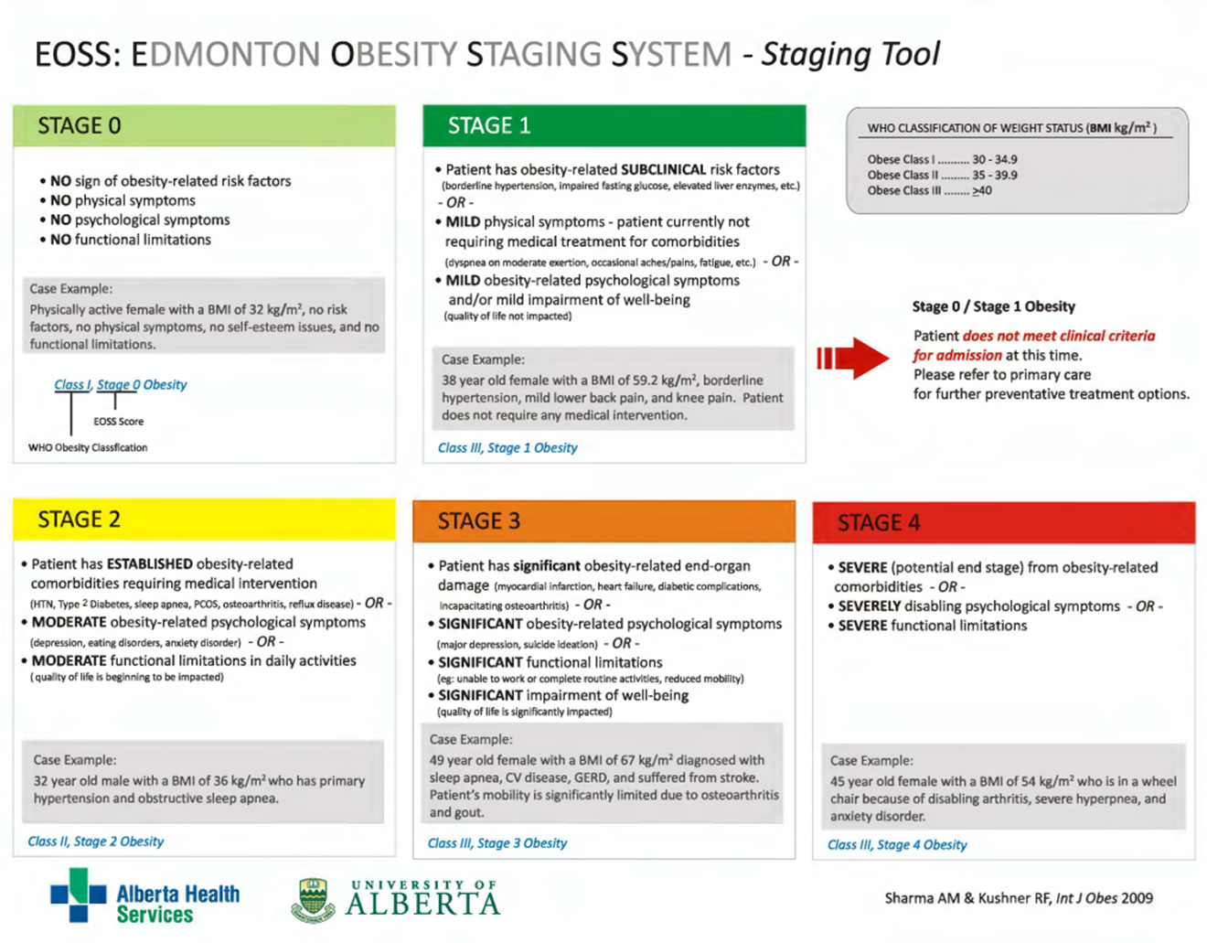
Notes:
The Edmonton Obesity Staging System is presented as a reminder of the differing stages of obesity with different impacts on the MSK and other systems.

Slide 12
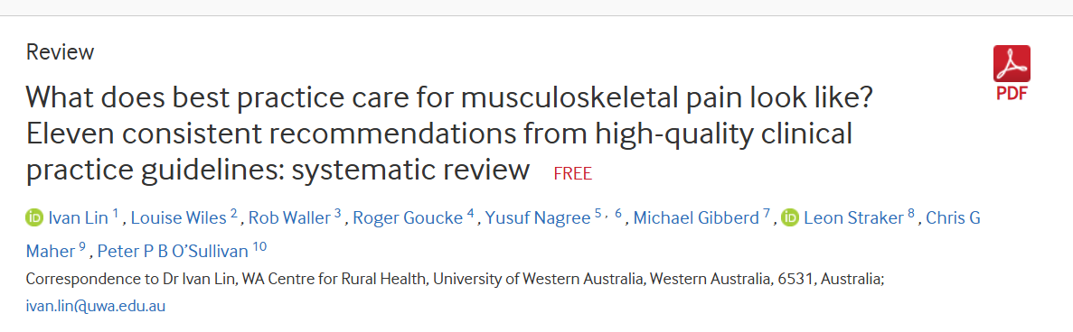
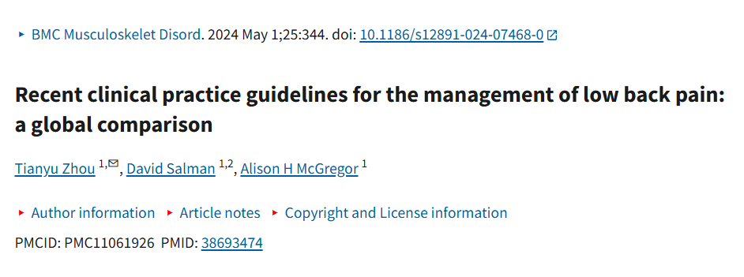
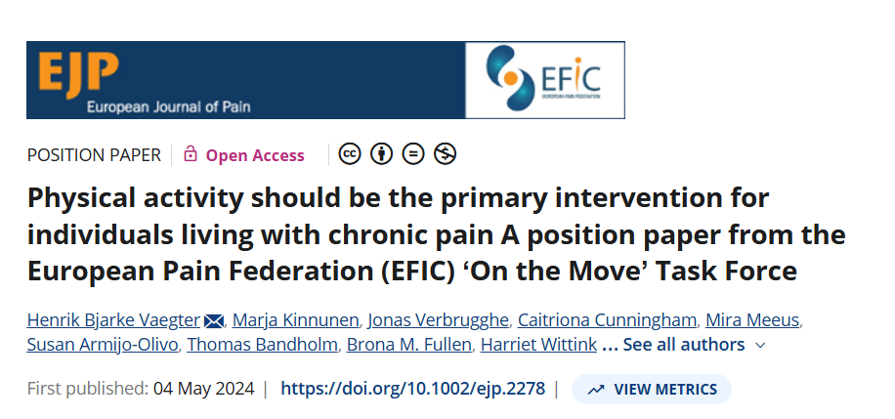
Implications for physiotherapy practice
Notes:
When we consider best practice care for musculoskeletal conditions and pain, recent high-quality clinical guidelines and evidence, such as the papers shown here, consistently recommend a person-centred approach that prioritises physical activity, self-management, and multimodal interventions.
This evidence indicates the importance of individualised exercise, education, and addressing psychosocial factors to optimise outcomes in adults with chronic pain.
However, it is crucial to recognise that evidence such as this does not specifically refer to the management of pain in adults living with obesity and thus, does not take into account the additional mechanical, metabolic, and psychosocial challenges present.
Obesity can impact implementation of evidence-based recommendations for a specific MSK condition through factors such as altered biomechanics, reduced physical capacity, fear avoidance, and stigma, all of which may affect patient engagement and outcomes.
Physiotherapists must therefore adopt flexible, empathic strategies that balance evidence-based principles for a particular musculoskeletal condition with individualised care that takes account of the presence of obesity and related complications.
This includes adapting exercises for safety and feasibility, addressing barriers to physical activity, and fostering motivation and confidence. Collaboration with multidisciplinary teams, ongoing patient education, and advocacy for stigma-free care environments are also essential.

Slide 13
Rehabilitation with obesity and MSK pain
Person-centred and weight-neutral approach
Though weight management is recommended, focus on functional improvement not weight loss alone
Use a biopsychosocial approach and address all contributors to pain (e.g., mechanical load, metabolic health, physical conditioning and psychological contributors)
Be aware that fear of movement is common and need to explore such fear and address any myths (e.g., pain does not equal damage)
Build movement confidence/ self efficacy through graded exposure
Emphasise graded, active rehabilitation over passive treatments; movement is central for improving pain, function and cardiometabolic health
(Fullen et al. 2023*; Lim et al., 2022)
*Note: Applying general pain research principles in absence of obesity specific guidance
Notes:
When providing rehabilitation for adults living with obesity and musculoskeletal pain, a person-centred and weight-neutral approach is essential.
While weight management is often recommended as part of overall healthcare, the primary focus of physiotherapy should be on functional improvement rather than weight loss alone.
Adopting a biopsychosocial framework helps us address the full range of contributors to pain.
Fear of movement is common in this population, so it’s important to explore any concerns or misconceptions. For example, reassuring patients that pain does not always equal tissue damage can reduce fear and encourage activity.
Building movement confidence and self-efficacy through graded exposure is a key strategy. Gradually increasing activity levels helps patients regain trust in their bodies and improves function.
Physiotherapy should emphasise active, graded rehabilitation over passive treatments. Movement itself is central not only for reducing pain and improving musculoskeletal function, but also for supporting cardiometabolic health.
Ultimately, rehabilitation that is respectful, individualised, and focused on meaningful functional goals promotes better outcomes and long-term engagement.

Slide 14

Facilitating movement and PA in adults with obesity and MSK pain
Consider the severity of obesity when prescribing exercise and physical activity
Combined (aerobic and resistance training) exercise for Edmonton Obesity Staging System (EOSS) Stages 0-2 (in line with obesity and cardiovascular risk guidelines)
Aerobic exercise target: 150–300 min/week recommended (gradually progressed)
Resistance training target: 2–3 days/week
Flexibility and balance exercises may also be beneficial for mobility, falls prevention and functional ability
(Davis and O’Donoghue, 2022; Lee et al., 2025; Oppert et al., 2021)
Notes:
When prescribing exercise for adults living with obesity, it’s important to consider the severity of obesity, often classified using the Edmonton Obesity Staging System, or EOSS.
Using this system (EOSS) stages 0 to 2, where obesity-related complications are minimal or moderate, combined aerobic and resistance training is recommended, consistent with cardiovascular and obesity management guidelines.
The aerobic exercise target is 150 to 300 minutes per week, gradually progressed based on individual capacity and tolerance.
Resistance training should be incorporated two to three days per week to support muscle strength and joint stability.
Flexibility and balance exercises may also be beneficial to improve mobility, prevent falls and enhance overall functional ability.
Prescribing a mixed exercise programme that addresses these components supports cardiovascular health, musculoskeletal function and quality of life.

Slide 15
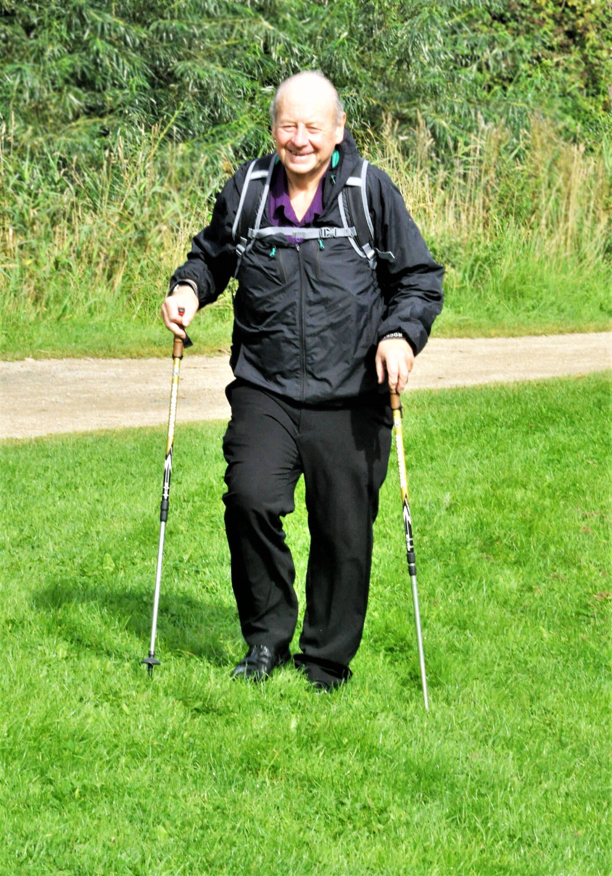
Facilitating movement and PA in adults with obesity and MSK pain
For adults with EOSS 3 obesity, where the complications of obesity may have greater impact upon the client’s ability to engage with PA and exercise (e.g., stroke, etc.), prescribe PA and exercise in line with disease specific clinical guidelines
For adults with EOSS 4 obesity, where complications of obesity and limitations with mobility may pose the greatest challenge, focus more upon ‘little and often’ or ‘everything counts’ as opposed to specific exercise duration/intensity. Aim to prioritise function and pain management
(Davis and O’Donoghue, 2022; Lee et al., 2025; Oppert et al., 2021)
Notes:
For adults with more advanced obesity complications, classified as EOSS stage 3, obesity-related health issues may significantly impact the ability to engage in physical activity and exercise.
In these cases, it’s still important to align exercise prescription with disease-specific clinical guidelines. For example, guidelines for conditions such as stroke, heart disease, or diabetes.
At EOSS stage 4, where obesity complications and mobility limitations are often greatest, the focus should shift toward encouraging ‘little and often’ or an ‘everything counts’ approach when it comes to physical activity.
Here, specific exercise duration or intensity targets are less important than prioritising function, managing pain, and supporting any achievable movement.
This flexible approach respects the individual’s capacity and promotes gradual improvements without overwhelming the person.

Slide 16

Facilitating movement and PA in adults with obesity and MSK pain
For all adults with obesity:
Prioritise low‑impact exercise to reduce joint stress while improving capacity (e.g., walking on flat surfaces, cycling, aquatic exercise [if safe to do so and not immediately post surgery], seated or supported strengthening)
Use graded exposure and pacing: start below pain‑provoking thresholds, progress duration and intensity gradually, and monitor symptom response between sessions
Target large muscle groups where possible (hip and knee extensors, trunk stabilisers, gluteal muscles) to improve load sharing and joint stability
Prioritise exercise that patient enjoys and will adhere to
(Davis and O’Donoghue, 2022; Fullen et al., 2023*; Lee et al., 2025; Oppert et al., 2021)
Notes:
Regardless of obesity severity, some key principles apply when supporting adults to increase physical activity and exercise.
Low-impact exercises should be prioritised to reduce joint stress while improving capacity. Examples include walking on flat surfaces, cycling, aquatic exercise if appropriate, and seated or supported strengthening exercises.
Using graded exposure and pacing is vital. Start exercise below pain-provoking thresholds, then gradually increase duration and intensity while carefully monitoring symptoms between sessions.
Targeting large muscle groups, such as the hip and knee extensors, trunk stabilisers, and gluteal muscles, helps improve load sharing and joint stability.
Finally, it’s important to prioritise exercise that the person enjoys and is likely to adhere to, as consistency is key for long-term benefits.
By tailoring programmes with these principles in mind, physiotherapists can support sustainable improvements in function, pain management, and overall health.

Slide 17

Education and behaviour change
Education:
Explore beliefs about pain weight and exercise
Address fear‑avoidance and catastrophising
Correct myths about painful movement and reassure about safe movement
Discuss pacing strategies
Behaviour change:
Use goal‑setting and motivational strategies to collaborate on realistic, meaningful functional goals (e.g., walking to the shop, playing with children), enhance adherence and promote self-management and physical activity routines
Emphasise small, achievable goals
(Fullen et al., 2023*)
Notes:
Education is a vital part of managing musculoskeletal pain in adults living with obesity.
Start by exploring the person’s beliefs about pain, weight, and exercise. Address fear-avoidance behaviours and catastrophising, which can increase disability and reduce activity.
It’s important to correct common myths about painful movement and reassure patients that movement is generally safe and beneficial.
Discuss pacing strategies to help patients balance activity and rest, reducing the risk of flare-ups.
For behaviour change, collaborate on realistic and meaningful functional goals, like walking to the shop, work or playing with children, to enhance motivation and adherence.
Use goal-setting and motivational strategies to promote self-management and establish sustainable physical activity routines.
Emphasise small, achievable steps, as these build confidence and support long-term success.

Slide 18
Manual therapy for MSK conditions in people living with obesity
Role of manual therapy
Manual therapy may have a role depending on the specific MSK condition and individual patient presentation
Refer to relevant evidence-based clinical guidelines when considering its use
As with all patients, consider whether manual therapy is indicated or whether a more active, exercise-based approach is preferable
Clinical reasoning should consider underlying causal factors and adopt a biopsychosocial approach
Select physiotherapy interventions, or intervention packages, most likely to lead to optimal patient outcomes
When used, manual therapy should be applied only in conjunction with other treatments
Bariatric care principles
Consider patient positioning and therapist biomechanics to optimise comfort, safety, and treatment effectiveness
Use appropriate plinths, supports, and equipment to reduce injury risk and facilitate effective manual therapy
(Lin et al., 2020)
Notes:
Manual therapy may have a role in managing musculoskeletal conditions in adults with obesity, but as always, its use should be guided by the individual patient presentation and relevant evidence-based clinical guidelines.
As for all patients, consider whether manual therapy is indicated, whether a more active, exercise-based approach is preferable or perhaps a combined approach, perhaps moving from some manual therapy initially, and then to a more active approach.
Clinical reasoning should adopt a biopsychosocial approach, addressing underlying causal factors and selecting interventions or intervention packages most likely to lead to optimal outcomes.
When manual therapy is used, it should complement other treatments rather than stand alone.
People moving and handling principles are important here. Consider patient positioning and therapist biomechanics to optimise comfort, safety and treatment effectiveness when using manual therapy techniques. Ensure appropriate plinths, supports and equipment to reduce injury risk for the physiotherapist and to facilitate effective manual therapy.
These considerations help ensure that manual therapy is safe, comfortable, and effective for adults with obesity.
Bariatric ergonomics is covered in a separate OER section where the need for risk benefit analysis is highlighted when making clinical decisions.

Slide 19
Pain management
Weight loss
Modest weight loss (5–10%) can reduce joint pain and improve function in people with overweight/obesity and MSK pain
Reductions in adiposity are associated with lower inflammatory markers (e.g., CRP, IL‑6) and parallel improvements in chronic MSK pain and mobility
However, it is important to recognise that obesity is a chronic, relapsing disease and that the weight loss journey may not be linear
Pharmacotherapy
Many adults will use analgesics (paracetamol, NSAIDs), adjuvant agents (e.g., certain antidepressants) or joint injections
Physiotherapists should understand indications and potential side effects
Patient education important - medications can support active rehab but are not stand‑alone solutions
(Budiansky and Eipe, 2024; Dong et al. 2021; Lim et al., 2022)
Notes:
Modest weight loss - typically five to ten percent of body weight - can reduce joint pain and improve function in people with overweight or obesity and musculoskeletal pain.
Reductions in adiposity are associated with lower levels of inflammatory markers, such as C-reactive protein and interleukin-6, which often parallel improvements in chronic pain and mobility.
However, it’s important to recognise that obesity is a chronic, relapsing disease. The weight loss journey is often non-linear and requires ongoing support and realistic expectations.
Pharmacotherapy is commonly used as part of pain management. Many adults take analgesics such as paracetamol or NSAIDs, adjuvant agents like certain antidepressants, or they may receive joint injections.
Physiotherapists should understand the indications and potential side effects of these medications in order to provide comprehensive care.
Patient education is crucial. Medications can support active rehabilitation but should never be considered as stand-alone solutions.
By integrating weight management, pharmacotherapy, education, and active rehabilitation, physiotherapists can contribute to effective, holistic pain management for adults with obesity and musculoskeletal pain.

Slide 20
References
Binvignat M, Sellam J, Berenbaum F, Felson DT. The role of obesity and adipose tissue dysfunction in osteoarthritis pain. Nature Reviews Rheumatology. 2024 Sep;20(9):565-84.
Budiansky AS, Eipe N. Acute pain management in patients with severe obesity. BJA education. 2024 Sep 1;24(9):318-25.
Chin SH, Huang WL, Akter S, Binks M. Obesity and pain: a systematic review. International journal of obesity. 2020 May;44(5):969-79.
Davis, M. E. and O’Donoghue, G. The Role of Physiotherapy in Weight Management in Adults. Irish Society for Chartered Physiotherapists. 2022. Link not available for external use.
Dong HJ, Dragioti E, Rivano Fischer M, Gerdle B. Lose pain, lose weight, and lose both: a cohort study of patients with chronic pain and obesity using a national quality registry. Journal of pain research. 2021 Jun 21:1863-73.
Dzakpasu FQ, Carver A, Brakenridge CJ, Cicuttini F, Urquhart DM, Owen N, Dunstan DW. Musculoskeletal pain and sedentary behaviour in occupational and non-occupational settings: a systematic review with meta-analysis. International Journal of Behavioral Nutrition and Physical Activity. 2021 Dec 13;18(1):159.
Fullen BM, Wittink H, De Groef A, Hoegh M, McVeigh JG, Martin D, Smart K. Musculoskeletal pain: current and future directions of physical therapy practice. Archives of rehabilitation research and clinical translation. 2023 Mar 1;5(1):100258.
Gao L, Wen Y, Guo K, Li R, Mao M, Feng S, Wang X. Research trends and hot spots in obesity-induced pain: A bibliometric analysis of the last 20 years. IBRO Neuroscience Reports. 2025 Feb 10.
Garcia MM, Corrales P, Huerta MÁ, Czachorowski MJ, López-Miranda V, Medina-Gómez G, et al. Adults with excess weight or obesity, but not with overweight, report greater pain intensities than individuals with normal weight: a systematic review and meta-analysis. Front Endocrinol (Lausanne). 2024 Mar 6;15:1340465. https://doi.org/10.3389/fendo.2024.1340465.
Gatto A, Liu K, Milan N, Wong S. The Effects of GLP-1 Agonists on Musculoskeletal Health and Orthopedic Care. Curr Rev Musculoskelet Med. 2025 Oct;18(10):469-480. https://doi.org/10.1007/s12178-025-09978-3.
Hinwood NS, Casey MB, Dunlevy CG, Doody C, Blake C, Fullen BM, O'Donoghue G, Birney S, Fildes F, Smart KM. "It Is a Vicious Circle": Experiences of People Living With Obesity and Chronic Pain: A Qualitative Evidence Synthesis (QES). Obes Rev. 2025 Jul 28. https://doi.org/10.1111/obr.70004.
Lee HS, Suk MH, Jang HS, Kim JH. Exercise Guidelines for Enhancing Mobility and Stability in Individuals with Severe Obesity. Journal of obesity & metabolic syndrome. J Obes Metab Syndr. 2025 Oct 23. https://doi.org/10.7570/jomes24047.

Slide 21
References
Law LF, Sluka KA. How does physical activity modulate pain? Pain. 2017 Mar;158(3):369-370. https://doi.org/10.1097/j.pain.0000000000000792. PMID: 28135214; PMCID: PMC5303119
Liechti M, Menegon M, Schurz AP, Taeymans J, Baur H, Clijsen R, Malfliet A, Lutz N. Association between pain intensity and body composition in adults with chronic non-specific low back pain: A systematic review and meta-analysis. Obesity Reviews. 2025 Apr;26(4):e13875
Liechti M, Menegon M, Schurz AP, Vanroose M, Clijsen R, Malfliet A, Faeh D, Baur H, Taeymans J, Lutz N. Physical therapists' perspectives and practices on weight management for chronic pain patients with obesity: a cross-sectional survey. Arch Physiother. 2025 Dec 1;15:286-296. https://doi.org/10.33393/aop.2025.3590.
Lim YZ, Wong J, Hussain SM, Estee MM, Zolio L, Page MJ, Harrison CL, Wluka AE, Wang Y, Cicuttini FM. Recommendations for weight management in osteoarthritis: a systematic review of clinical practice guidelines. Osteoarthritis and Cartilage Open. 2022 Dec 1;4(4):100298
Lin I, Wiles L, Waller R, et al. What does best practice care for musculoskeletal pain look like? Eleven consistent recommendations from high-quality clinical practice guidelines: systematic review. Br J Sports Med. 2020;54:79–86. https://doi.org/10.1136/bjsports-2018-099878.
Macchi M, Spezia M, Elli S, Schiaffini G, Chisari E. Obesity increases the risk of tendinopathy, tendon tear and rupture, and postoperative complications: a systematic review of clinical studies. Clinical Orthopaedics and Related Research®. 2020 Aug 1;478(8):1839-47.
Malfliet A, Quiroz Marnef A, Nijs J, Clarys P, Huybrechts I, Elma Ö, Tumkaya Yilmaz S, Deliens T. Obesity hurts: the why and how of integrating weight reduction with chronic pain management. Physical therapy. 2021 Nov 1;101(11).
Mendonça CR, Noll M, dos Santos Rodrigues AP, Silveira EA. High prevalence of musculoskeletal pain in individuals with severe obesity: sites, intensity, and associated factors. The Korean Journal of Pain. 2020 Jul 1;33(3):245.
Menoth Mohan D, Al Anouti F, Kohli N, Khalaf K. Association of obesity with musculoskeletal health and functional mobility in females-a systematic review. Int J Obes (Lond). 2025 Nov;49(11):2184-2205. https://doi.org/10.1038/s41366-025-01881-8.
Narouze S, Souzdalnitski D. Obesity and chronic pain: systematic review of prevalence and implications for pain practice. Regional Anesthesia & Pain Medicine. 2015 Mar 1;40(2):91-111.

Slide 22
References
Nedunchezhiyan U, Varughese I, Sun AR, Wu X, Crawford R, Prasadam I. Obesity, Inflammation, and Immune System in Osteoarthritis. Front Immunol. 2022 Jul 4;13:907750. doi: 10.3389/fimmu.2022.907750.
Oppert JM, Bellicha A, van Baak MA, Battista F, Beaulieu K, Blundell JE, Carraça EV, Encantado J, Ermolao A, Pramono A, Farpour‐Lambert N. Exercise training in the management of overweight and obesity in adults: Synthesis of the evidence and recommendations from the European Association for the Study of Obesity Physical Activity Working Group. Obesity reviews. 2021 Jul;22:e13273.
Shiri R, Karppinen J, Leino-Arjas P, Solovieva S, Viikari-Juntura E. The association between obesity and low back pain: a meta-analysis. Am J Epidemiol. 2010 Jan 15;171(2):135-54. doi: 10.1093/aje/kwp356. Epub 2009 Dec 11. PMID: 20007994.
Vaegter HB, Kinnunen M, Verbrugghe J, Cunningham C, Meeus M, Armijo-Olivo S, Bandholm T, Fullen BM, Wittink H, Morlion B, Reneman MF. Physical activity should be the primary intervention for individuals living with chronic pain A position paper from the European Pain Federation (EFIC) 'On the Move' Task Force. Eur J Pain. 2024 Sep;28(8):1249-1256. doi: 10.1002/ejp.2278. Epub 2024 May 4. PMID: 38703009.
Varallo G, Giusti EM, Scarpina F, Cattivelli R, Capodaglio P, Castelnuovo G. The Association of Kinesiophobia and Pain Catastrophizing with Pain-Related Disability and Pain Intensity in Obesity and Chronic Lower-Back Pain. Brain Sci. 2020 Dec 24;11(1):11. https://doi.org/10.3390/brainsci11010011.
Wang T, He C. Pro-inflammatory cytokines: The link between obesity and osteoarthritis. Cytokine & growth factor reviews. 2018 Dec 1;44:38-50.
Zhou, T., Salman, D. & McGregor, A.H. Recent clinical practice guidelines for the management of low back pain: a global comparison. BMC Musculoskelet Disord 25, 344 (2024). https://doi.org/10.1186/s12891-024-07468-0

